Slide 1
Cheap Solid State Power on 10 GHz
EME Meeting 2012 in Örebro
Michael Kohla
DL1YMK

Slide 2
Situation at start....
interest in 3 cm EME, as YMK’s 6th moonbounce band
last RW1127-TWT given to WW2R for 24G conversion, so only SSPA the way to go
at least 30 W RF out
quote from DB6NT for SSPA-modules off shelf: 25 W = 2850,- €, 50 W = 4920,- €
Fujitsu & Toshiba GaAs-Fet’s available and affordable from Chinese distributors, but was warned of low gain and inferior output level ...Fake City products
Thinking it over for a while...: NO, too much money invested in DXpeditions!

Slide 3
Luckily, it happened to be that…
in DL all TWT TV-AM link transmitters had been replaced by SSPA‘s some 15 years ago , rendering abt 2- 5 W out on 11.7 – 12.4 GHz
manufacturer was an Israelian company called ELISRA
with decommissioning of AM-TV in DL those ELISRA‘s appeared on surplus markets
different makes available with FLM and TIM devices
best: older model (short box)-> 2 x FLM1011-12F in final
newer models with 5 stages -> 2 x TIM1112-8 in final
common for all elder models: no neg. gate bias on board, just -9V fed in from heavy external power supply

Slide 4
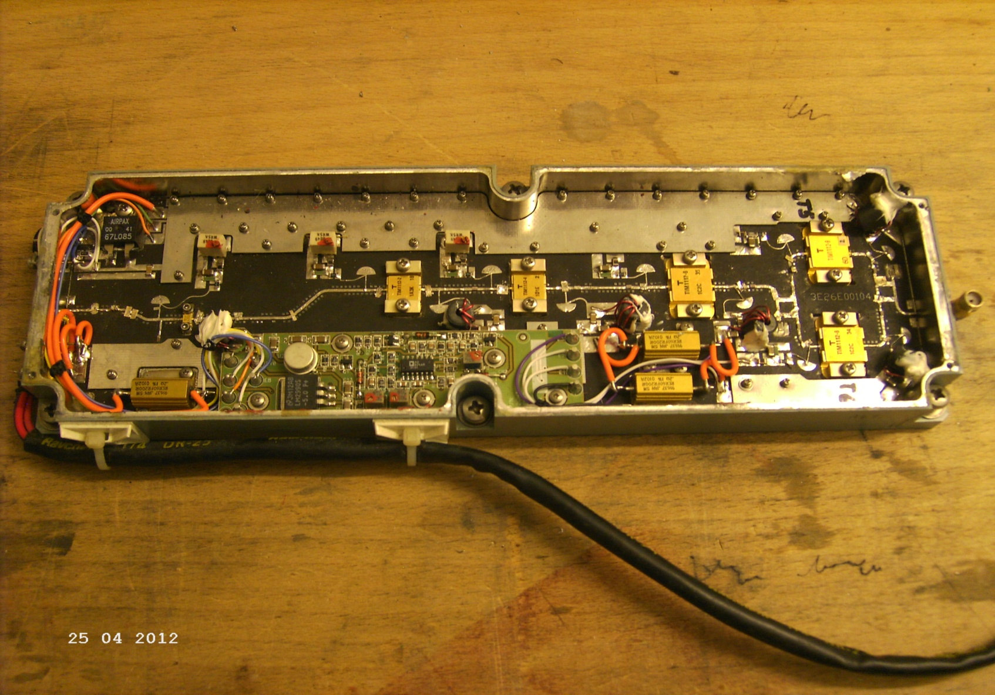
New model ELISRA

Slide 5
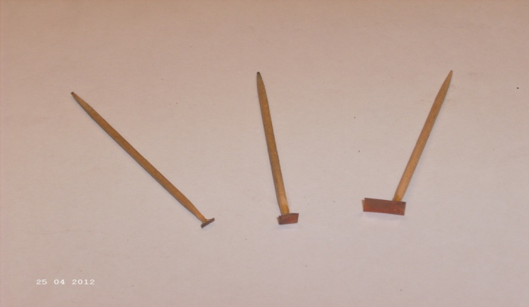
Converting to 10 GHz
not too bad: FLM1011-12F: P₁dB = 40.5 dBm typ.; gain = 6.0 dB; prematched 10.7- 11.7 GHz; PAE = 25 % typ.
re-engineering of circuitry by DF1VB, very instructive website: www.df1vb.de/dateien/10G_PA_Umbau.PDF
decrease drain currents of all stages & do, what a microwaver has to do: move stubs on striplines with specially made toothpicks and solder stubs on stripline
best result after hours of fine-tuning
was 16 W RF on 10368 MHz
not satisfied…40.5dBm = 11.5 W!!
hybrids on pcb weren‘t quite right

Slide 6
How to get a suitable pcb then ??
asked DL2AM for pcb –> clear answer: NO!
asked DB6NT for pcb -> even clearer answer: NO, NO!
asked DK2FD for pcb->‘…well, maybe..let‘s see..‘-> translation: NO!
did not want to re-invent the wheel…
finally got a faulty pcb (from the dark side of the moon…) converted it to a CAD file and reworked it a little..
The result looks like this…..

Slide 7
Next steps…
etched pcb on RT5870/0.5, got me a suitable milled alu box, glued pcb into box with home-made highly silverflake-filled epoxy resin, cured it under 3 bar and 100°C (I am a chemist…) in a heated lab press
Ripped GaAs-Fet‘s from ELISRA, relocated them with Indium foils for low thermal resistance into new pcb
Populated the pcb and….did slide stubs again…for hours…
Result: at 120 mW in -> 22 W out (P₁dB) at 10 V drain voltage and 9 Amp, @ 24% PAE, close to data sheet quotations

Slide 8
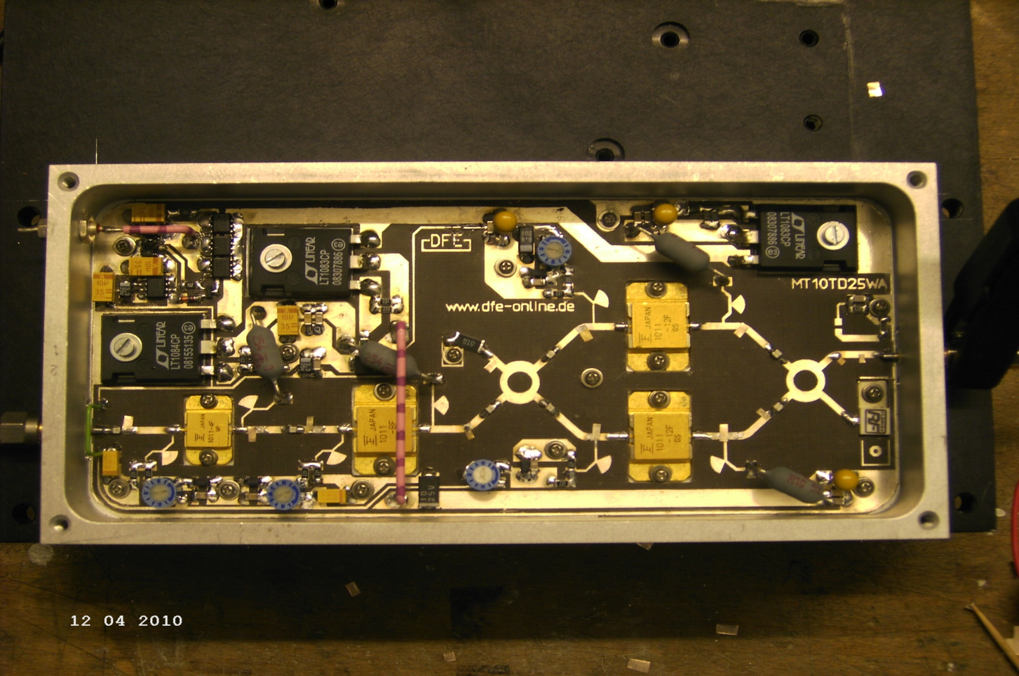
Poor man‘s SSPA looks like this:

Slide 9
Oops, did it again…
Had been given another old model ELISRA, meanwhile
Made another poor man‘s SSPA, same results, 100% repeatable
Combined 2 units by Narda 90° hybrids, using semirigid with soft alu mantle, complete failure, phase angle off limits, no VNA for 10G; output was temperature dependant ??
Tried semiflex phasing cables, cut it down ½ mm-wise and: bingo!!
  220 mW in -> 36W out, stable power output, not enough drive from DB6NT trvtr for more goo…
Made 1st 3cm EME-QSO as Test for DXpedition with LX1DB on 22.04.12

Slide 10
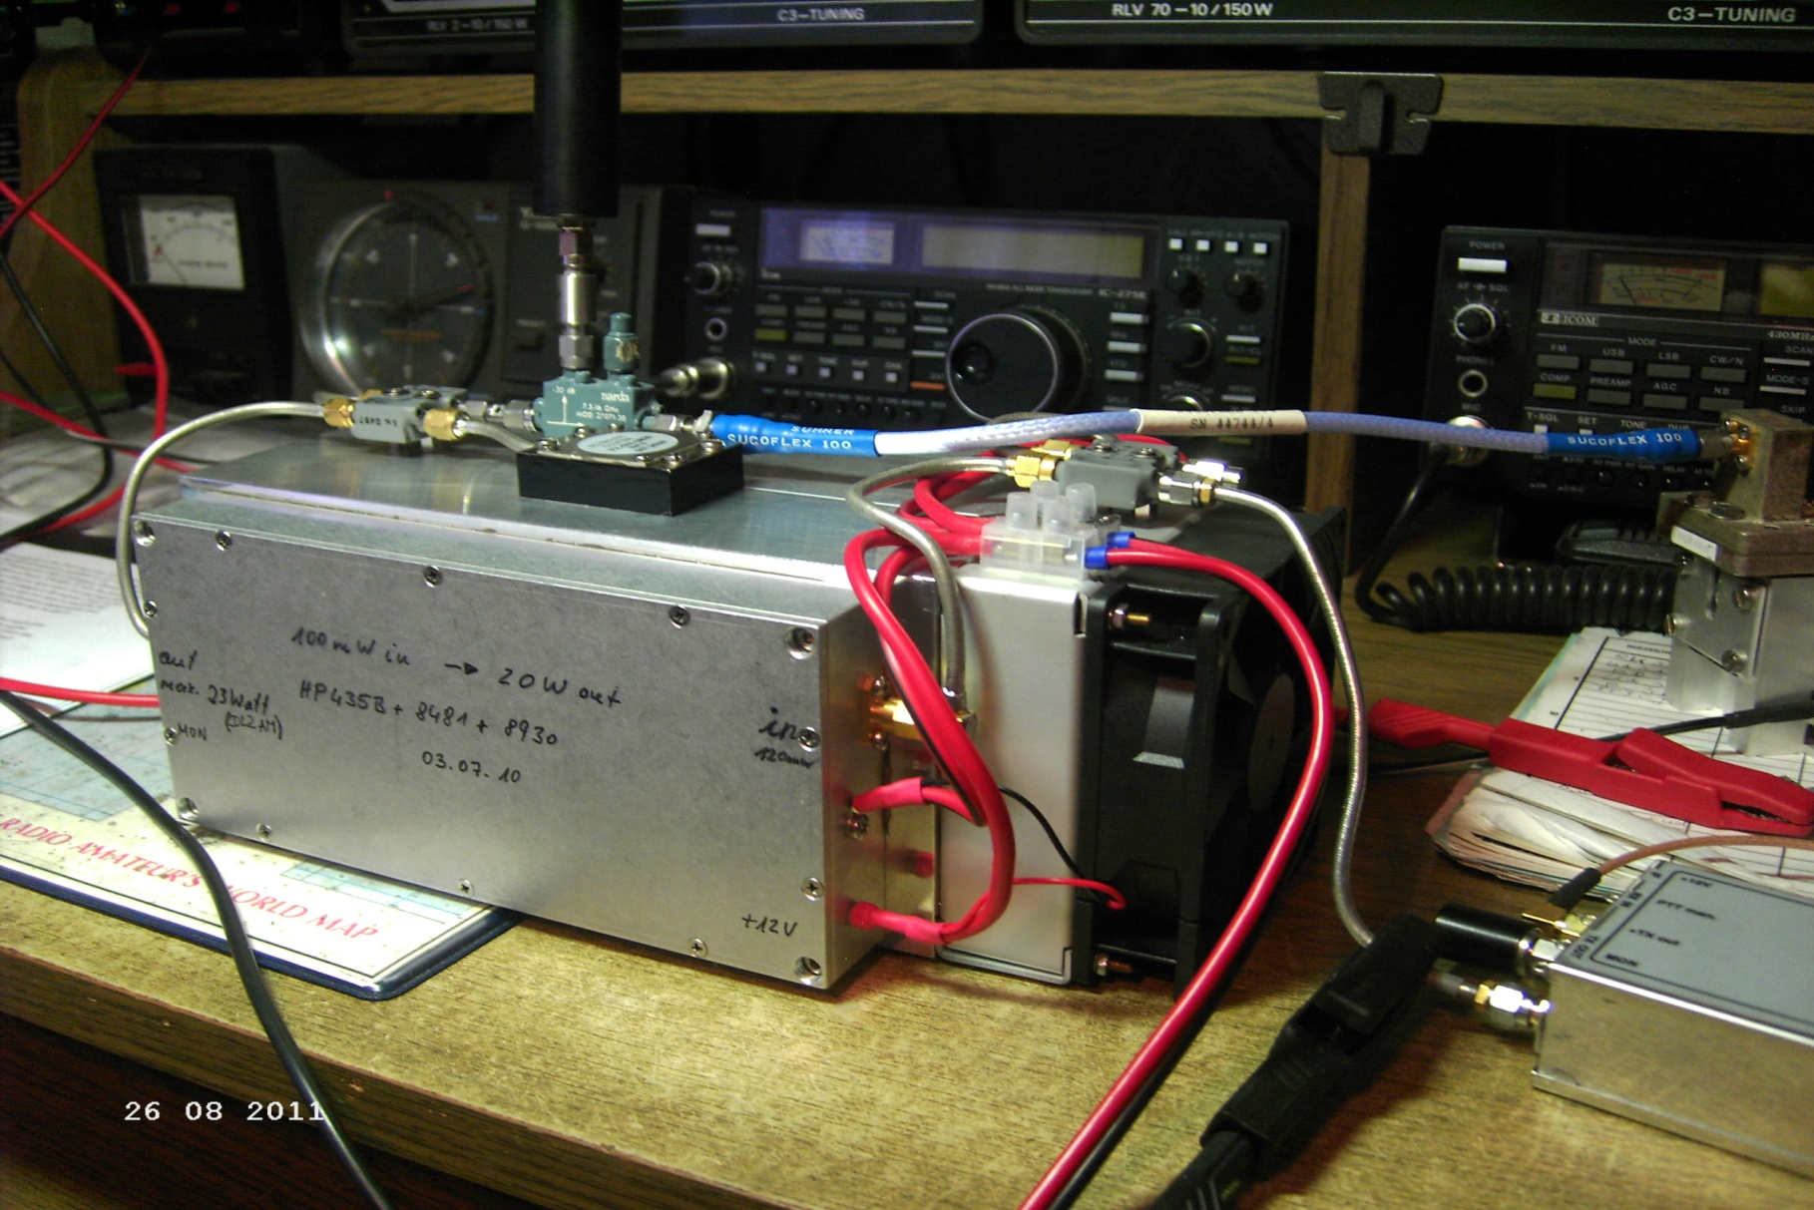
The gain block

Slide 11
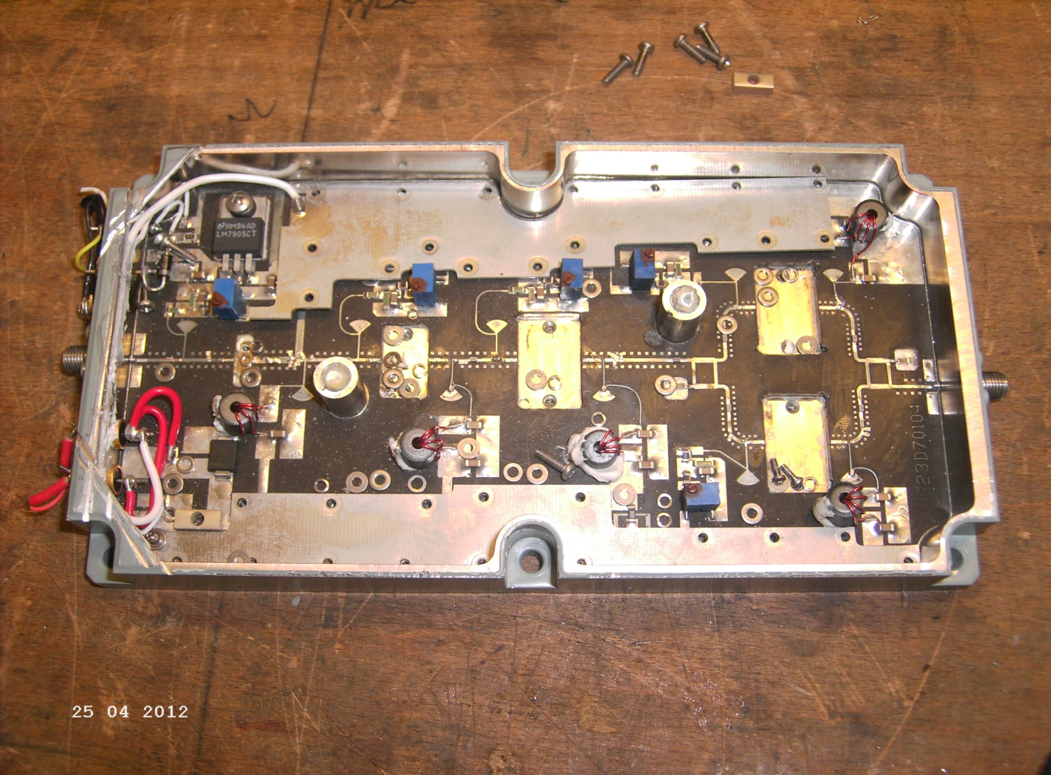
The remnants…RIP !

Slide 12
The End
Thank you for your attention
ANY QUESTIONS ???

