Slide 1
EME DXpedition 2011 to LY - Lithuania: known as our first “barn” DXpedition EME Meeting 2012 in Örebro
Monika and Michael
aka: the M&M-team

Slide 2
Applying for license
First the most important thing: the license
This year the licensing process for LY was a very special challenge as we learnt that
licenses for radio amateurs are limited to lower power levels than we need for EME
we had to apply for a license for “commercial” radio stations
we should keep a certain distance to other houses

Slide 3
The LY-license – this time in Lithuanian language…
Google translate was our friend……

Slide 4
Searching for the QTH
Not new, but every year the ultimate challenge for the logistics manager: searching for a QTH
without neigborhood,
without trees around
I was happy, when I found the homepage of a holiday home in Lithunia in German language with an obviously nice and new „appartment“ only for us inside the house

Slide 5
The QTH in Google Earth
It seemed close to ideal: no neighbours, a big barn (which was the kitchen according the internet), no trees around…???
House
„Kitchen“

Slide 6
A nice holiday house…
Arriving we recognised, that it would be impossible to set up the dish near the house as the trees were much too high and the internet description was very old

Slide 7
„The barn kitchen“……
We learned, that the kitchen was only a small room in the left side of the barn (we refused to take a photo) and that the right side was only for storage….
Storage
Kitchen

Slide 8
The future shack
First we were in doubt, whether it was safe enough to enter the barn…but it was the only chance to get qrv

Slide 9
The decision…
The barn was used for storage of old furniture and for the wood to heat the house; we transfered the 2 tables from the kitchen and the chairs into the barn

Slide 10
…and ready was our shack
Due to the muddy ground we tried to stabilise the tables and the chairs….

Slide 11
We had only 4 problems…
First: the cold - we suffered from the cold (0 deg) as there was no possibilitiy to heat our „well ventilated“ barn

Slide 12
Our kitchen
The only possibility to get warmer was an old oven in our kitchen – it was close to romantic….

Slide 13
Making fire
I learned again - same problem as in Uruguay 2008 - to make fire with the wood from the barn without setting fire to the kitchen or
suffocating…

Slide 14
Source of heat
When the fingers were to clumsy for CW, Michael came in to warm up himself and the fingers….
he doesn´t look content ….

Slide 15
Suffering under the cold
Before breakfast we had to fire up the oven to get warmer after a very cold night (the sleeping room was not heated and humid)

Slide 16
The second problem
The house was situated at the end of the mains power supply and we had to use an extension cable from the house to the barn…
The power line

Slide 17
Second Problem: the electric current
The voltage in the barn was „normally“ around 220 Volts
With driving of the PA the voltage dropped down to 180 V
Coax-relay in the sequencer box went mad
As a consequence we only had largely reduced power output on all bands

Slide 18
The consequence
… the mood was more or less down….

Slide 19
The third problem
We shared the small sleeping room with other „living objects“ with 6 legs – we were not alone….

Slide 20
Our fourth problem
It was the water in the house: brown and with a smell in the first days, no water in the 2nd week after the pipe was broken….. time for a decision….
Waste water
The WC and the showers
The „dwell“

Slide 21
The second home
We have to admit: we changed the QTH and we left the dish and the station alone during our absense….
We found a nice hotel 30 min away

Slide 22
The second home
The little hotel had fantatic rooms and an excellent restaurant, where we had dinner even at 23.00 and breakfast at 04.30 am

Slide 23
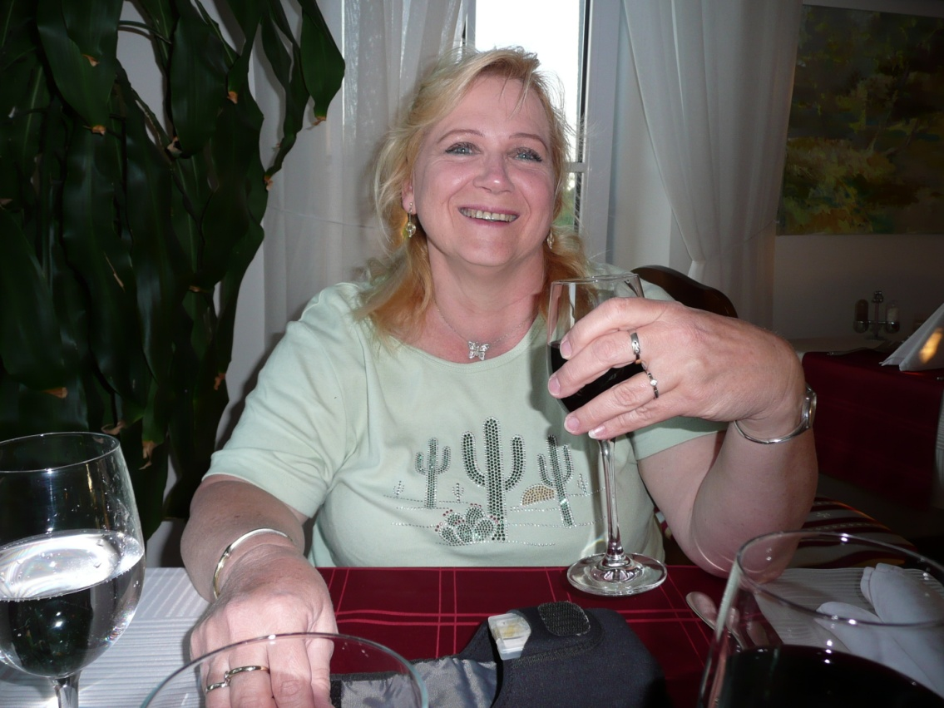
Dinner in the restaurant
The mood was rising with a glass of good red wine….

Slide 24
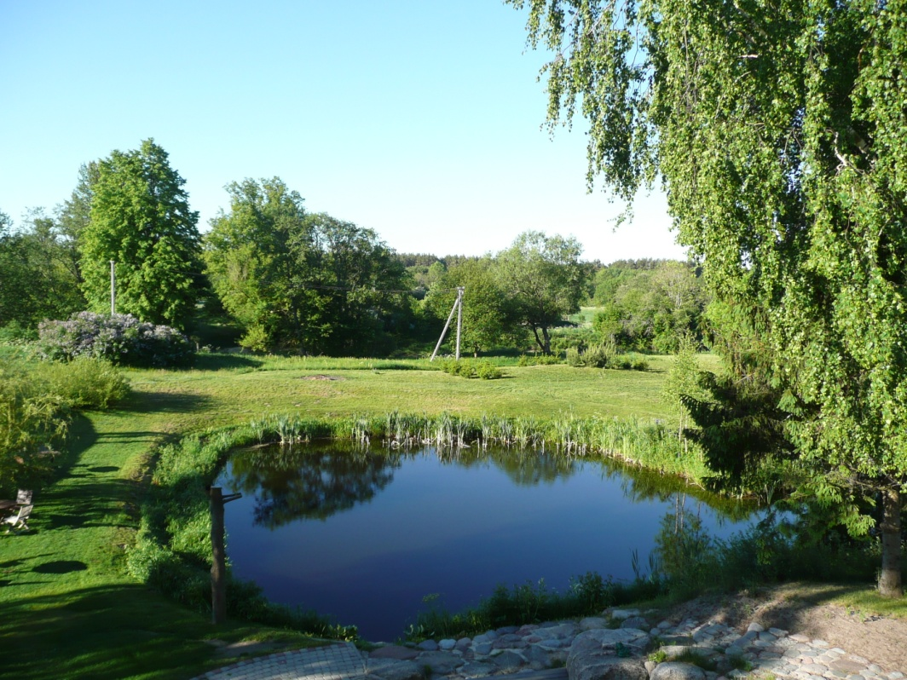
Nice surrounding
Just the contrast to our first QTH

Slide 25
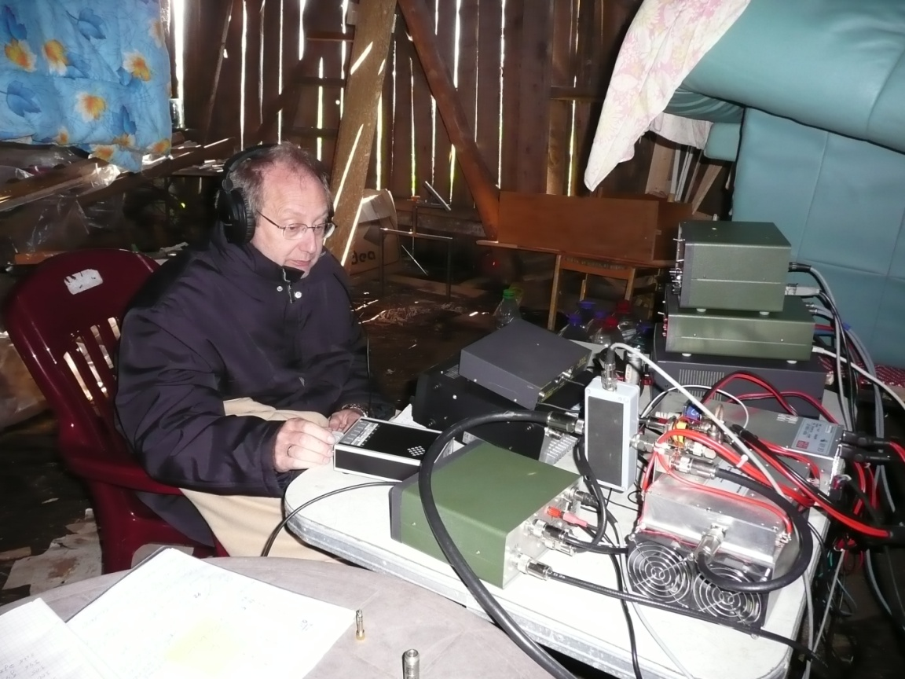
Before and afterwards…
Do you see the difference??
….. and it became warmer in the second week! So we started to enjoy the DXpedition

Slide 26
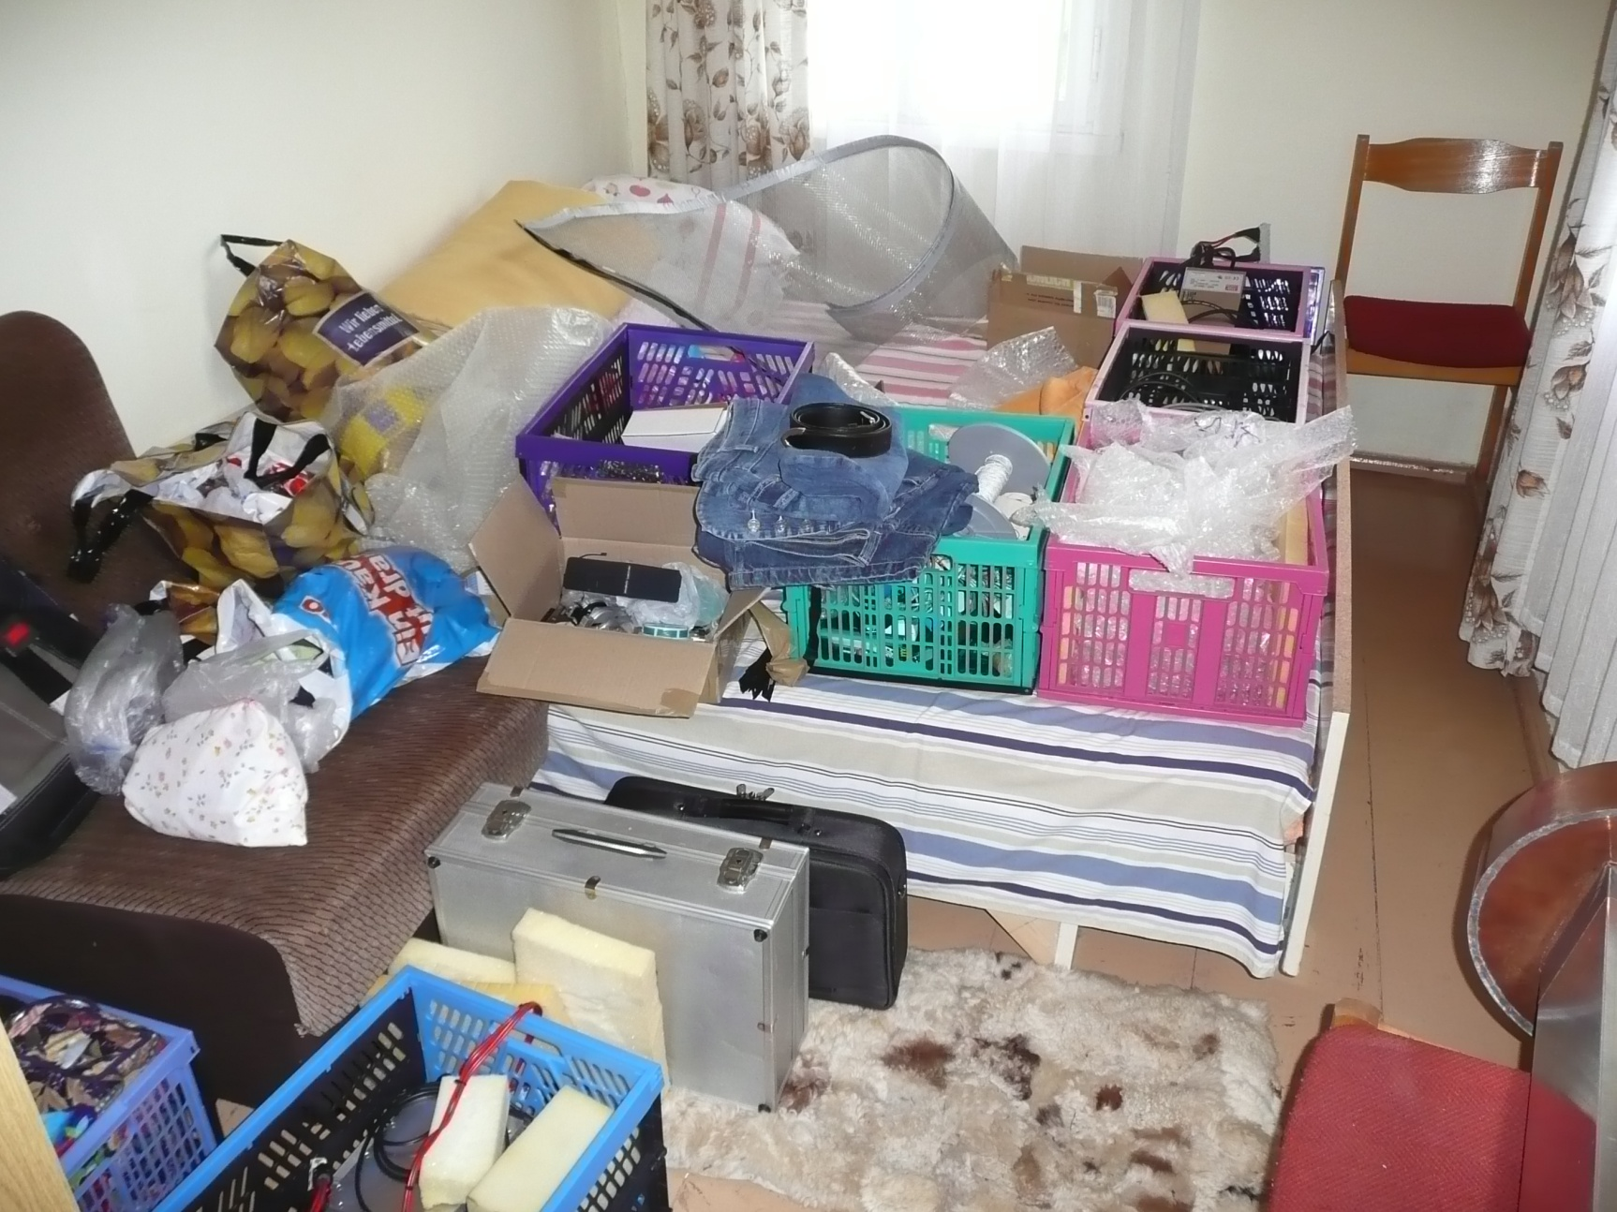
Playing on the wireless
The technical storage room: a second sleeping room in our “appart-ment”

Slide 27
The station on 2 tables
This was the essential element for easy moon tracking: OE5JFL’s superb generation 2 controller, the populated pcb’s provided by Alex, HB9RDI

Slide 28
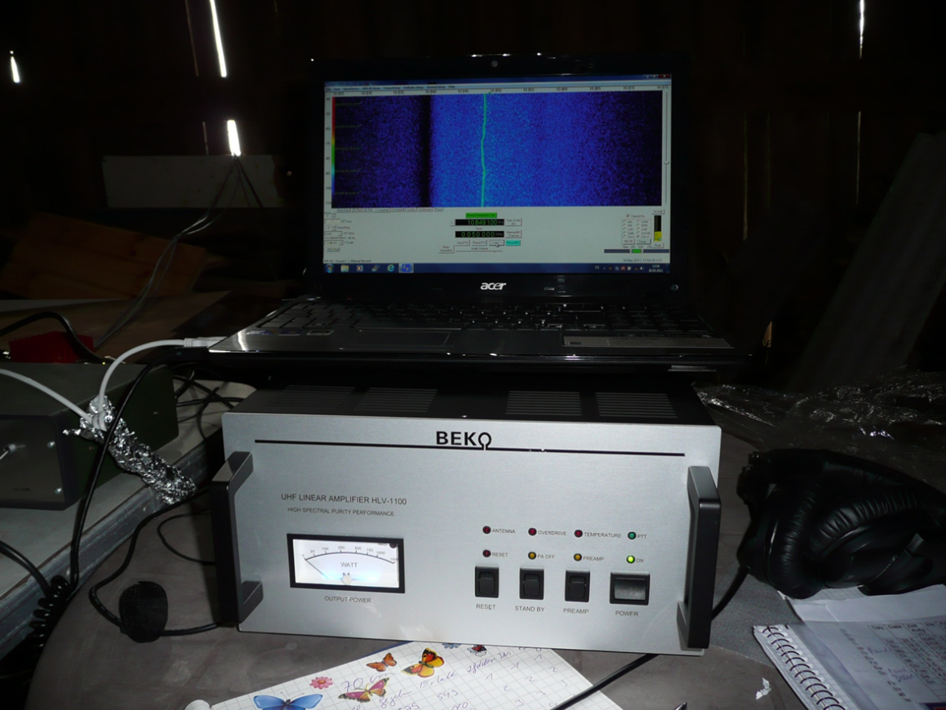
70 cm Station
70 cm PA from BEKO, still without modification: for 2012 BEKO modified for ceramic transistors (Freescale)
Actual output in LY only 550 W
The waterfall display, which was in use for the 2nd time after R2, was a help to find weak signals, because some smaller stations with skeds were not „on frequency“, so it was a hard work to find them

Slide 29
Station on 23 cm
23 cm PA made by DB6NT (4 Infineon LDMOS devices PTF 141501, each capable of 150 W sat)
Actual output in LY: only 350 W

Slide 30
Station on 13 cm
13cm PA homebrew with 2x300W Ericsson, 4mW to 600W ;
actual output in LY: 380 W

Slide 31
13 cm to JA
The 13 cm contact to JA was borderline as we had heavy interferences with WiFi. This was the reason to modify the converter for 2012….

Slide 32
Adding a filter
For 2012 we add a inter- digital filter in order to minimise WiFi interferences

Slide 33
New filter
The filter close up

Slide 34
Only 3 bands possible
Changing betweeen the 3 different bands was as usual no problem due to the modular station design
9 cm was not allowed in LY – the same problem will be this year in XX….
On 6 cm and 3 cm we were not qrv in LY, but we will try it this year – 3 cm with a second, but smaller dish (solid dish with ideal curvature,), 6 cm with the old dish

Slide 35
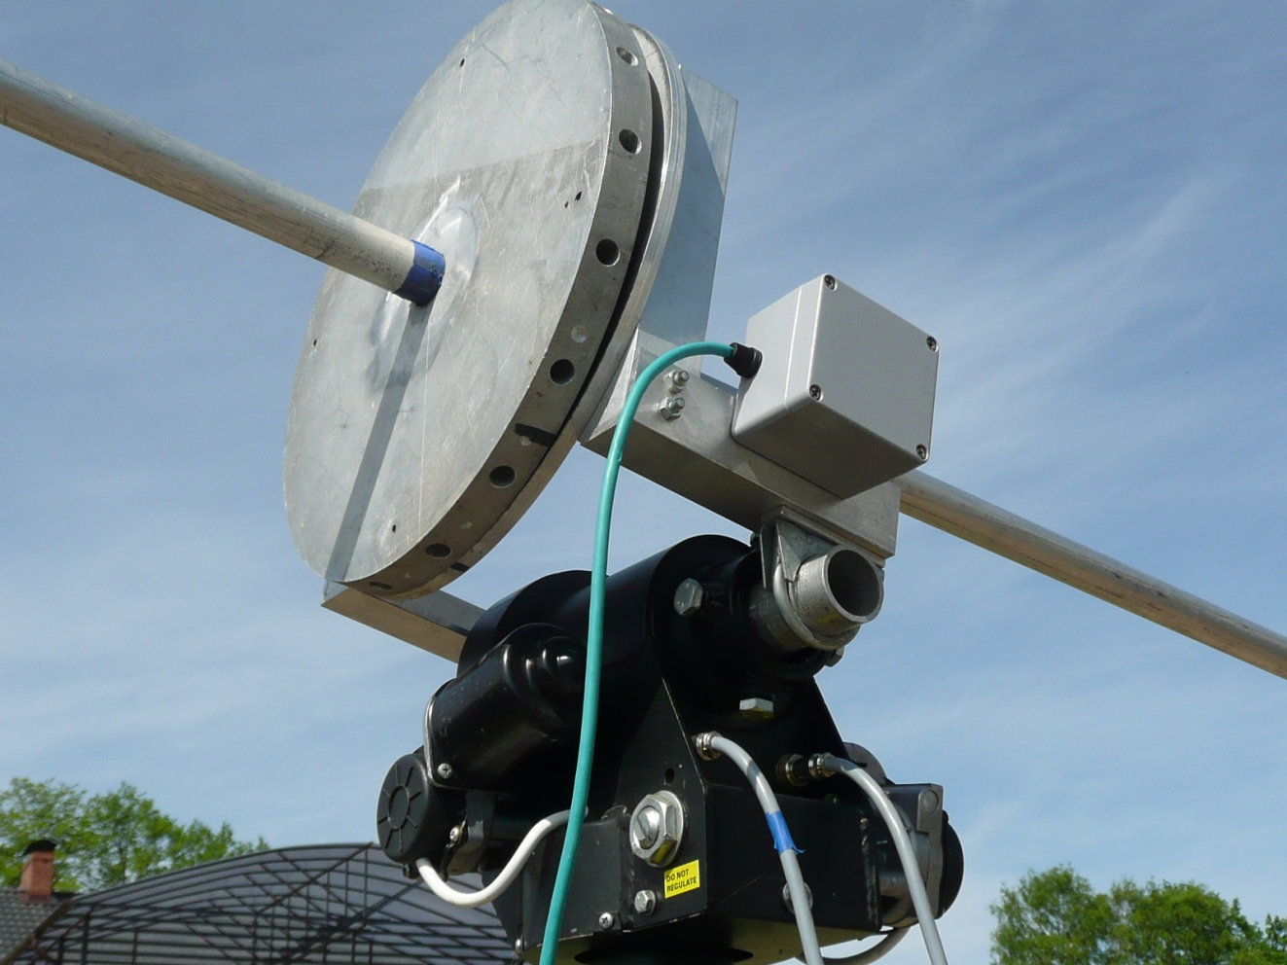
Installing the dish
As you know, the Spid RAS rotator and the central plate with the holes for the tubes were most important
The central hub consists of 2 solid plates, which are rotatable against each other, this enables us to insert the aluminum tubes and putting in the meshes at ground level

Slide 36
Our dish on his 8th DXpedition
The aluminium tubes have to be substituted every 2nd DXpedition to provide a shape „close to a dish“ –
otherwise the bending of the tubes would be too much close to the hub

Slide 37
Dish pointing East
We had a perfect unobscured window to the East, so VK and JA were very easy to work

Slide 38
Limited window to the West
The window to the West was very limited due a huge tree besides the house; this minimised the possibility to work with US stations

Slide 39
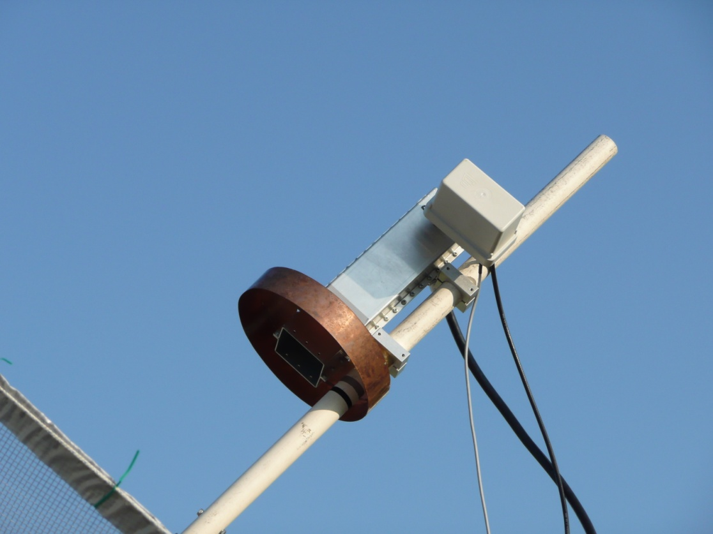
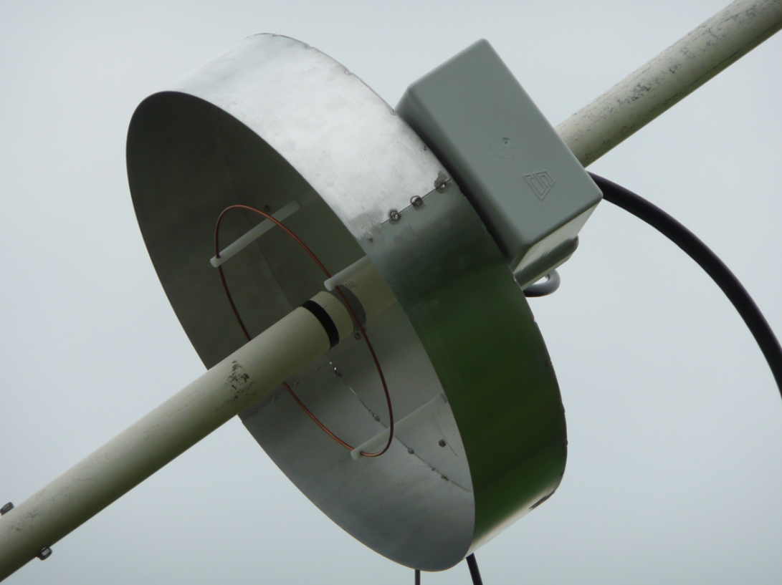
Feeding the dish
…..with the 70 cm loop feed with adjustable linear polarisation
……with 13 cm feed: according 23 cm with a small choke ring for better f/b ratio

Slide 40
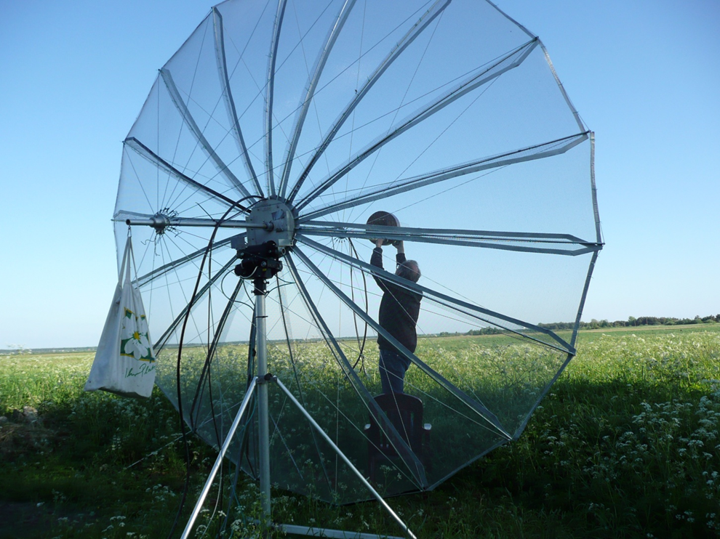
Changing the feeds
…. was no problem as usual – we need less than 10 minutes to change the feeds and to jump between the bands – in the last days we were active on all 3 bands per day

Slide 41
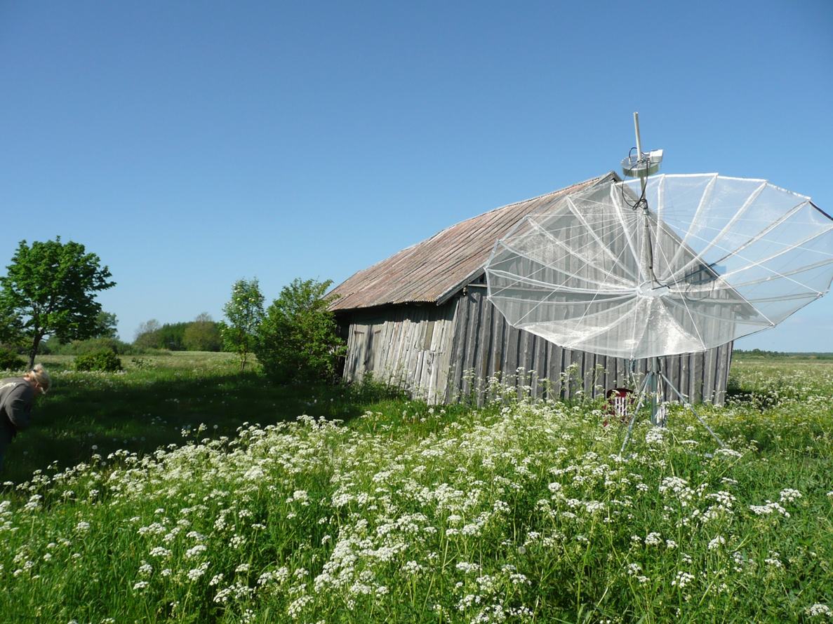
Sunny weather
In the 2nd week we had fine and warm weather (and the grass began to blossom) so we also set out for sightseeing

Slide 42
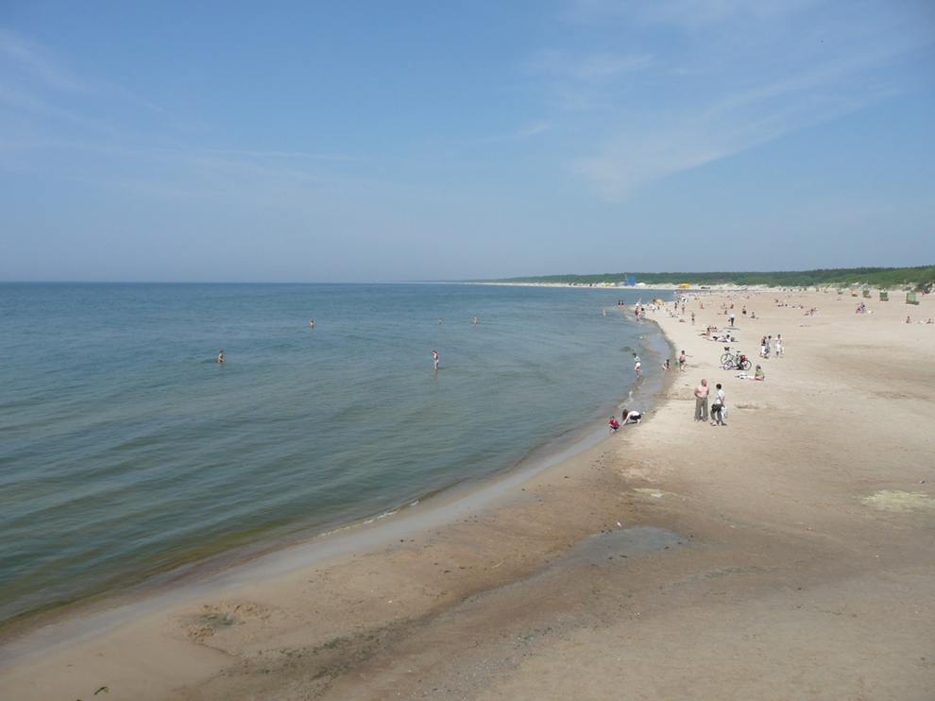
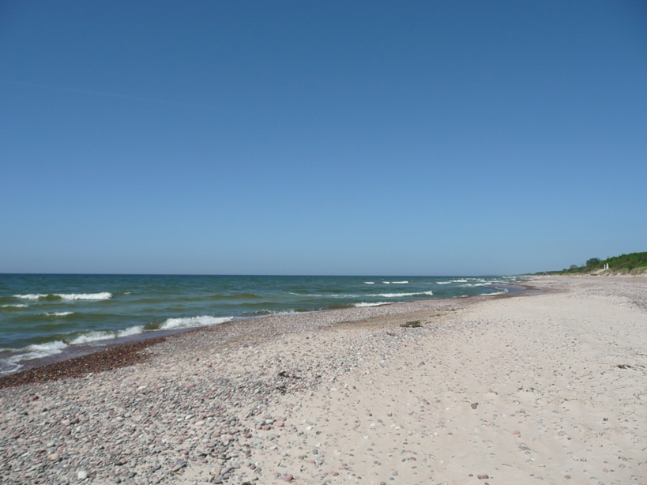
Fantastic beaches
To the North: YL
To the South: LY

Slide 43
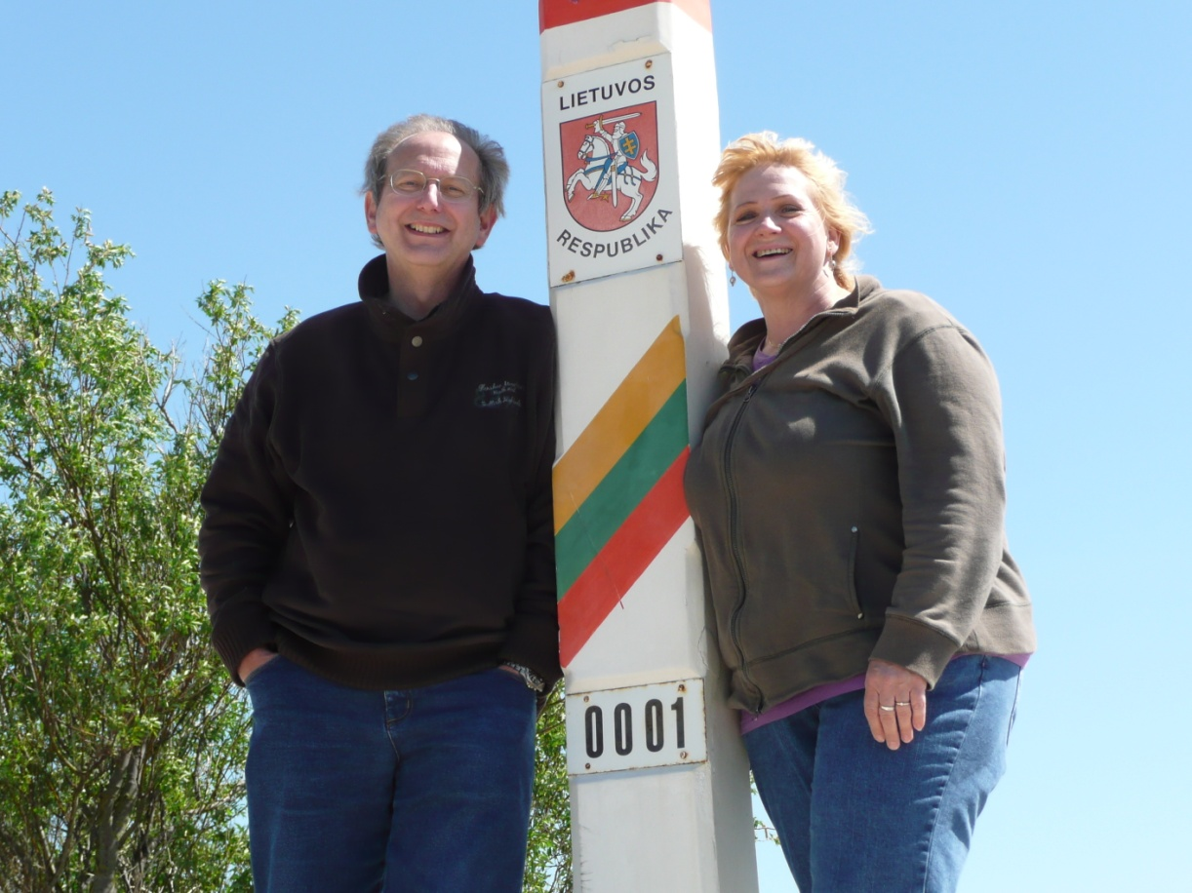
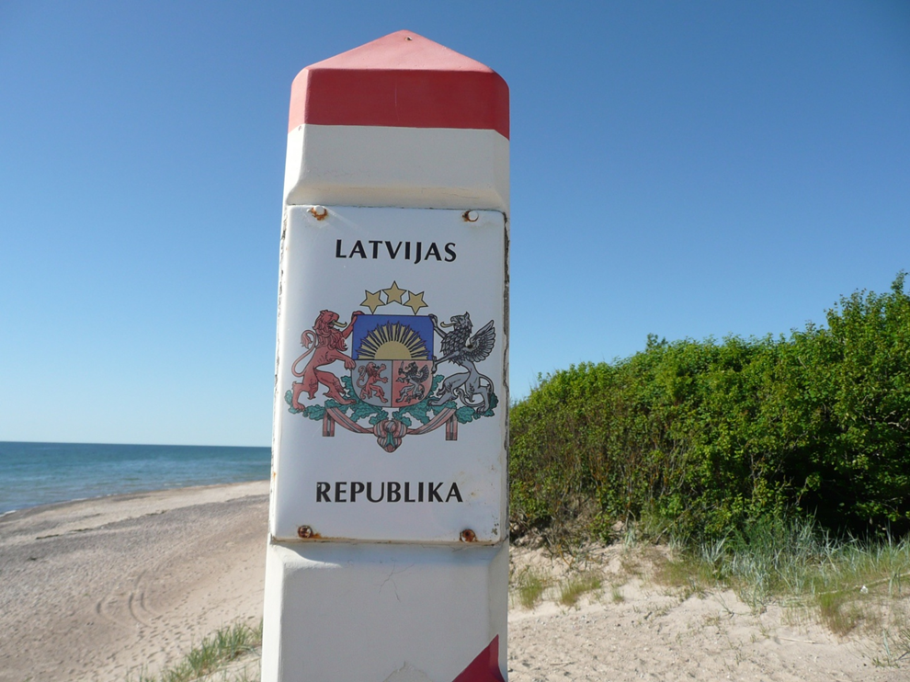
Crossing the border on the beach
The border between Lithuania and Latvia
It is fun to be an illegal alien….

Slide 44
Romantic LY
Untouched flora and fauna in the wetlands

Slide 45
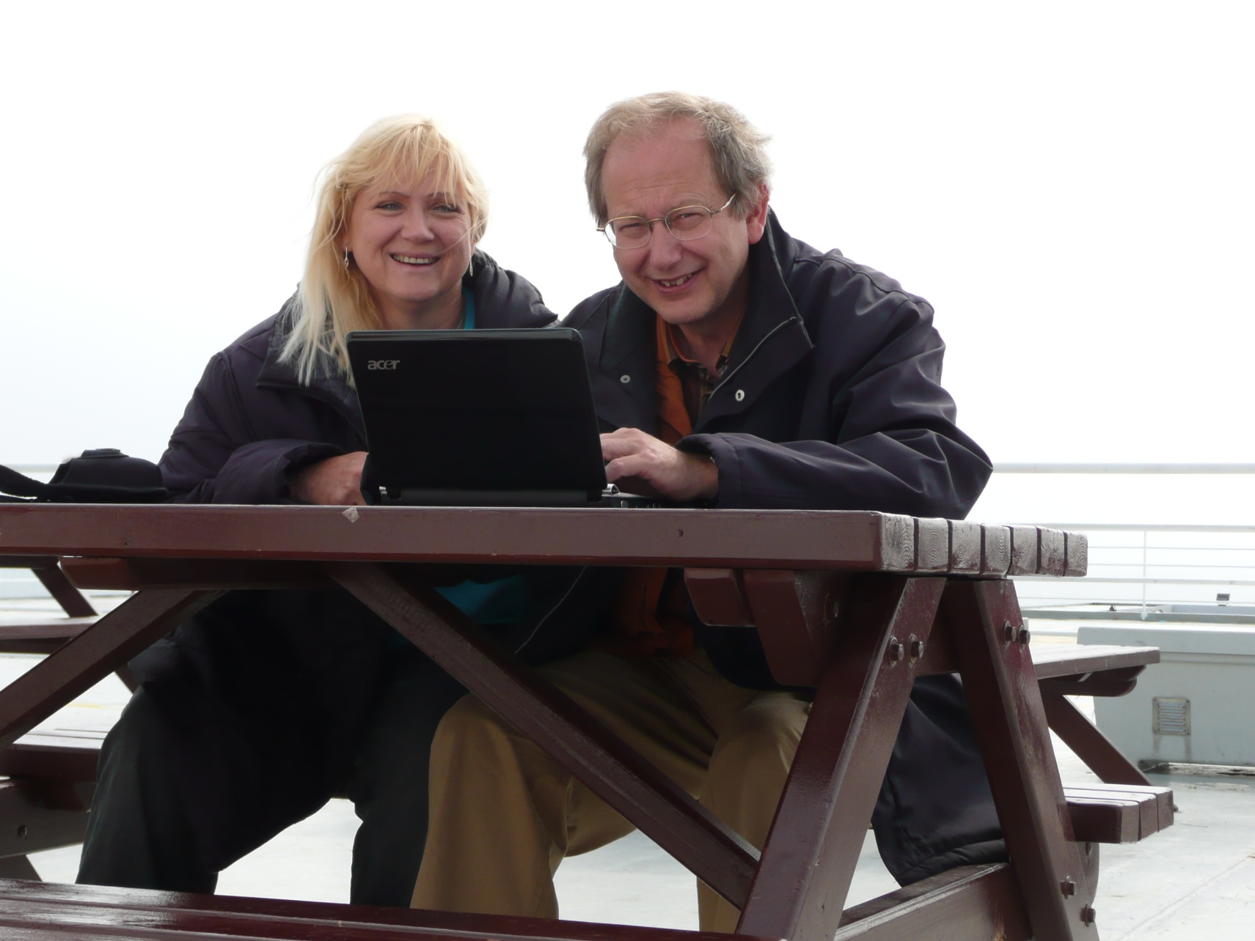
Tack för er uppmärksamhet
M&M -team on the way back on the ferry, writing the last update for the moon-net

Slide 46
Tack för er uppmärksamhet
M&M -team on the way back on the ferry, writing the last update for the moon-net
See you next week on 70, 23 an 13 cm – and the following week hopefully also on 6 and 3 cm from XX – our 2nd barn Dxpedition (but this barn is built from stones and was an old sheep stable and should be heated, hi…..). It is the only lonely house, which we have found in a nice holiday surrounding

