Slide 1
6cm EME Today & Optimising your Multiband Operation
Why 6cm EME?
Some 6cm issues
Current Systems, Dishes and Feeds
Transverters, LNAs and Transmitters
System measurement and optimisation
Optimised Multiband operation

Slide 2
Why 6cm EME?
Wide availability and common allocation
Growing number of stations and activity

Slide 3
Dedicated weekend per band plus Activity Weekends boosts 6cm EME
x

Slide 4
Why 6cm EME?
Wide availability and common allocation
Growing number of stations and activity
Good results achieveable with 1.8-3m dish
A nice engineering challenge and an experimenters playground
Not too hard to get the components
Some designs on the web
“Plug and play” available…. (at a price)

Slide 5
Some 6 cm Issues
Doppler Shift and Libration
Antenna pointing accuracy
Noise temperature of mesh dishes
Mounting systems at the dish focus

Slide 6
Libration minimum
Notes:
Doppler graph, in EME measurements

Slide 7
Libration Spreading OK1KIR 15-08-09
Calculated Libration (by G3WDG) 78Hz

Slide 8
Very interesting test with PI9CAM
G3LTF Echoes
0.6 deg. BW
PI9CAM Echoes
0.15 deg. BW

Slide 9
Antenna should point within the 1 dB beamwidth. ( -3dB is -6dB on echoes)
Moon = 0.5 deg

Slide 10
Effect of Mesh size on Tsys and Gain
In a mesh dish the feed-horn “sees” the ground, 290K, through the mesh aperture and there is gain loss.
Mesh aperture Wire thickness Added Temp. Gain loss dB
6 x 6 mm 1 mm 18K 0.3
6 x 6 mm 2 mm 4K <0.1
6 x 8 mm 1 mm 33K 0.6
6 x 8 mm 2 mm 9K 0.15
8 x 8 mm 1 mm 51K 1.0
8 x 8 mm 2 mm 15K 0.3
10 x 10 mm 1mm 108K 3.0
A typical 6cm Tsys with a SOLID dish would be 85-95K
Spread-sheet in W1GHZ online Microwave antenna book

Slide 11
Mounting Systems at the focus
RF Power is expensive at 6cm.
Minimise feeder loss, mount PA at the dish focus or use waveguide.
Minimise blockage in prime focus dishes.
Provide for feed position adjustment
Rigorous screening of all units
Weather protection is never simple
Multiway cable and weather proof sockets

Slide 12
Current Systems, Dishes and Feeds
G3LTF
6m
0.375f/D
6mm mesh

Slide 13
G3LTF 6cm System
PSUs
Control
87.75MHz
40W
OCXO
SSPA
Driver
4W
Transverter
Diplexer
Diplexer
CP
Feed
Relay
LNA
144-14MHz
SDR
50R Load
TS850S
Spectran
Dish Focus
Shack
Tuneable
Audio
Filter

Slide 14
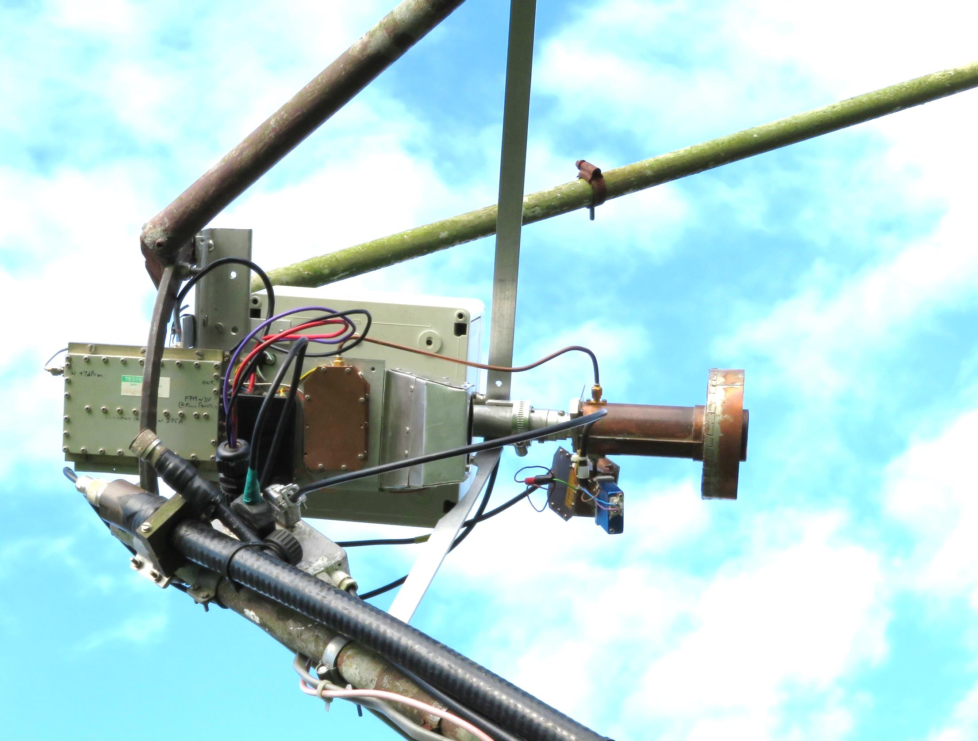
Feed support struts
Transverter
40W PA
4W Driver
SM6FHZ Kumar feed
Relay
W5LUA
Type LNA
30v,15v
Control &
LNA / relay
connectors

Slide 15
Two of the bigger dishes regularly used on 6cm EME
HB9Q 10m 0.43f/D 100W
TM8PB 13m Cassegrain 70W

Slide 16
OZ1LPR 2.4m Offset dish 100W
Feed
Driver
Relay
100W PA
LNA
Transverter

Slide 17
Novel feed design by OZ1LPR
Septum polariser
Taper section
Original C-band feed-horn

Slide 18
1.8m dishes with 100W make cw QSOs on 6cm
SM6PGP, Kumar feed
OK1DFC, Square Septum with Chaparral choke

Slide 19
LX1DB 3m dish 0.3f/D 225W

Slide 21
PA3DZL- New 3.7m solid dish
Chaparral Feed with squeezed WG polariser
Good Feed adjustment system

Slide 22
CT1DMK Squeezed waveguide polariser built by PA7JB

Slide 23
G4NNS 3.7m 0.4f/D solid dish, 40W
Square septum + choke
Relay
LNA
40W
PA
Transverter

Slide 24
DL7YC HB 5m dish
LNA
RA3AQ Feed
Relay

Slide 25
JA4BLC 3m 0.25f/D Cassegrain with 60cm sub-reflector. 100W
W2IMU Dual mode
feed-horn
HB 0.5dB LNA NE3515

Slide 26
PA7JB 2.4m 30W 39# cw
Potter (or Skobolev) dual mode feedhorn

Slide 27
W7 / VE4MA 5ft Offset (3/8 of a 10ft dish!)
W2IMU Dual mode feed 1.2L
Relay
LNA
Waveguide run from 125W TWTA

Slide 28
6cm Transverters
G4DDK x16
3 section Tx “clean up” filter
3 section Rx Filter G4JNT
HB mixer & tx-rx amps
F6BVA doubler (below)
I built my own, but there are simpler versions…!
With 144MHz IF a good tx filter is needed
A good rx filter helps keep out the Wi-Fi

Slide 29
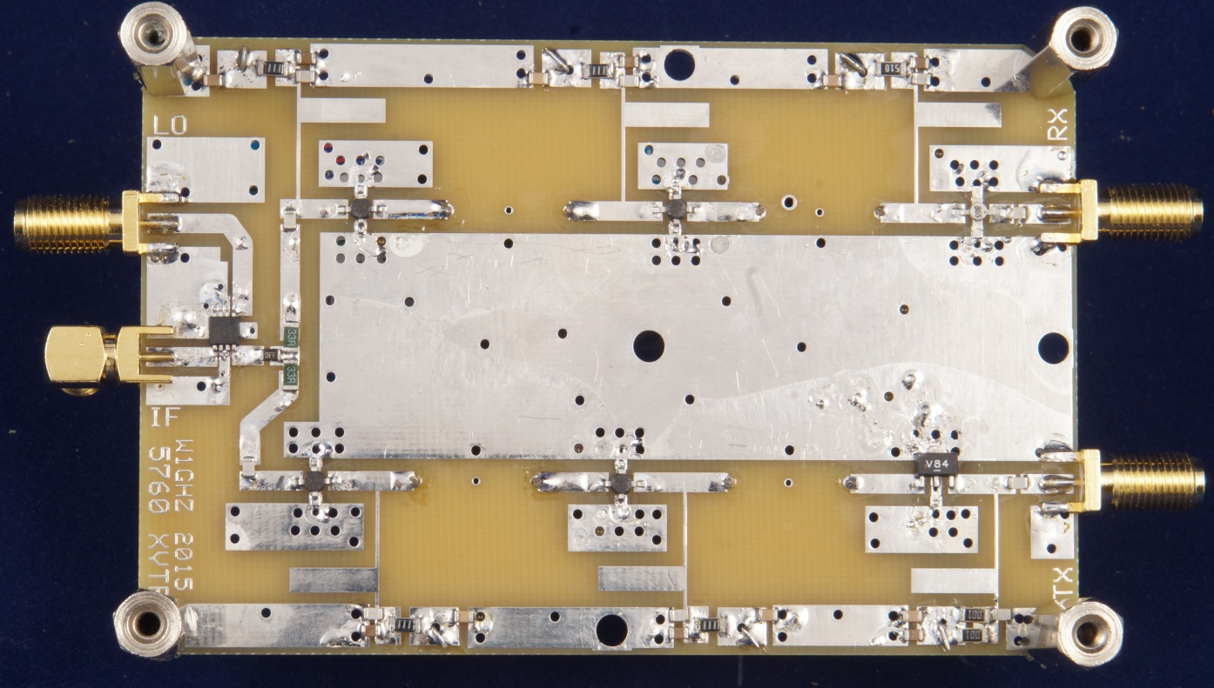
Simple, Low-cost, 6cm transverter on FR4 designed by W1GHZ using MMICs and “pipe-cap” filters. LO Synth or multiplier not shown.
See W1GHZ web site

Slide 30
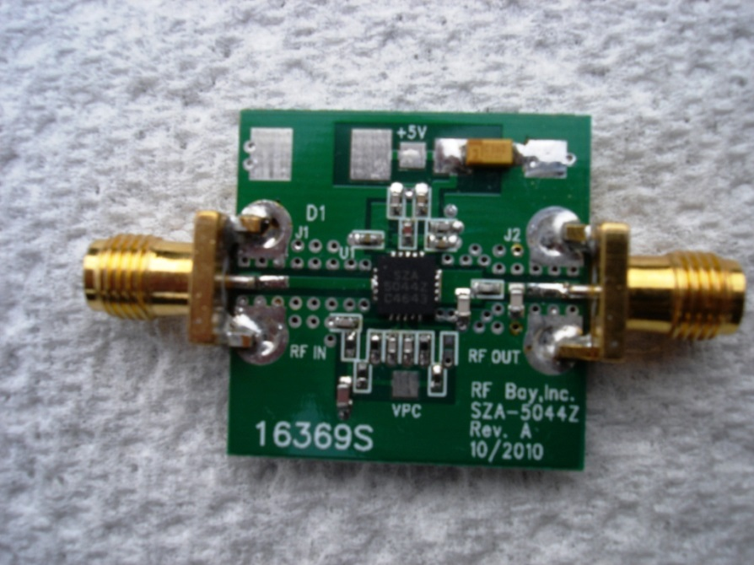
Lots of stuff on E-bay
8-12W PA
~1W amplifier

Slide 31
JA4BLC 100W PA SM6PGP design see www.moonbouncers.org Also F6BVA 63W PA and F5JWF

Slide 32
“Low noise amplifiers for…5760.. WB5LUA” See www.N5DUX.com
G3LTF build 0.65dB NF ATF36077

Slide 33
System measurement and optimisation
Sun noise measurement gives G/T estimate
Moon noise can give more accuracy
Ground to Cold Sky measurement useful but more complex than it first appears
VK3UM’s EMECalc programme can help analyse the results

Slide 34
My thanks to all who contributed material for my October paper Sorry I couldn’t use it all
G3WDG, G4CCH, G4NNS, G8ACE, HB9Q, IK3COJ, JA4BLC, K2UYH, LX1DB, OK1CA, OK1DFC, OK1KIR, OZ1LPR, PA3DZL, PA3FXB, PA7JB, SM6PGP, SM6FHZ, SP6JLW, VE4MA, WA9FWD

Slide 35
Optimising Multiband Operation
Multibanding is a lot of Fun.
Contests, Dx-peditions demand it
Basically it’s an engineering challenge
Standard Interfaces, Commonality, and Interchangeability are the keys to success
My system was not planned but evolved; changing bands 70cm though 6cm takes about 20-40 minutes

Slide 36
Safe Access is Essential!
Hands Free, slip protected
Love the picture… BUT NO!

Slide 37
Standard mechanical interface Four wing-nuts
Two holes for feed assembly bolts
Rain protection for cable ends
Bolts for feed support struts

Slide 38
Power supplies are in a fan ventilated weatherproof box at the foot of the dish
9cm system
Exit
Air inlet

Slide 39
13cm System has PA and PSU below dish. Transverter in shack
28V PSU
Rx cable
All feeds have
identical preamp volts and relay line via 9way D type
(gold plated)
Feed Support Strut
o/p coupler
Tx Cable 5m LDF5-50
10mW from shack
300W GSM PA

Slide 40
6cm System has transverter and PA at feed and PSUs below the dish
30V PSU
15V PSU
OCXO
OCXO +144MHz up/down
from shack

Slide 41
9cm system uses the same architecture as 6cm with same PSUs
SM6FHZ
Kumar Feed
Relay
LNA
90W PA
Feed adjustment
Power and
control lines
termination box
Transverter and original 30W PA
(Needs a shrink rebuild!)
OCXO and 144MHz up/down from shack

Slide 42
Thanks for listening
I’m sure others have done the same or similar, but if it takes you a day to change bands then maybe this gives you some ideas!

