Slide 1
The Future of the Dubus EME CW / SSB contest
This is the only EME contest dedicated to fully random CW or SSB contacts on all bands

Slide 2
We Get Fantastic Activity Levels
23cm Saturday morning 01-04-2017 G3LTF SDR

Slide 3
And Good Participation

Slide 4
But…… Joe, DL8HCZ, will not continue unless he can get some help. He has asked me to start the debate on how this can be realised.
Dubus / REF will continue to sponsor the contest but he needs help from individuals or a group

Slide 5
What is involved ? What are the tasks?
Decide on suitable dates. (me in past years)
Review rules and agree them with Dubus management who will advertise them in print and website.
Receive the entries. Dubus address can be used as now and forwarded to evaluators
Check entries for compliance to rules and check claimed scores
Continued.

Slide 6
Tasks (continued)
5. Sort into classes, QRP, QRO etc
6. Produce a draft list of results
7. Review with Dubus management and
obtain agreement
8. Produce final list of results for Dubus print
and website
9. Certificate printing and distribution (Dubus)
10. Prizes (free subs) arranged & sent by
Dubus. (REF pay 50%)

Slide 7
I am raising this here first for discussion but someone, or a group, needs to contact Joe DL8HCZ as soon as possible otherwise there may not be a contest in 2018
I am just the messenger and as they say…….

Slide 8
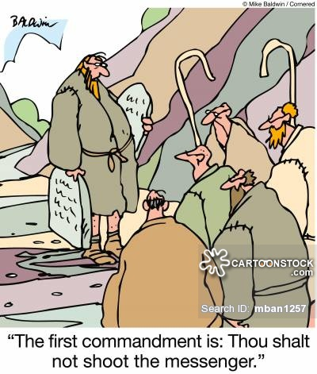

Slide 9
I am raising this here first for discussion but someone, or a group, needs to contact Joe DL8HCZ as soon as possible otherwise there may not be a contest in 2018
Offers of help to Joe,DL8HCZ
funk-telegramm@t-online.de

