Slide 1
Measurments
Plots of LNAs measured
HB9BBD

Slide 2
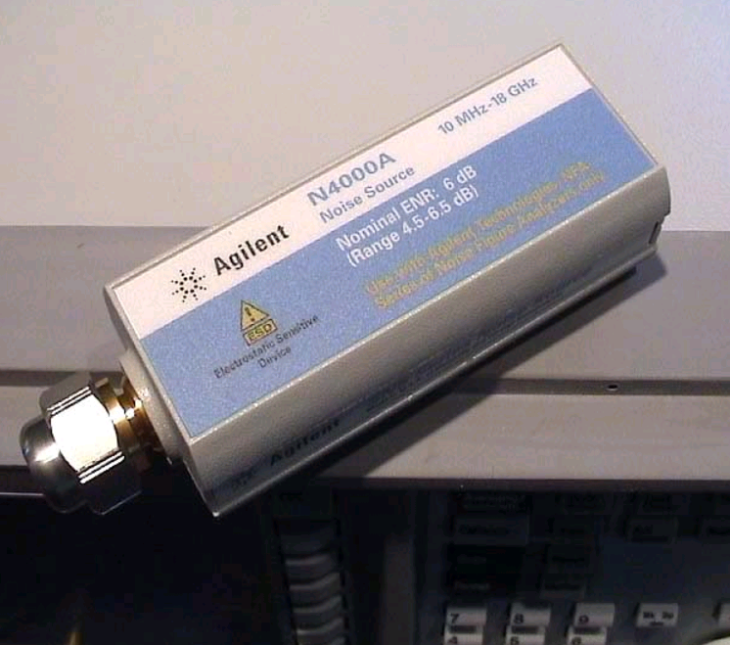
Introduction
First time in my life no LNA for 144 MHz and for 432 MHz were to be measured at a conference...
2 noise sources had been measured on the basis of the SNS noise head N4000A

Slide 3
Agenda
Wide-Band amplifiers
1296 MHz
1420 MHz
2.4 GHz
3.4 GHz
10‘368 MHz (all results incl. WG-SMA adapter!, where applicable)
Appendix: ENR Tables of reference Noise Head
Agilent N4000A and Noise-Head rel.ENR

Slide 4
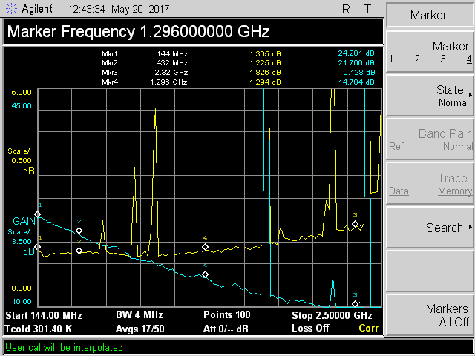
Wide-Band amplifiers
PA2DW
Low-Bands

Slide 5
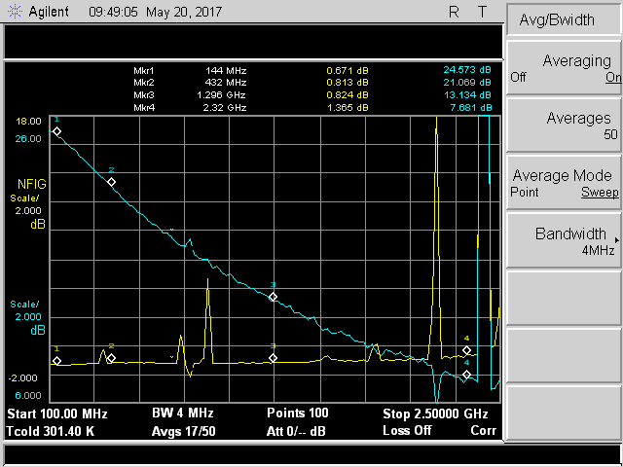
Wide-Band amplifiers
SM2CEW

Slide 6
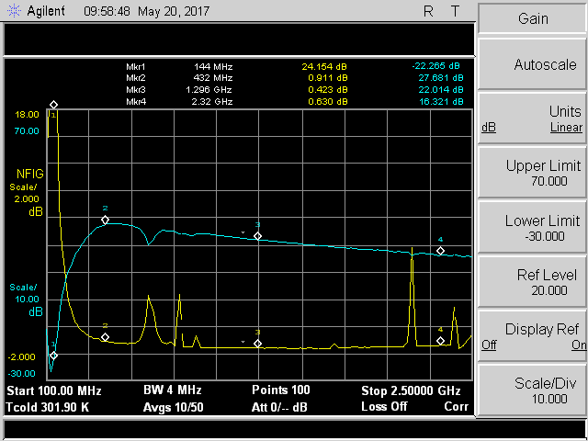
Wide-Band amplifiers
SM7GEP
PGA103+

Slide 7
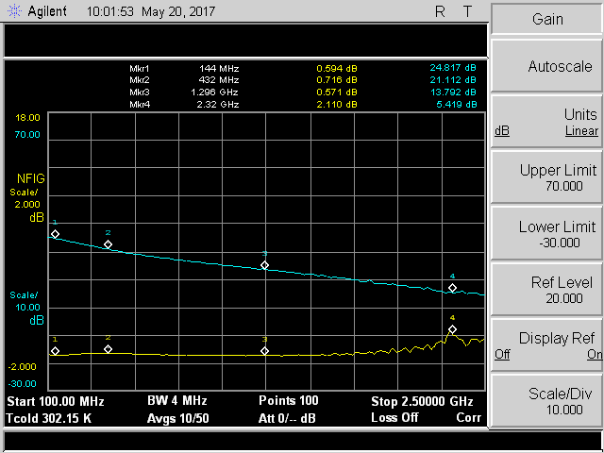
Wide-Band amplifiers
SM7GEP
W2ODO

Slide 8
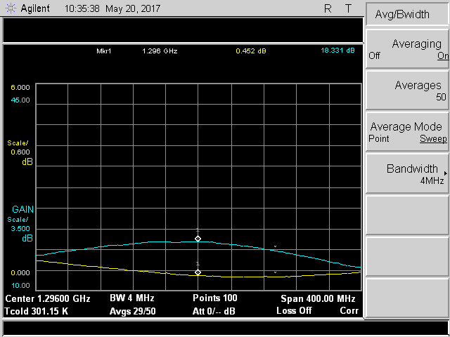
1296 MHz
SM7GEP
DJ9BV

Slide 9
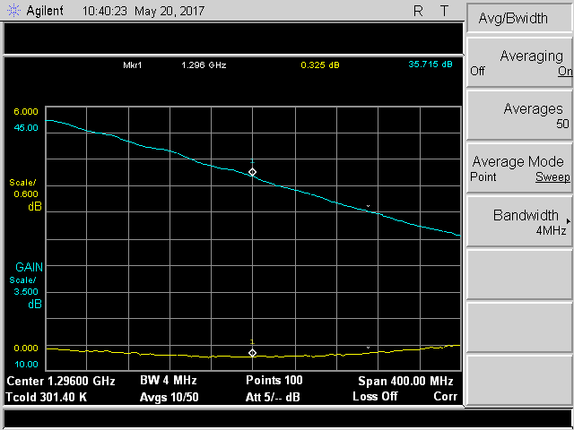
1296 MHz
SM7GEP
G4DDK

Slide 10
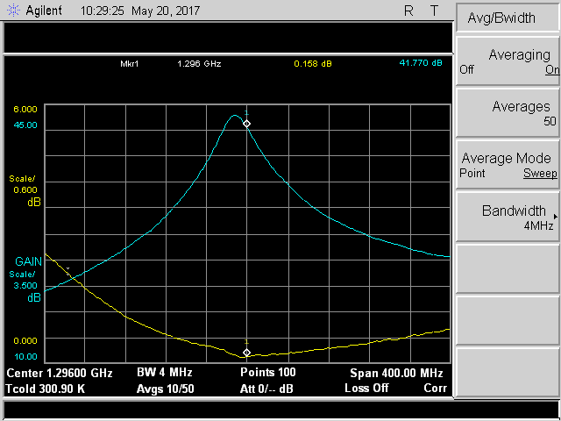
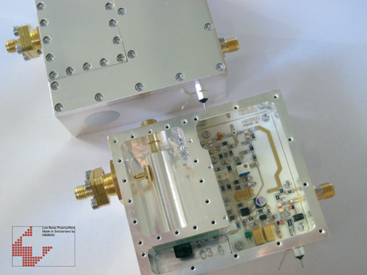
1296 MHz
HB9BBD
2-052

Slide 11
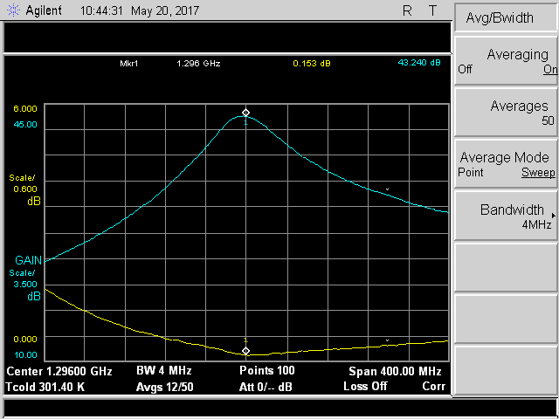
1296 MHz
HB9BBD
2-084

Slide 12
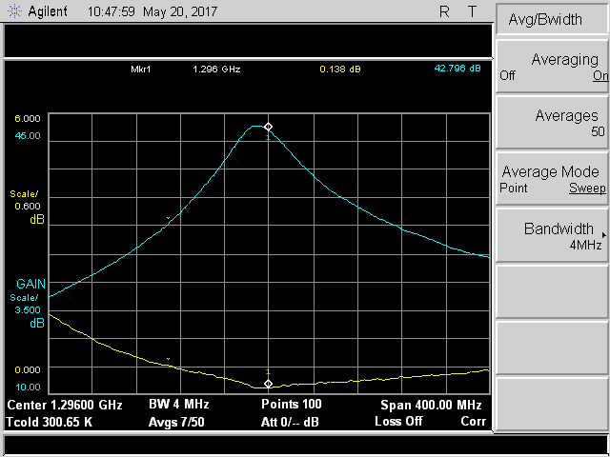
1296 MHz
HB9BBD
2-084

Slide 13
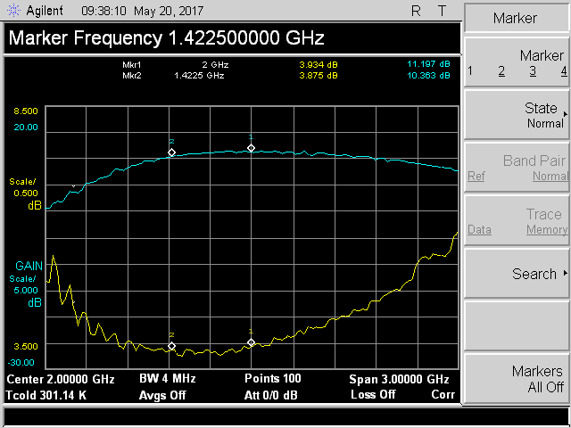
1420 MHz
HB9DUK
IC AMP

Slide 14
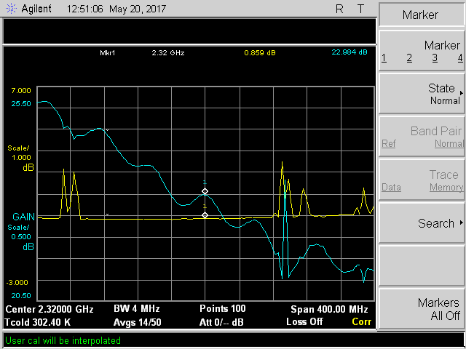
2320 MHz
PA7JB
G4DDK

Slide 15
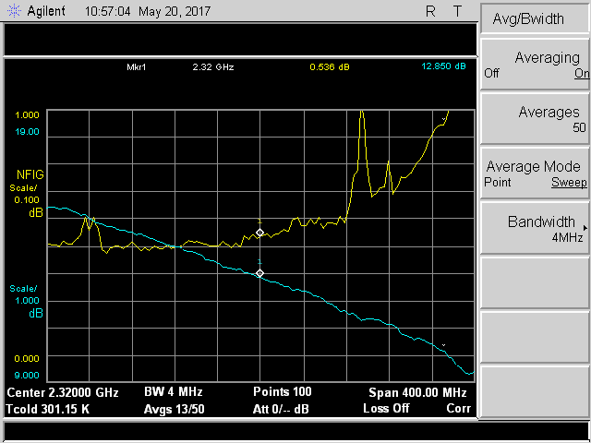
2320 MHz
SM7GEP
DJ9BV

Slide 16
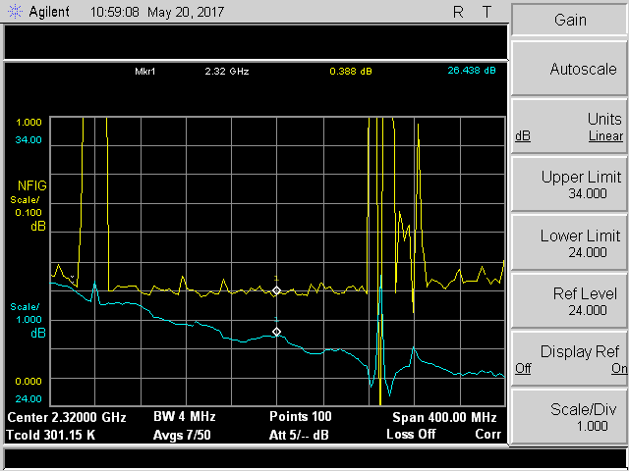
2320 MHz
SM7GEP
G4DDK

Slide 17
3.4 GHz
Sorry, chart somehow lost.. :-(
PA7JB NF 0.68 dB G 13.18 dB

Slide 18
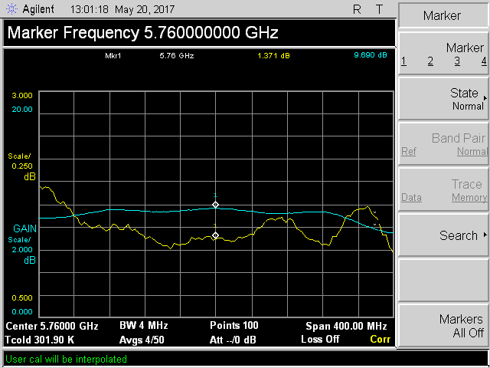
5.7 GHz
PA7JB
DJ9BV

Slide 19
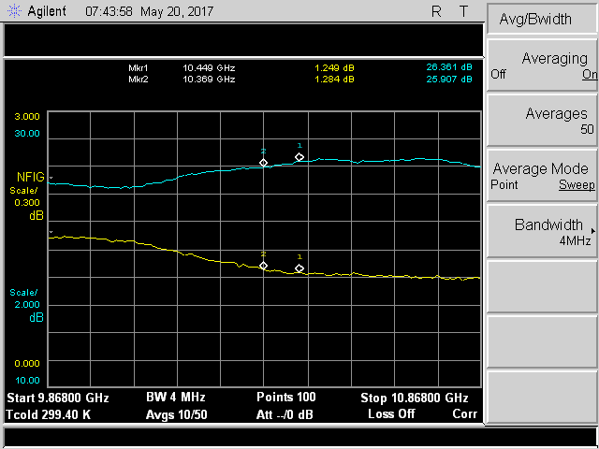
10‘368 MHz
SM3BYA
SM3BYA

Slide 20
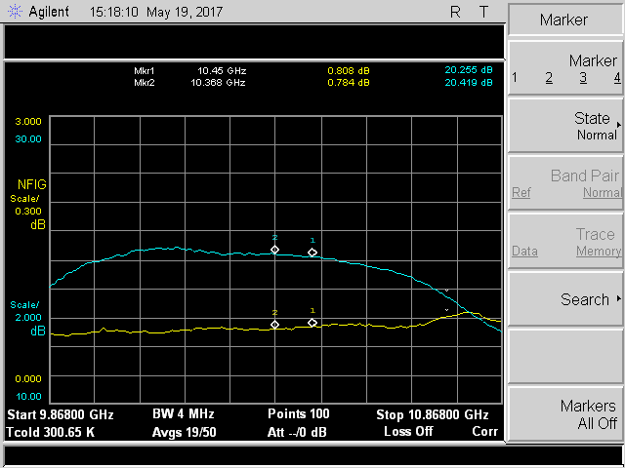
10‘368 MHz
HB9BBD
F1OPA #1615

Slide 21
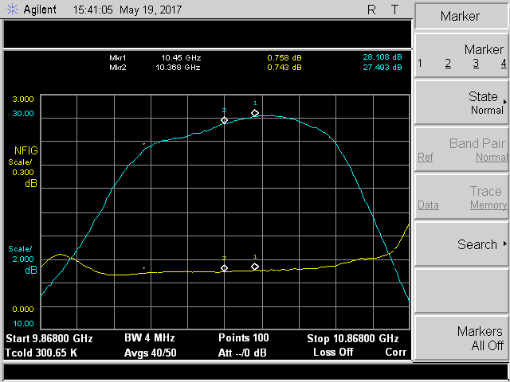
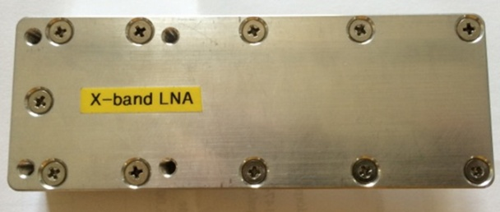
10‘368 MHz
HB9BBD
DL3BPC

Slide 22
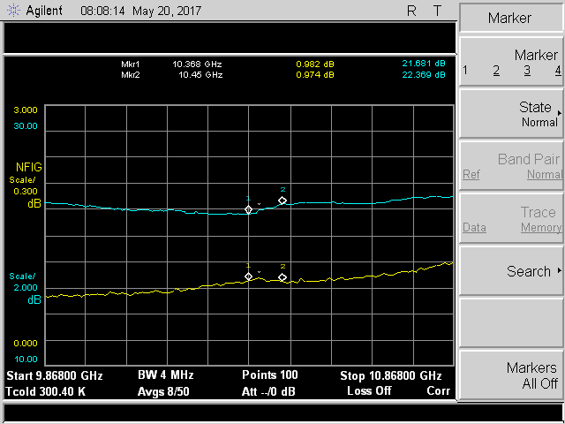
10‘368 MHz
HB9DUK
DB6NT

Slide 23
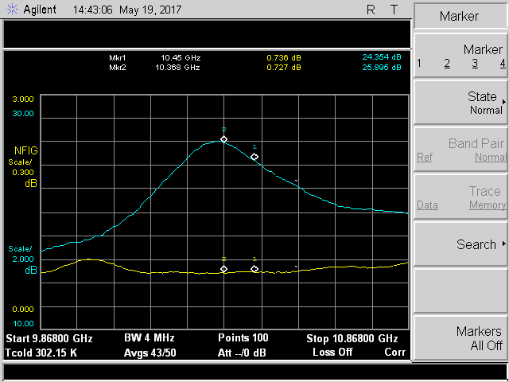
10‘368 MHz
HB9BBD
HB9BBD

Slide 24
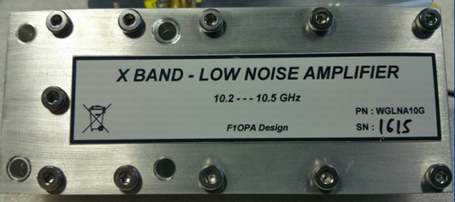
10‘368 MHz
HB9BBD
F1OPA #1615

Slide 25
10‘368 MHz
HB9DUK
Copy of DB6NT
No name

Slide 26
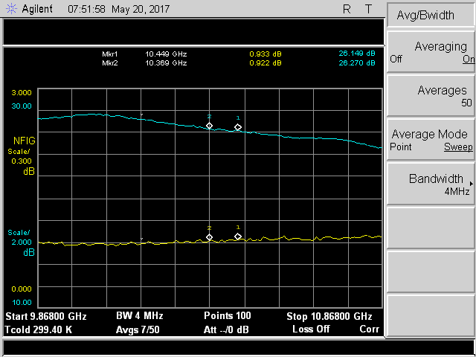
10‘368 MHz
HB9DUK
DB6NT

Slide 27
10‘368 MHz
OK1DFC
DB6NT

Slide 28
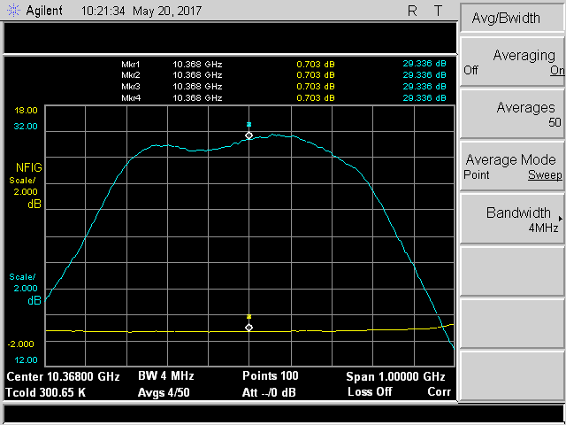
10‘368 MHz
PA2DW
DL3BPC

Slide 29
10‘368 MHz
OK1DFC
DB6NT

Slide 30
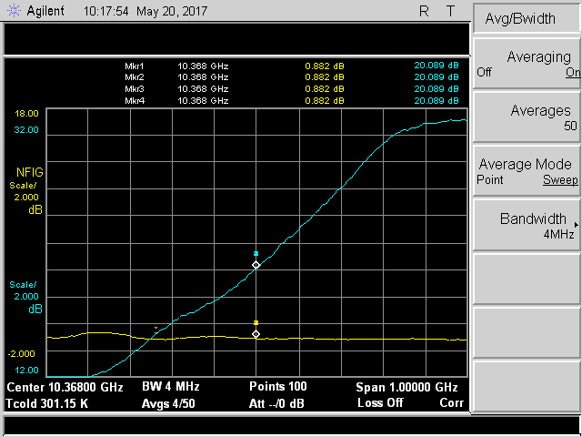
10‘368 MHz
SM2CEW
KU LNB

Slide 31
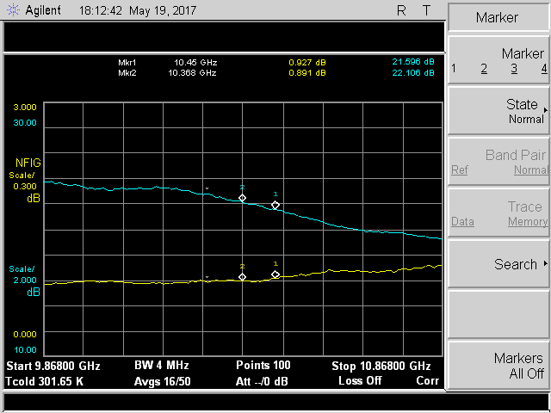
10‘368 MHz
UA3AVR
UA3AVR

Slide 32
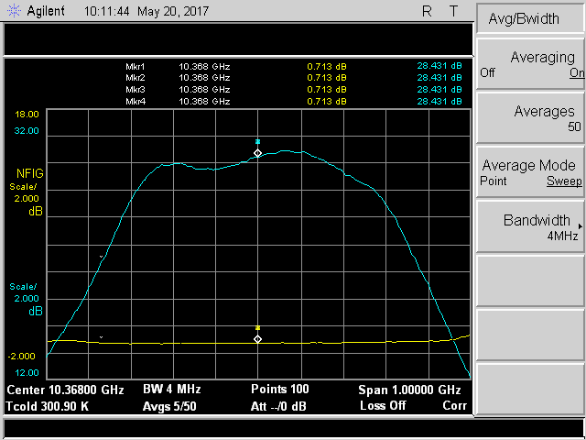
10‘368 MHz
SM7GEP
DL3BPC

Slide 33
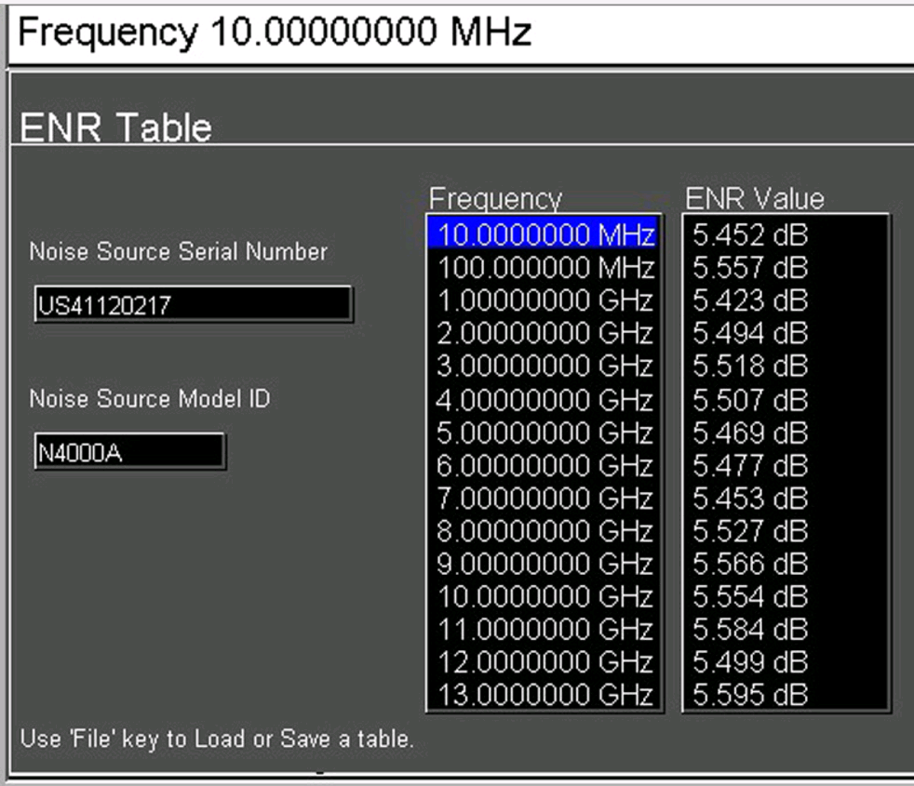
APPENDIX
ENR TABLES N4000A (HB9BBD)

Slide 34
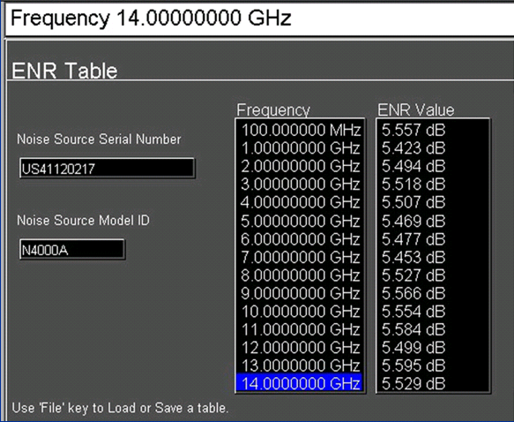
APPENDIX
ENR TABLES N4000A (HB9BBD)

Slide 35
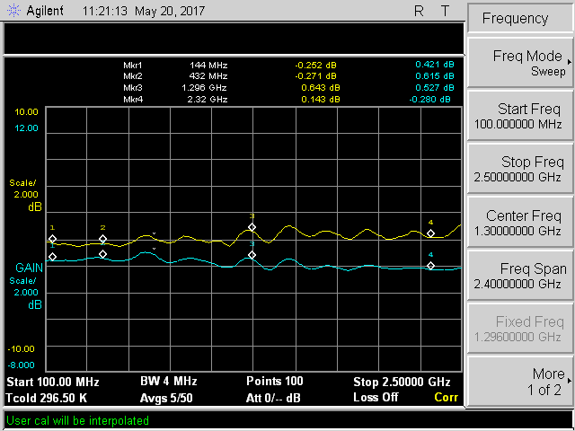
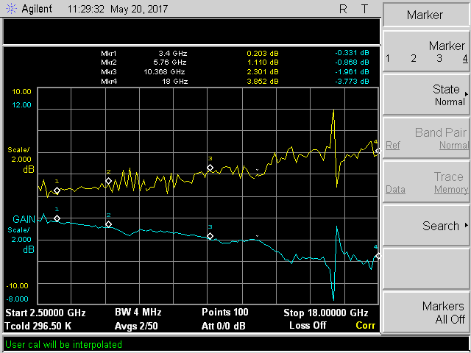
NOISE-HEADS: DL6SH

Slide 36
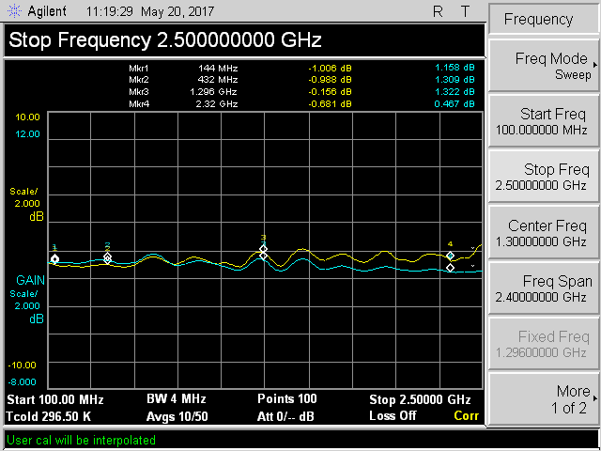
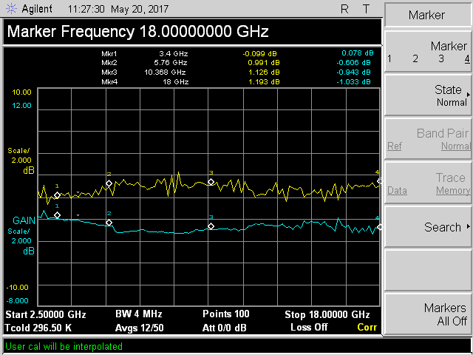
NOISE-HEAD: SM7FWZ

Slide 37
Questions ?

