Slide 1
PORTABLE MW EME 9 - 6 - 3 cm and EME DX pedition to Morocco October 2017
EME conference Örebro - May 20th 2017
Zdenek SAMEK – OK1DFC

Slide 2
Microwave portable EME is on the limit of possibilities!
Mainly size and quality of antenna is main limit of this traffic

Slide 3
So, what we need?
First accept that problem does not exist, just only challenge
We will need something where to install antenna and control it in AZ and EL.
Control antenna in real time and position
Choice right antenna
TRV with PLL LO and IF TRX with PLL LO
SW and accessories as GPS, SDR etc.
Make a QSO is just fun after all of that………

Slide 4
Schematic Diagram

Slide 5
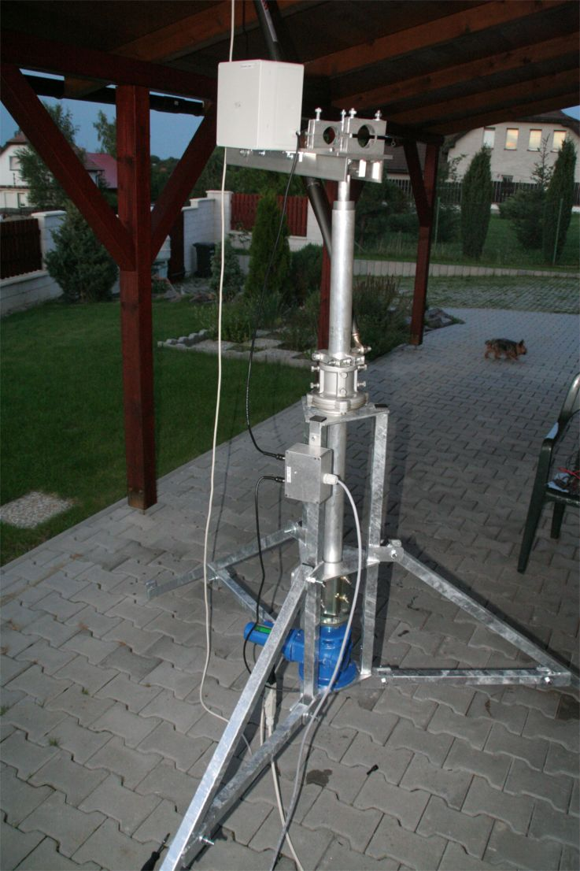
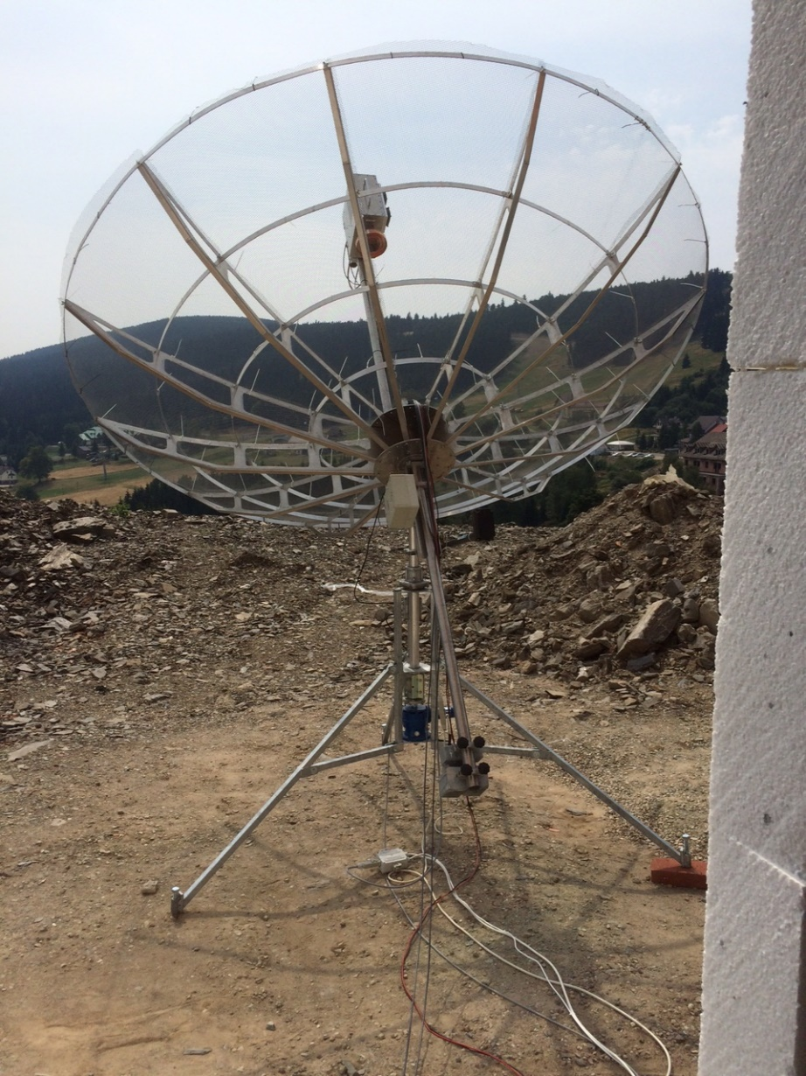
Azimuth and Elevation
Stability
Easy to build
Construction simple as possible
Zero back slash in AZ and EL

Slide 6
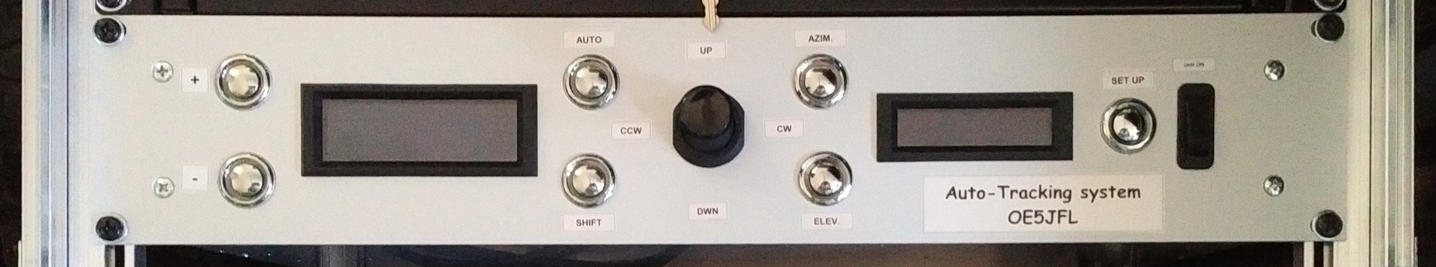
Control
OE5JFL
DF1SR
F1EHN
I have choice OE5JFL because options like this:
No PC required
Automatic time and location due to GPS module developed by Alex HB9DRI
Engine speed control for azimuth and elevation ON4BCB
Automatic correction of antenna position trough one button ON4BCB

Slide 7
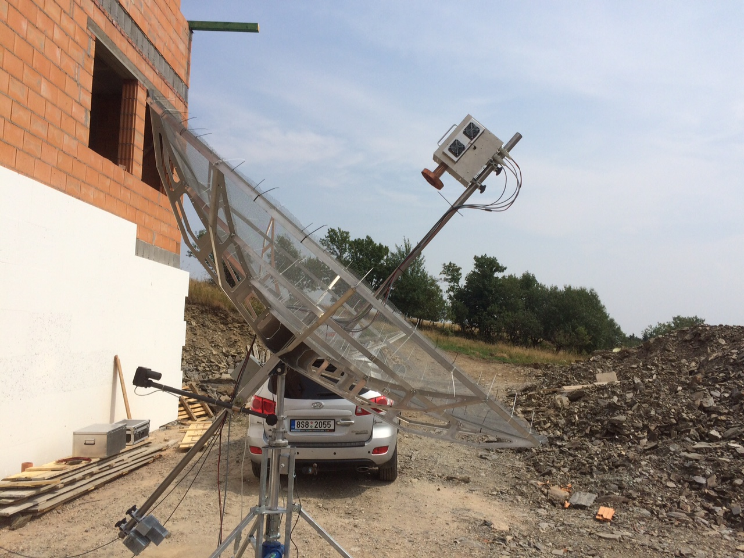
Antenna - Mesh dish
3,2m is usable for 432, 1296, 2320 MHz for 3400 MHz is problem with surface accuracy and 1,8m solid dish is giving almost same result

Slide 8
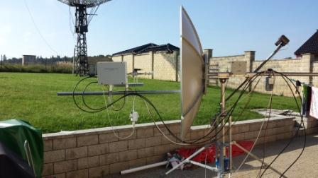
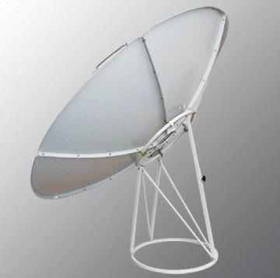
Antenna - Solid Dish 1st choice
180cm dish for satellite reception
F/D 0,38
Very good usable for 13 and 9cm............
BUT !!!!

Slide 9
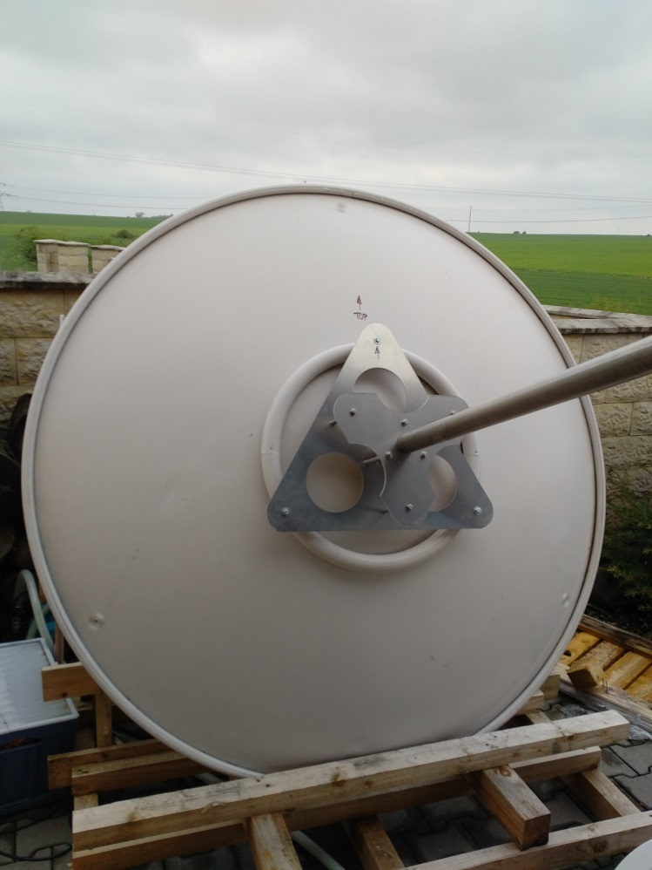
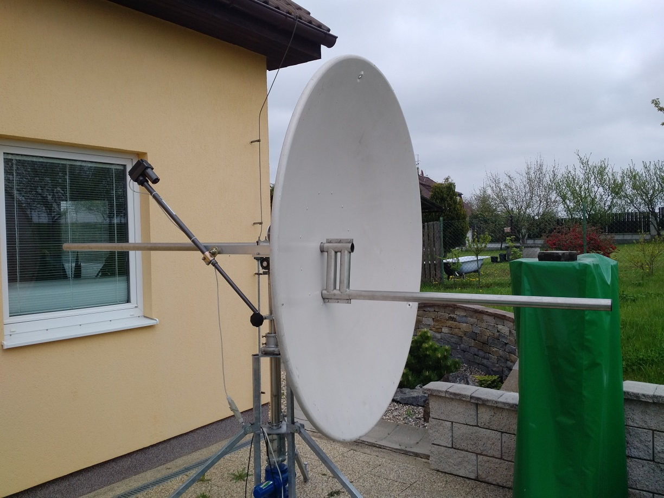
Antenna - Solid Dish 2nd choice
New dish courtesy of Eddy ON7UN
1,5dB Sun noise better as previous antenna on 10 GHz

Slide 10
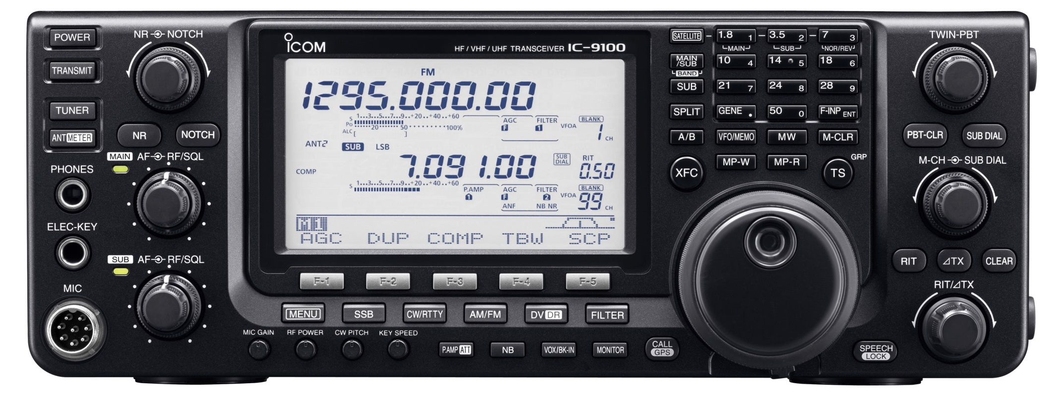
144 IF - 432 – 1296 MHz

Slide 11
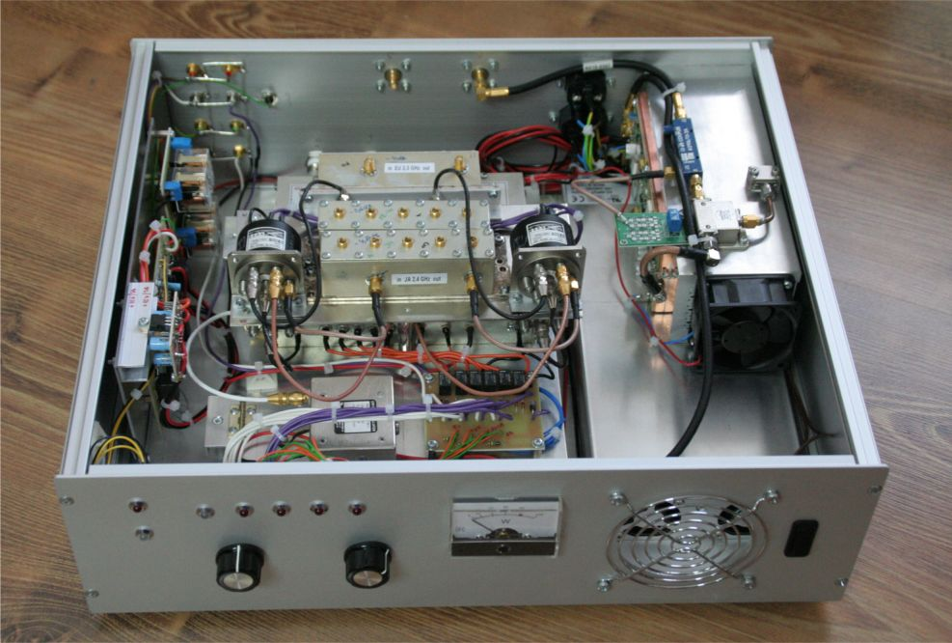
All band 2320 MHz

Slide 12
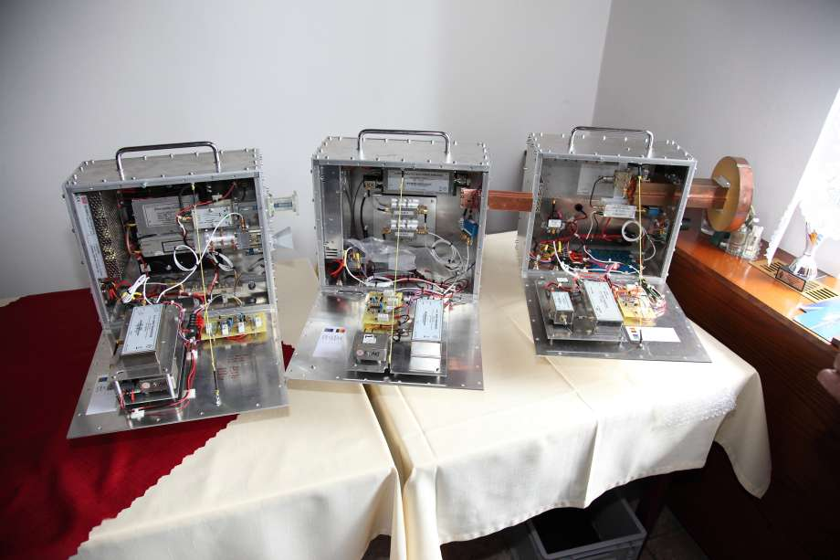
MW - TRVs

Slide 13
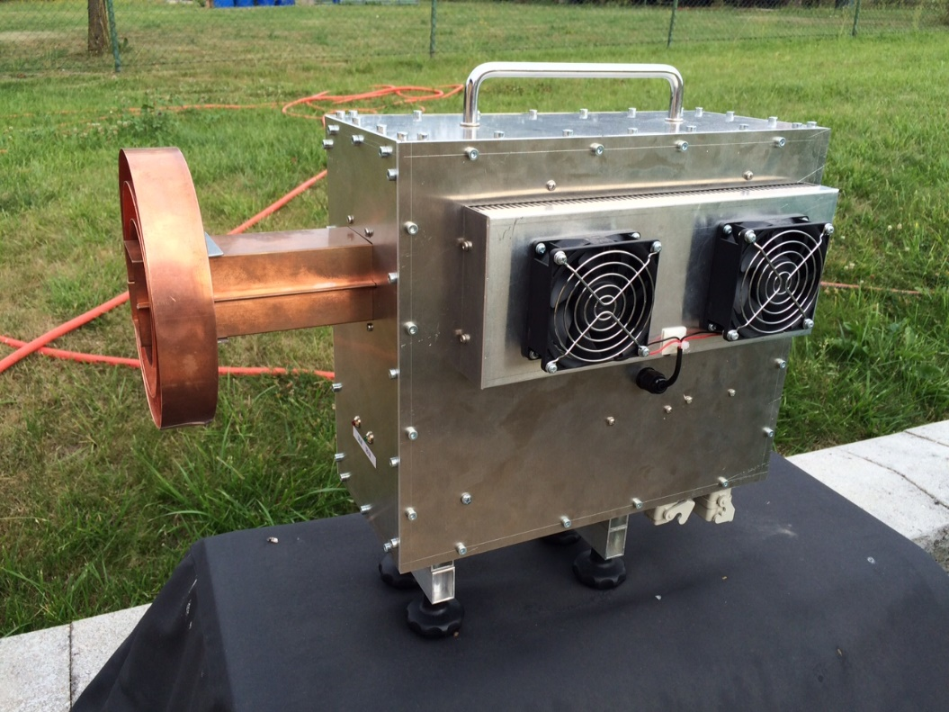
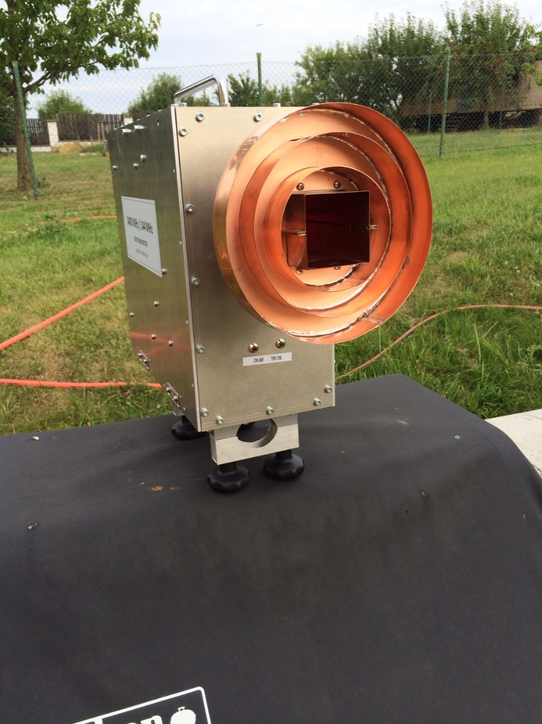
3400 MHz
100W RF
0,7dB N/F DB6NT
Septum feed OK1DFC and Chaparral ring

Slide 14
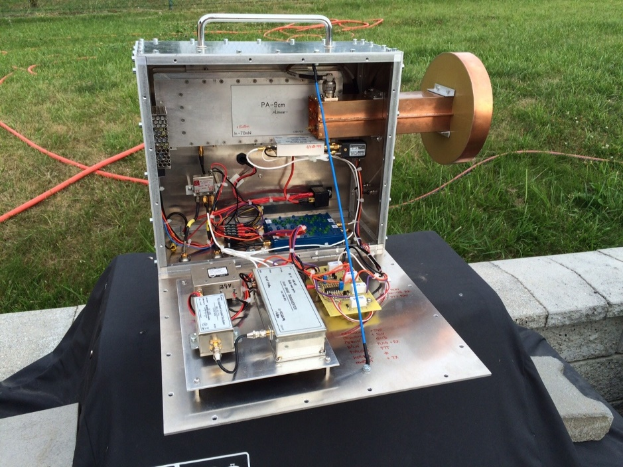
Opened TRV

Slide 15
HB9Q CQ EME 3400 MHz
PA3DZL EME QSO 3400 MHz
OK1KIR CQ RS 3400 MHz

Slide 16
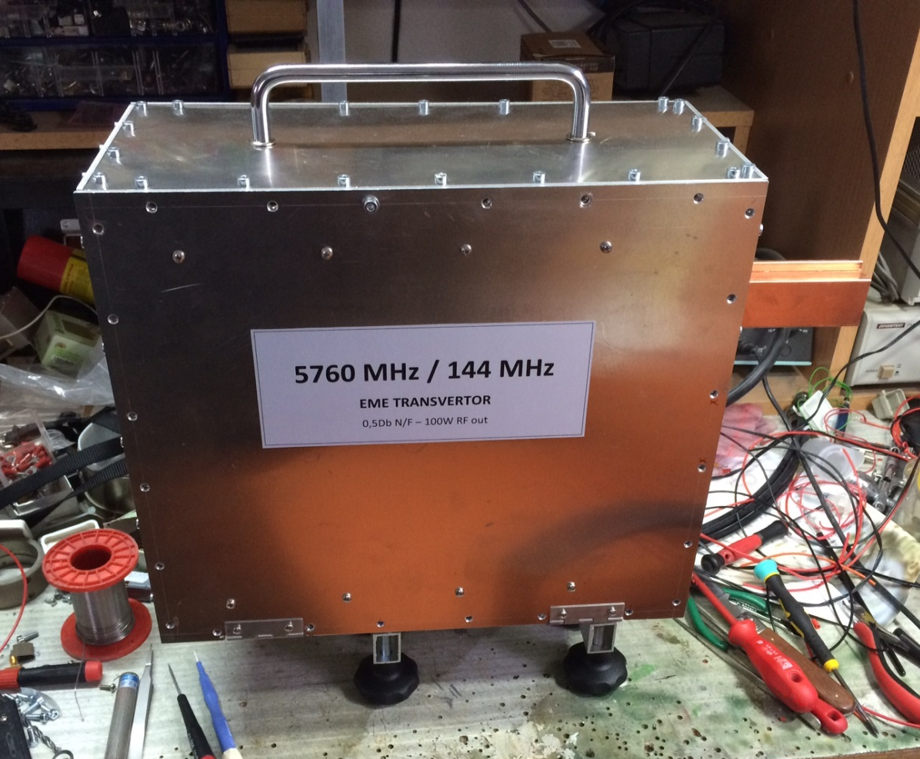
5760 MHz
100W RF DB6NT
0,9dB N/F DB6NT
Septum feed OK1DFC

Slide 17
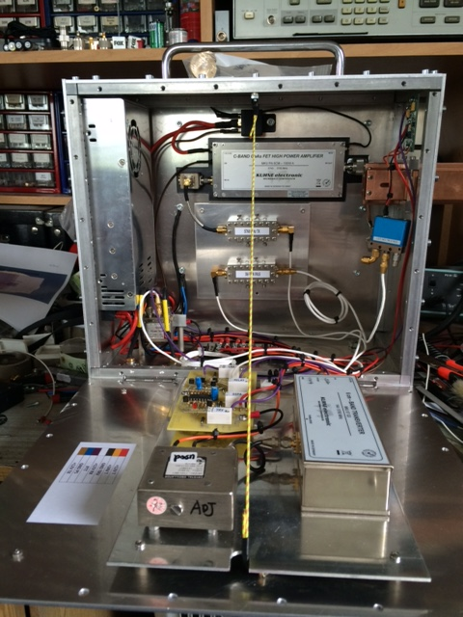
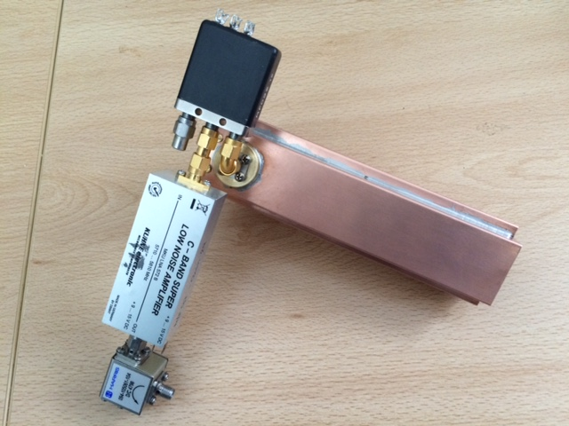
5760 MHz
Feed and VLNA detail
Internal construction

Slide 18
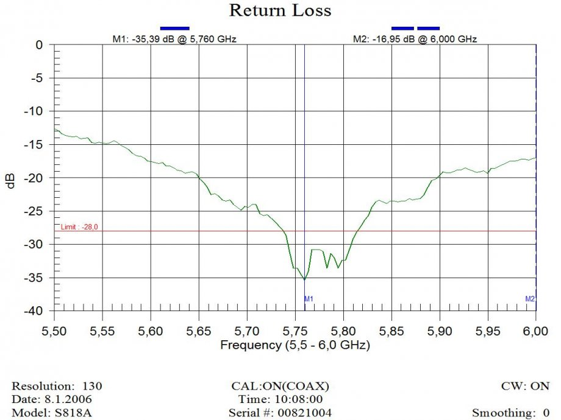
FEED SWR measuring

Slide 19
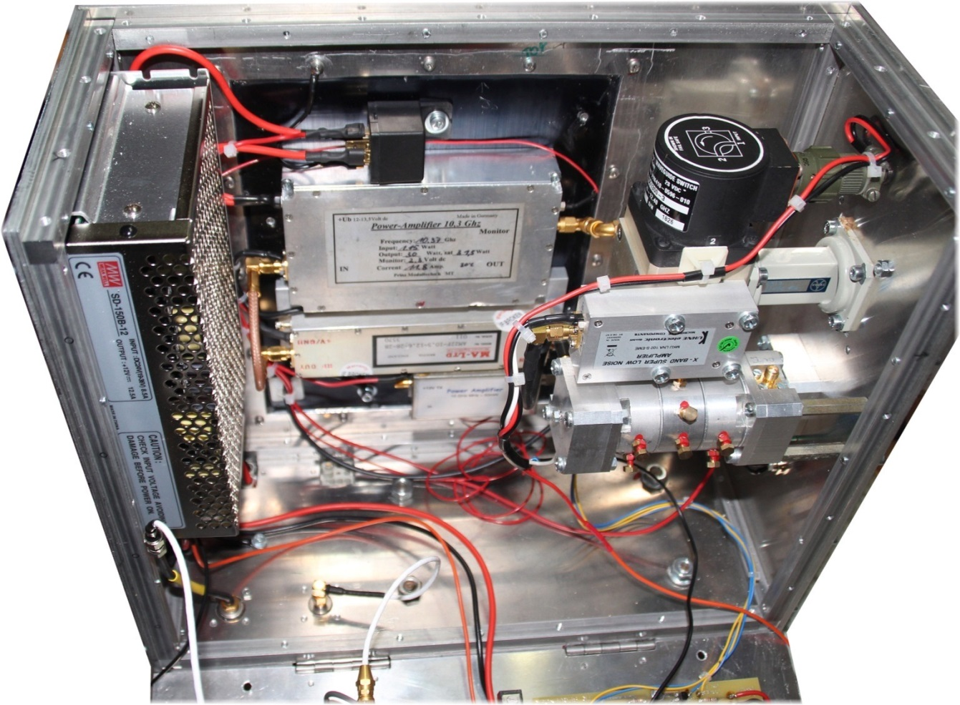
10368 MHz
52W RF – SSPA OK2AQ
0,6dB N/F LNA DU3BC
Linear feed V or H pol

Slide 20
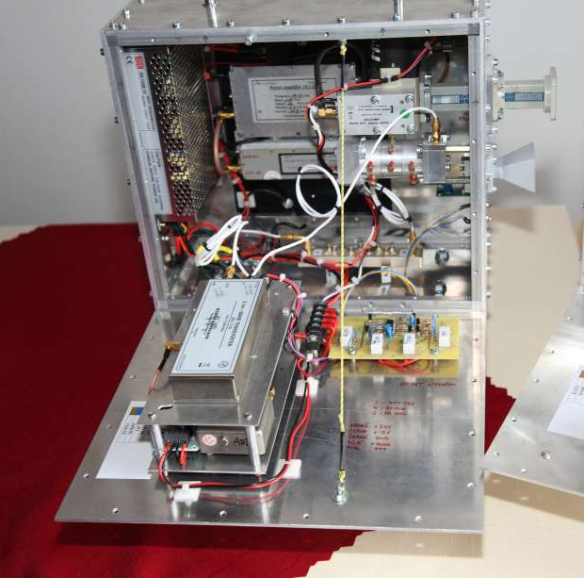
New TRV in Alu box and RF detection

Slide 21
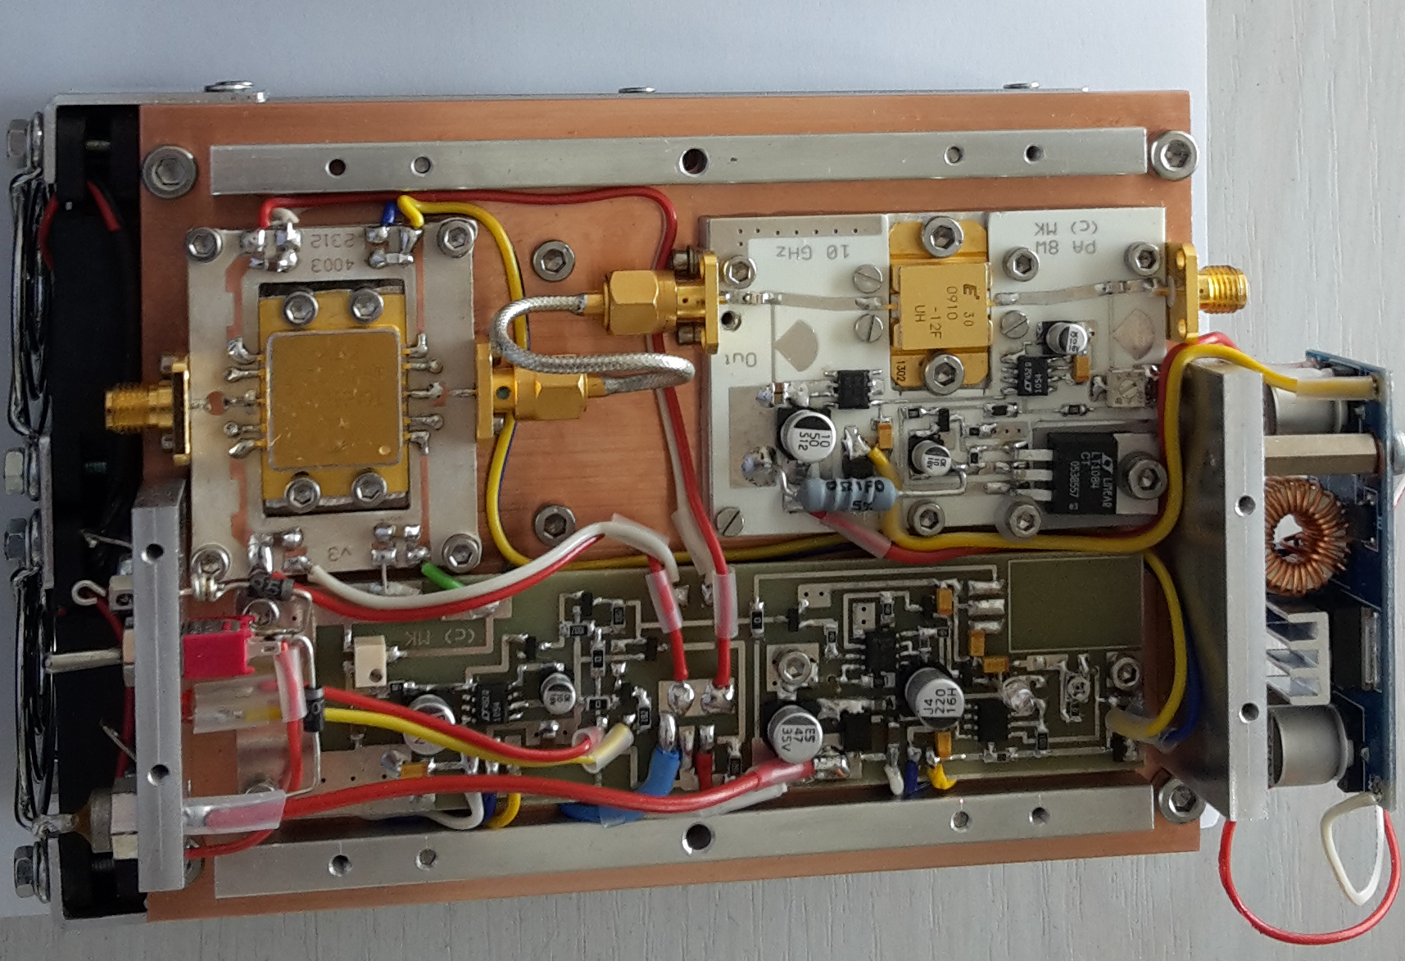
10368 MHz SSPA – OK2AQ

Slide 22
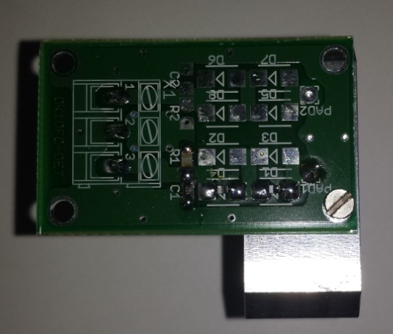
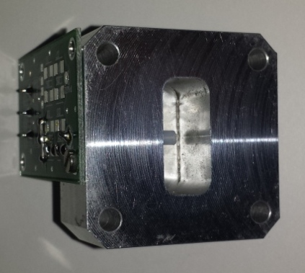
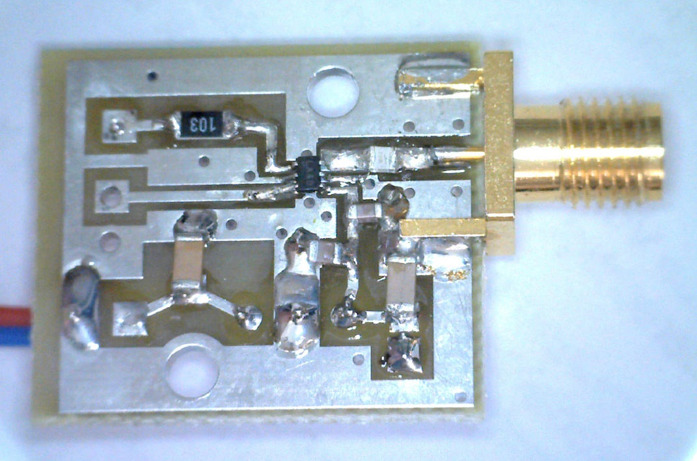
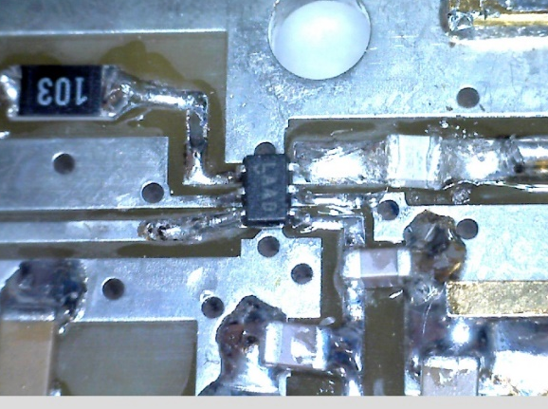
RF detection
Previous solution with diodes BAT15
New detection with W1GHZ design

Slide 23
RF detection LTC5508

Slide 25
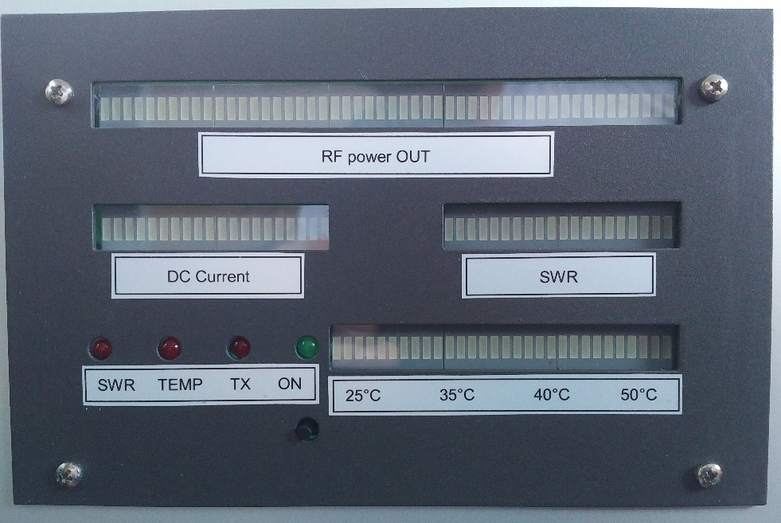
Current and Temperature detection

Slide 26
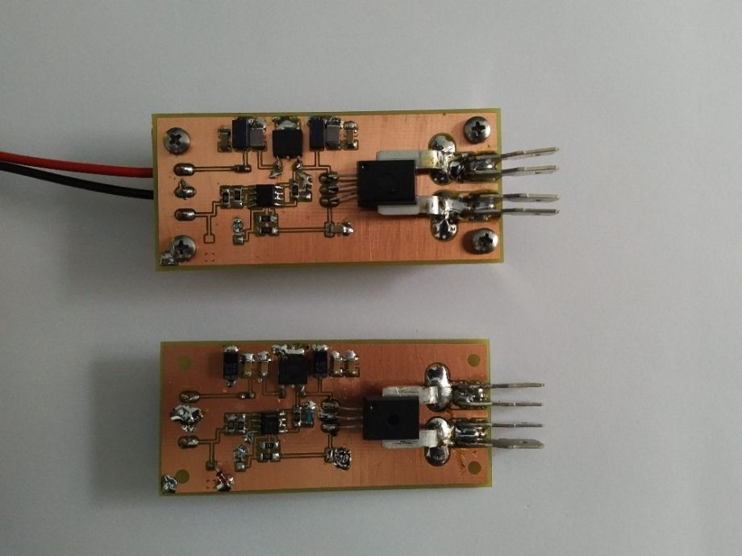
TRV current measuring
ACS 758 50A top - 100A bottom

Slide 27
TRV current measuring
ACS 758 unit

Slide 28
TRV temp. measuring
LM 35 unit

Slide 29

IC9100, Sequencer, Measuring and controll,
19“box

Slide 30
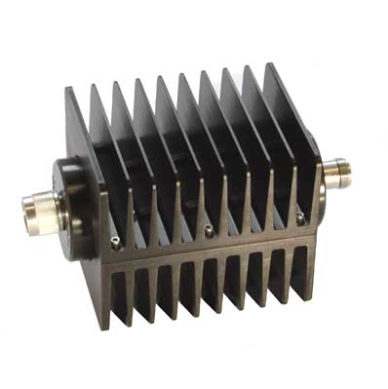
IF unit
Previous - IC756 PROII - 28MHz
Necessary to have other small 2m TRV
Not so good SDR part
Now - IC9100 - 144 - 432 - 1296 MHz direct MW are goes trough TRVs
Internal TCXO 3ppm
Possible to lock with 10 MHz GPS normal
20dB ATT because maximum RF power
for accidently connected TRV or RF peeks with full RF is only 1W maximum !!!

Slide 31
IC9100 a PLL LO GPS
Solution by David VK3HZ
Thanks to this PLL system I was in the sked with Charlie G3WDG only -12Hz from QRG on 10368 MHz !!!

Slide 32
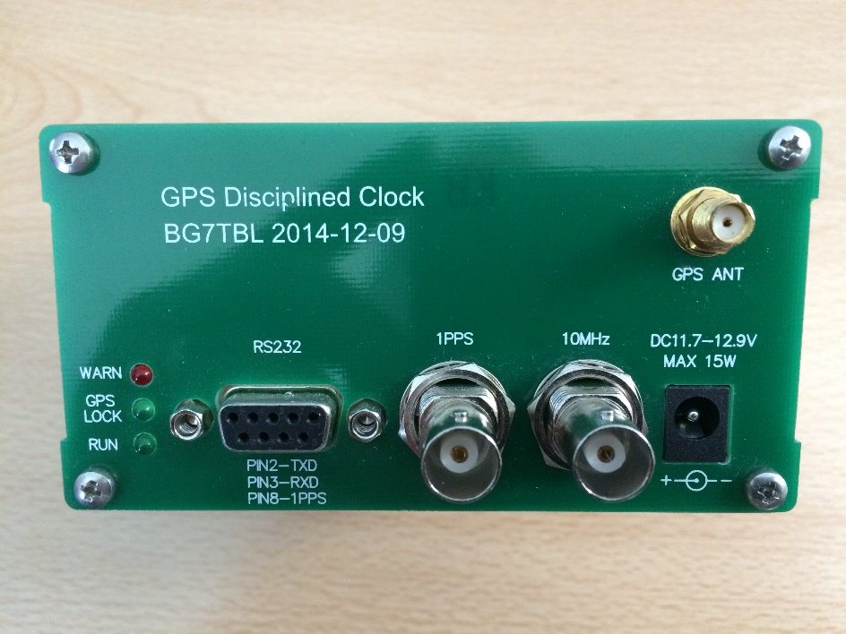
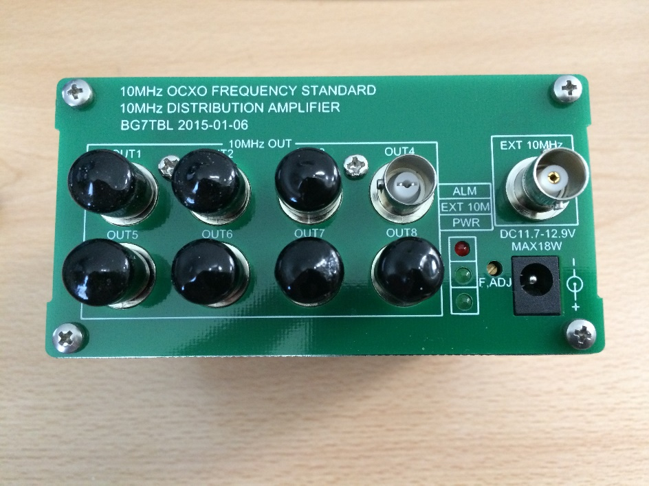
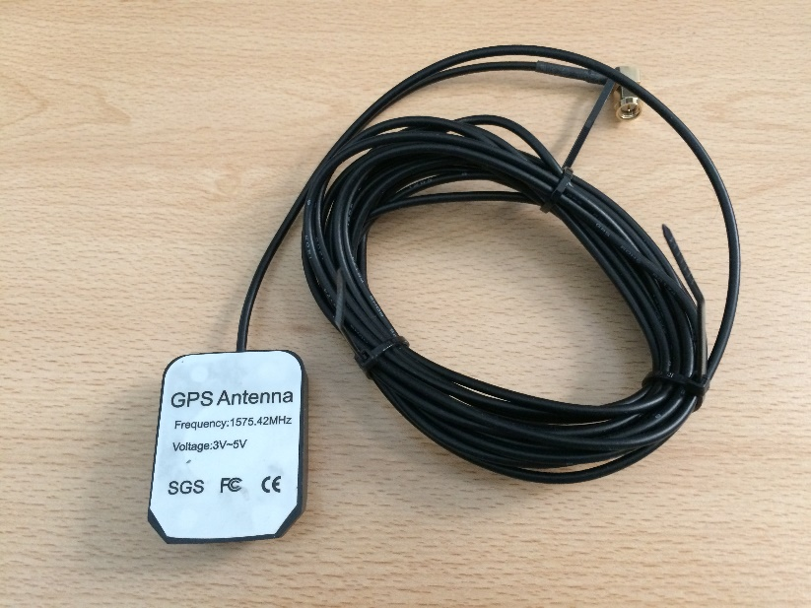
PLL GPS 10MHz

Slide 33
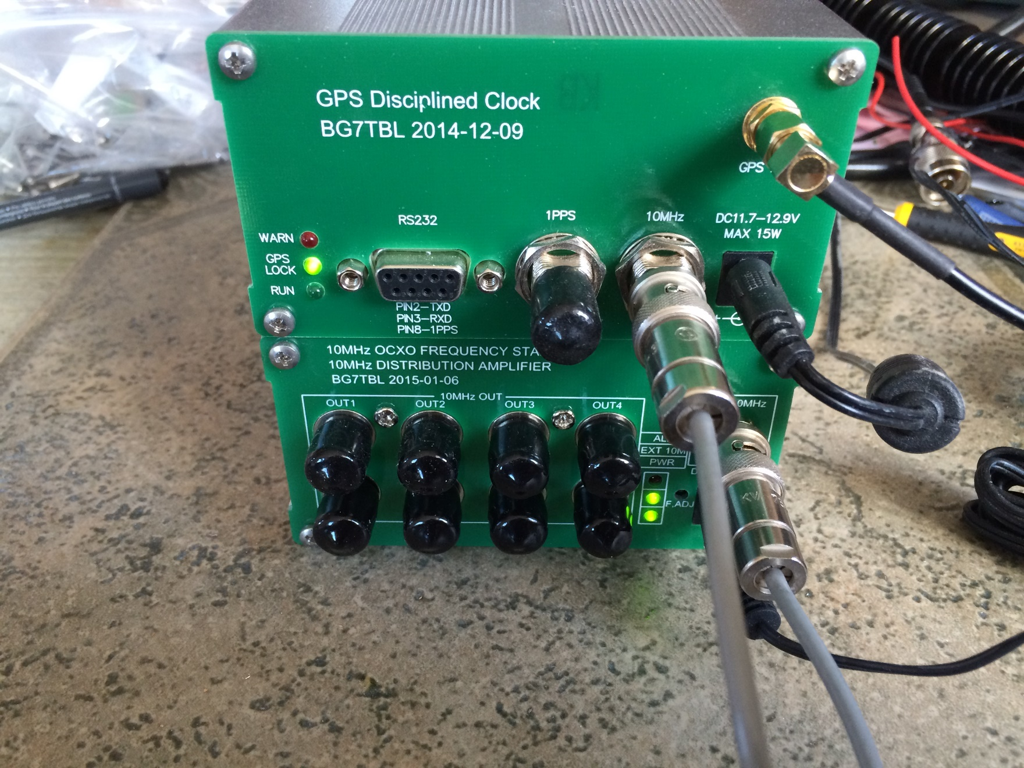

Slide 34
SW and accessories
SDR – 14
Signalhound
PC – with good RAM
GPS for PC clock control
GPS – 10 MHz for PLL LOs
JT SW – JT65C - JT4F 10 GHz etc.
WSJT-X - automatic Doppler correction
SDR HD SW and Spectrawiev SW
MicroHam USB interface

Slide 35
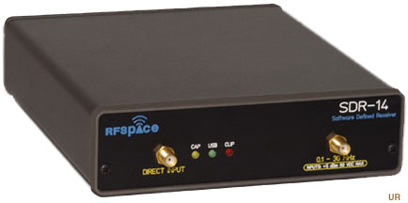
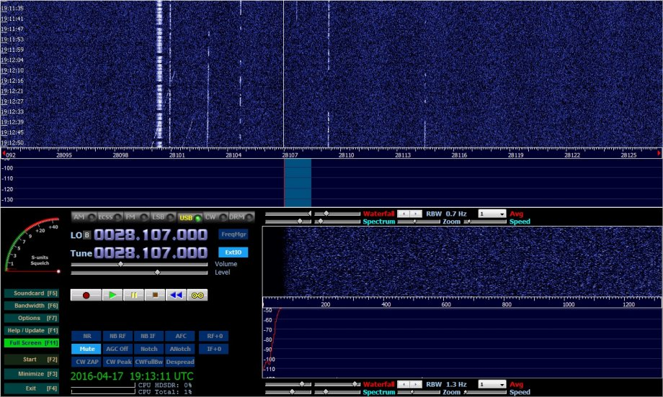
SDR

Slide 36
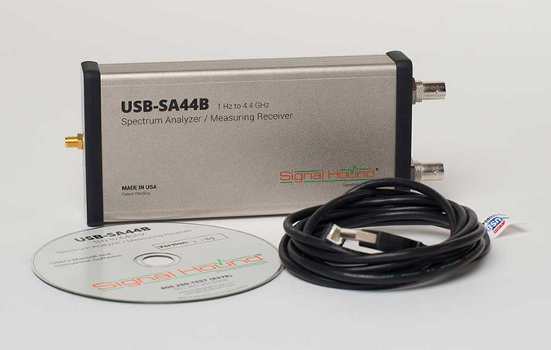
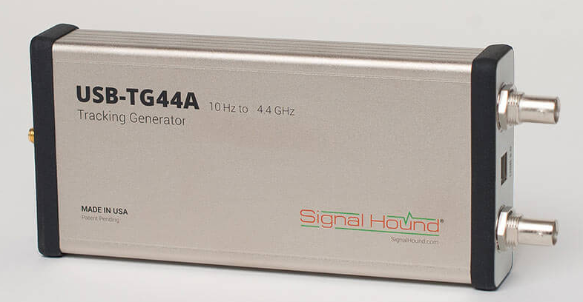
Signalhound 10Hz-4,4GHz
Spectrum analyzer and tracking generator
Possible to lock with GPS 10 MHz
Tracking works also as a CW generator
Possible to use as a SDR RX up to 9cm

Slide 37
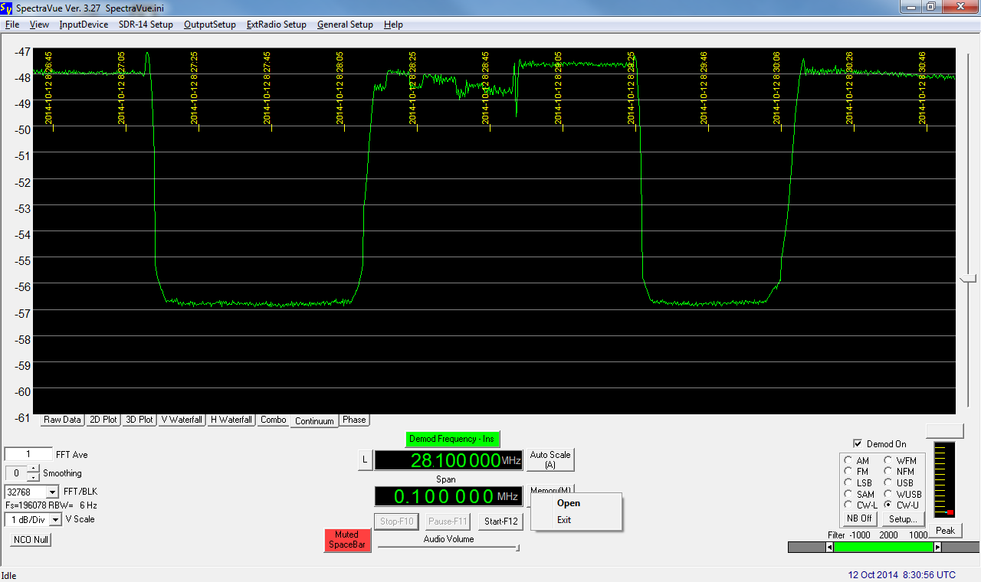
SW a QSO

Slide 38
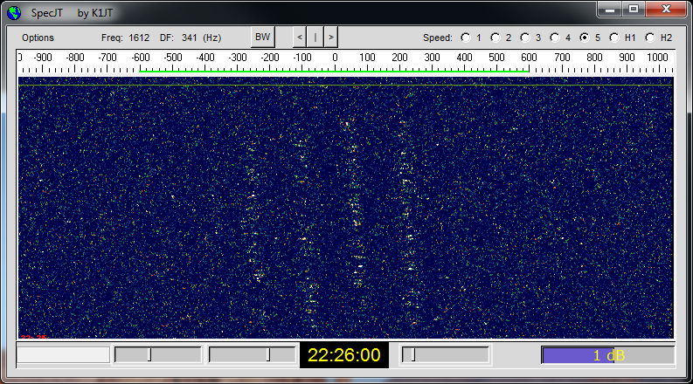

Slide 39
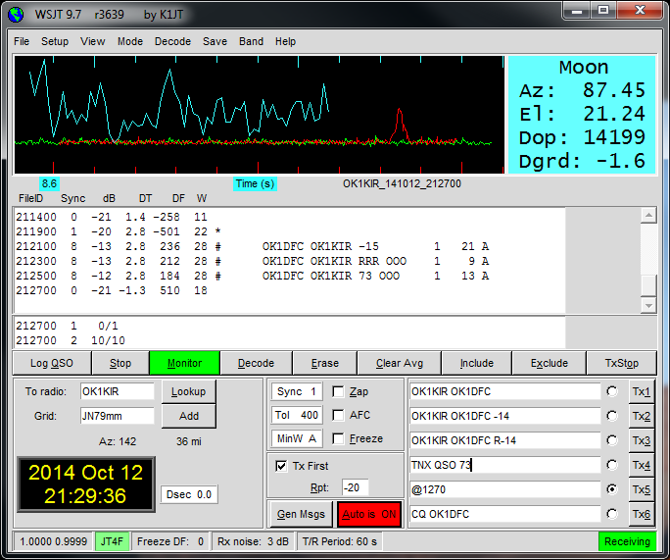

Slide 40
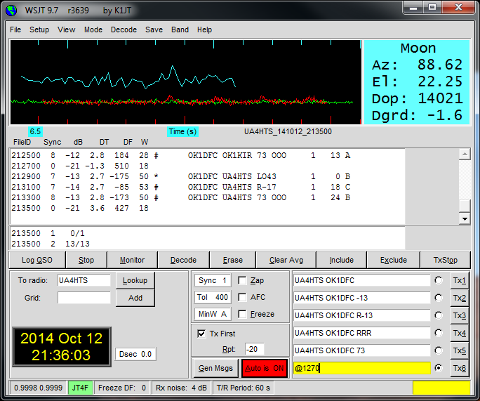

Slide 41
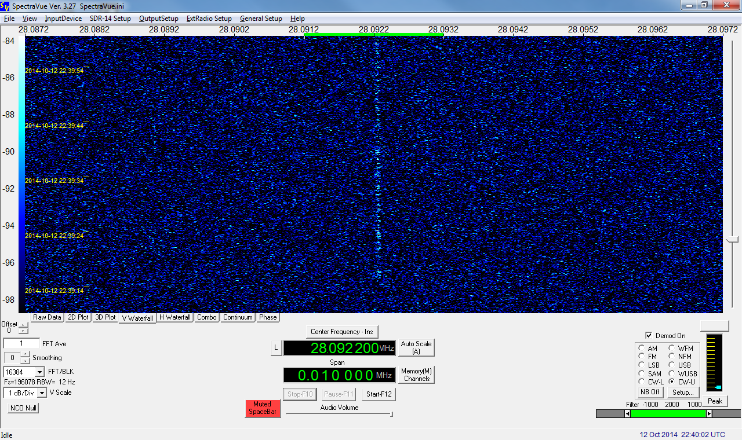

Slide 42
Thank you for your attention and see you via Moon as CN1EME or CN2R

