Slide 1
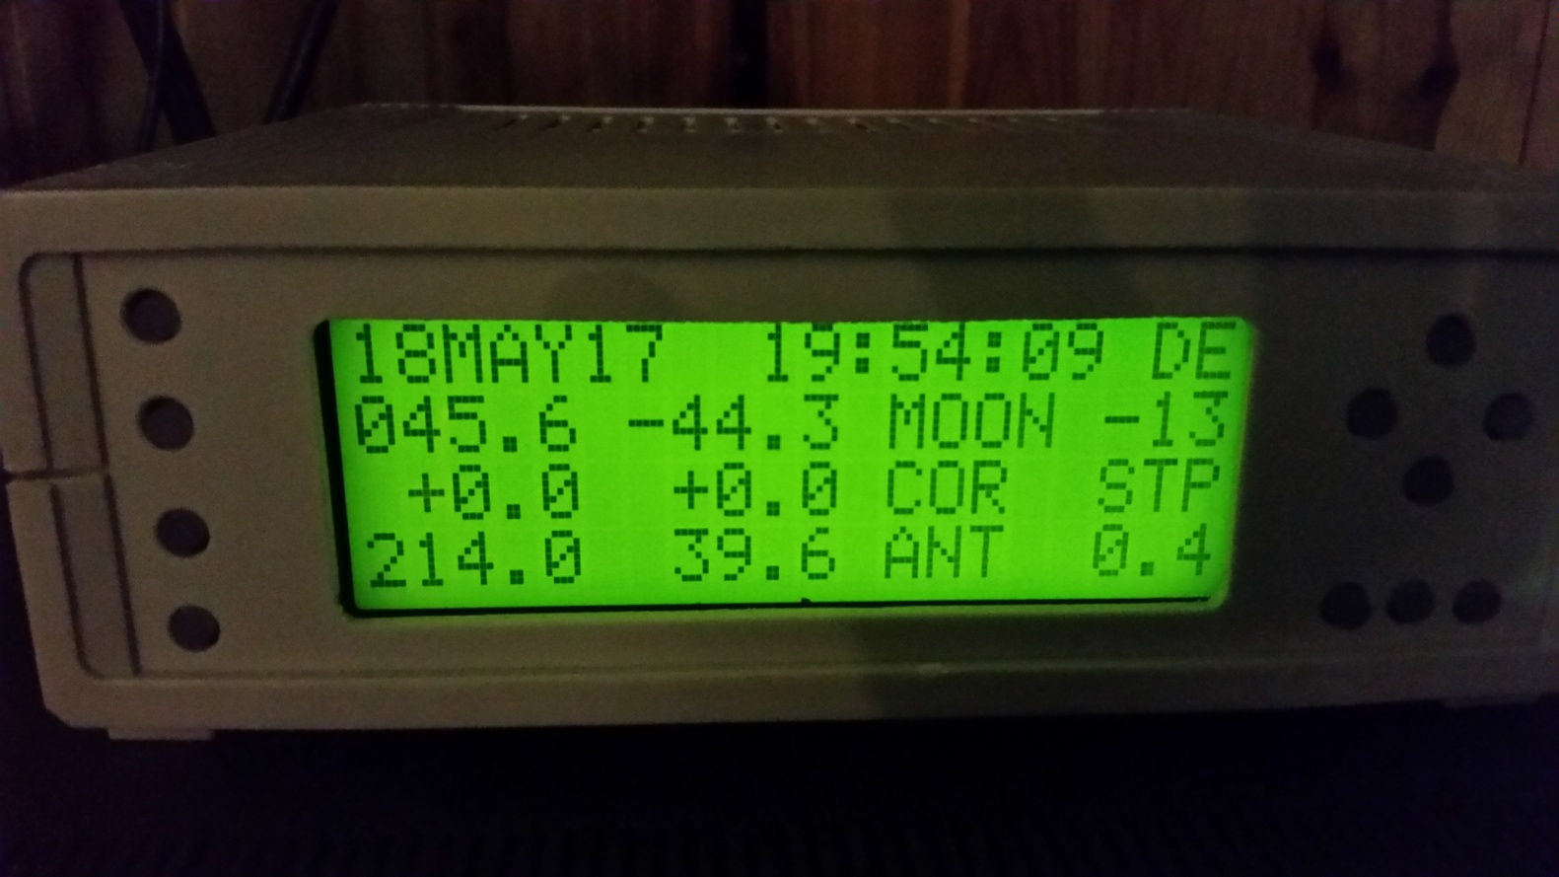
OE5JFL Antenna controller DIY (ON4BCB)
© 2017 ON4BCB Walter Crauwels

Slide 2
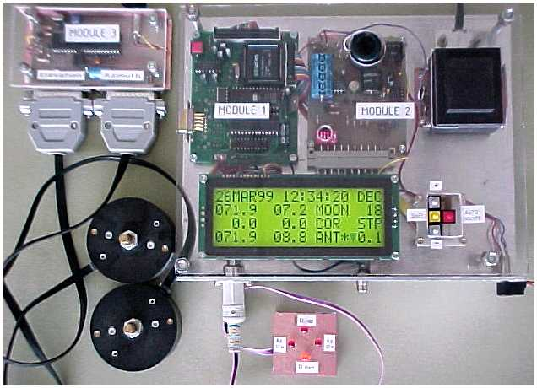
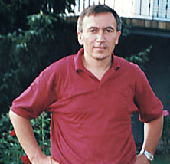
OE5JFL V1
The original V1 (obsolete)
© 2017 ON4BCB Walter Crauwels

Slide 3
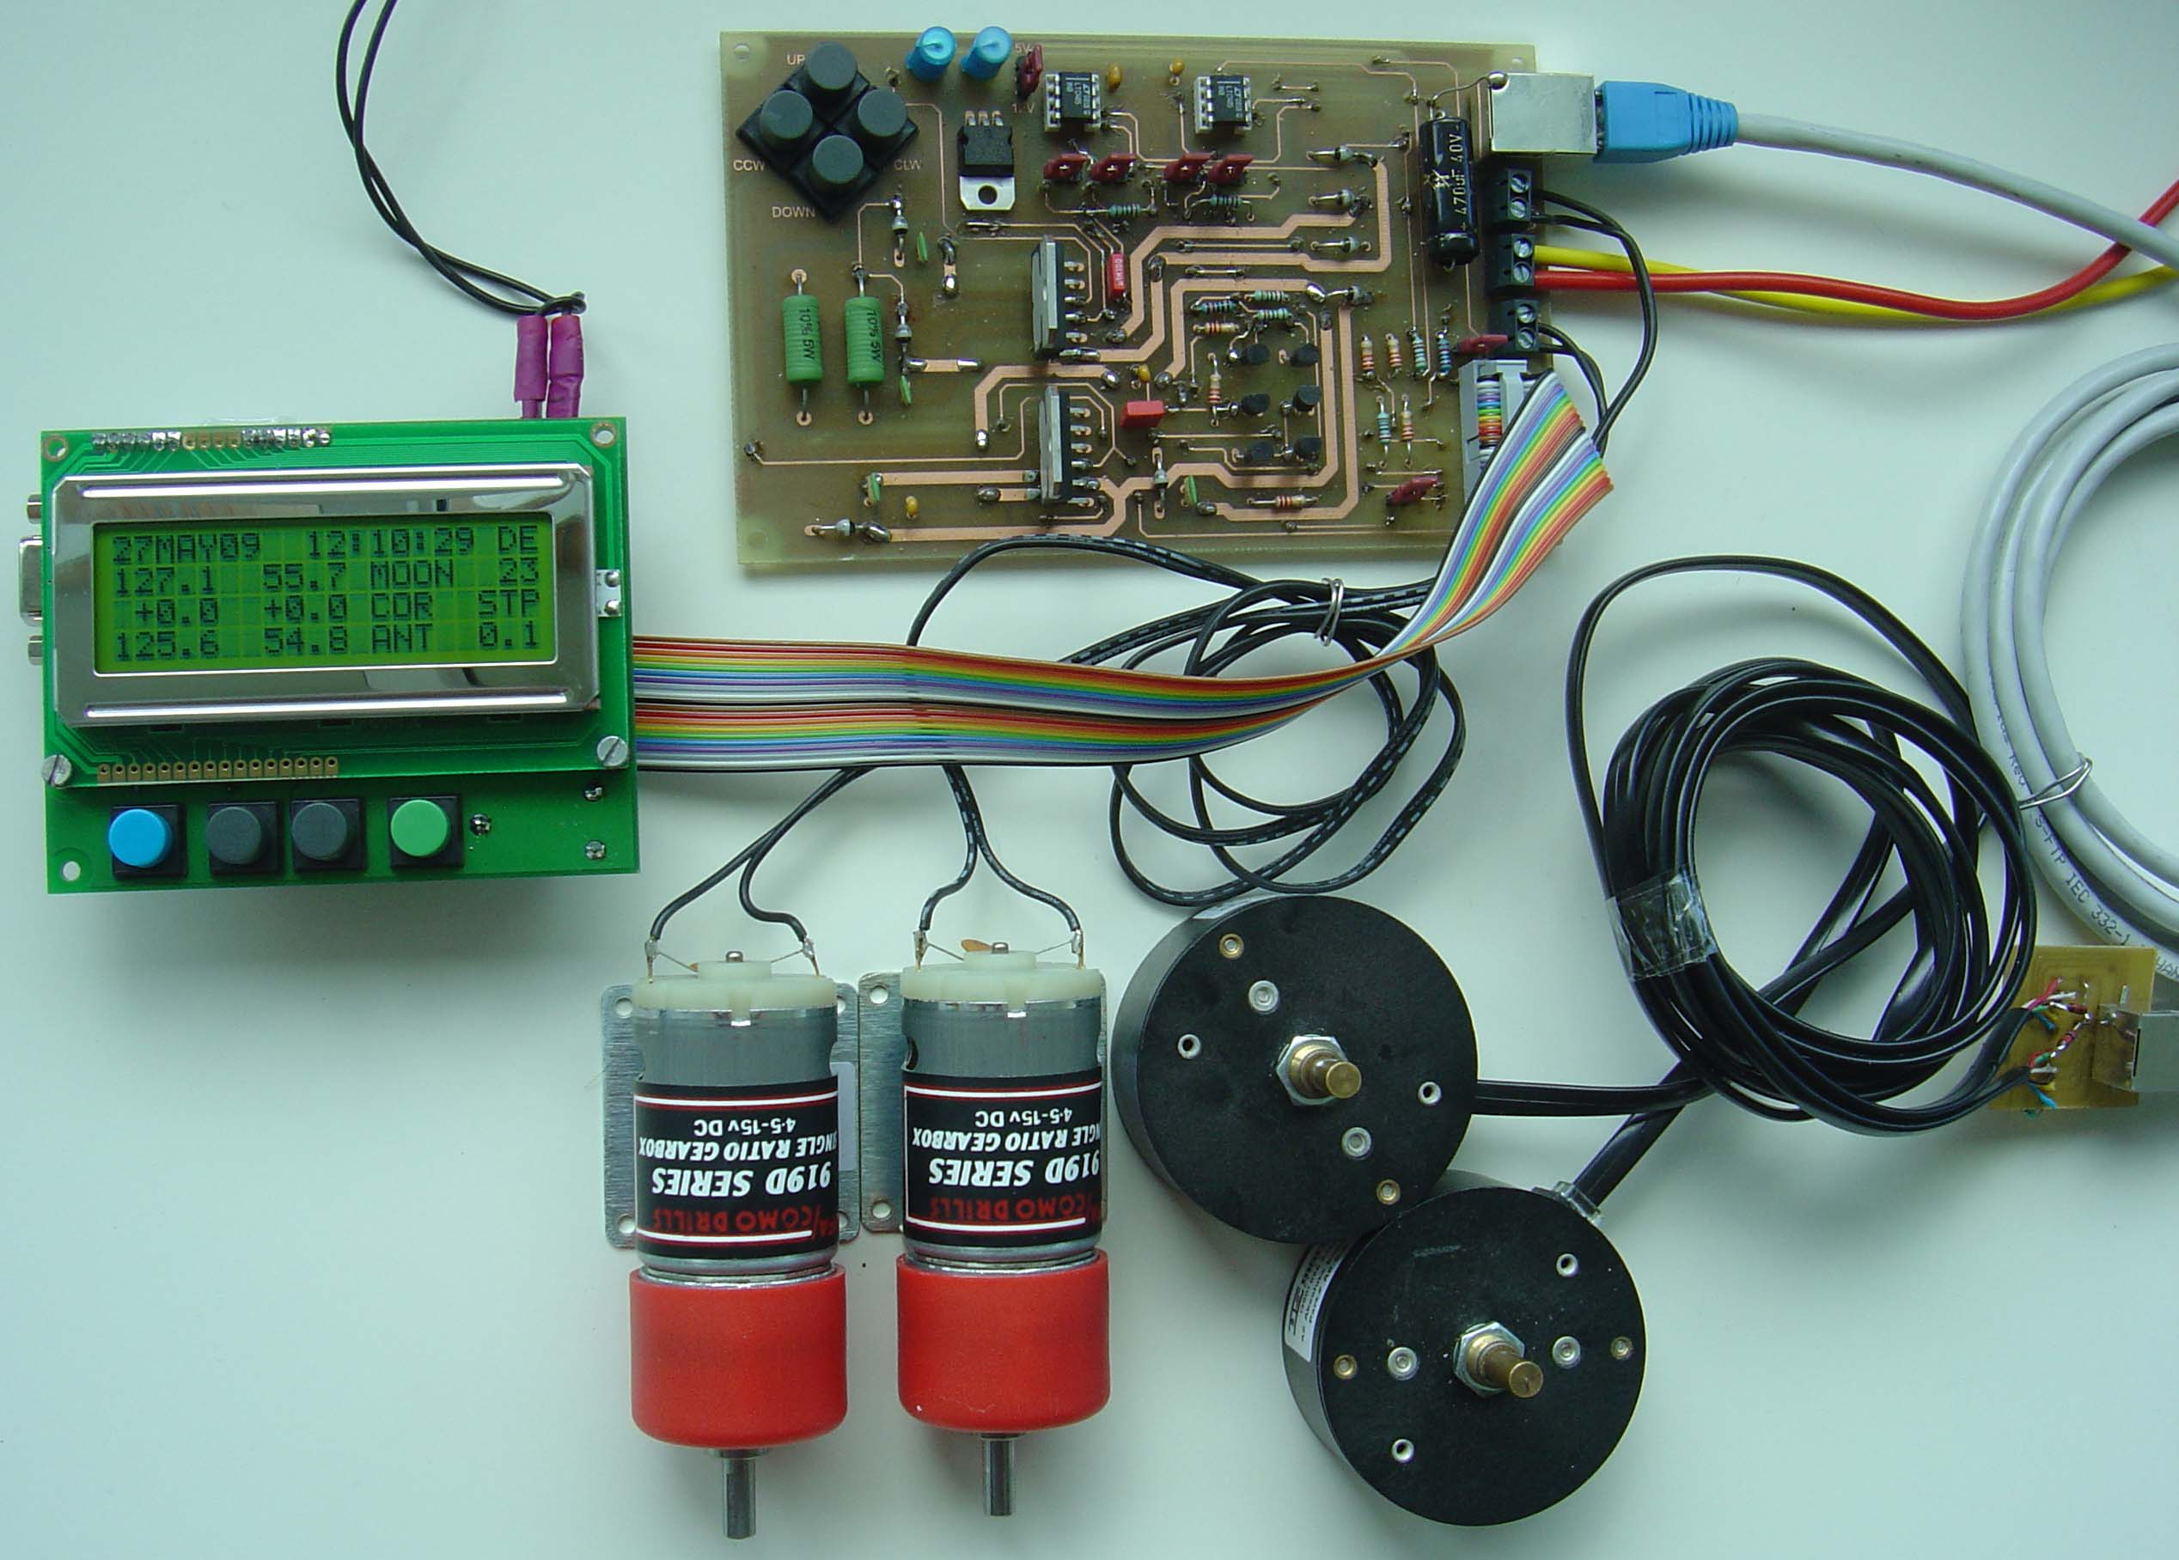
OE5JFL V2
The original V2
© 2017 ON4BCB Walter Crauwels

Slide 4
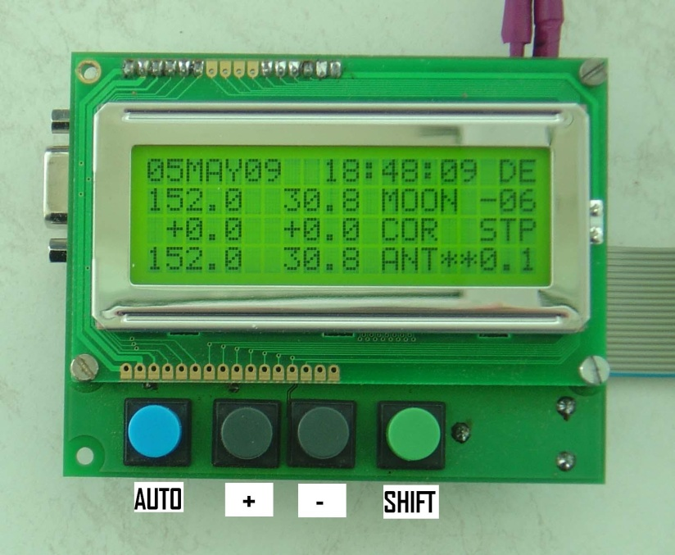
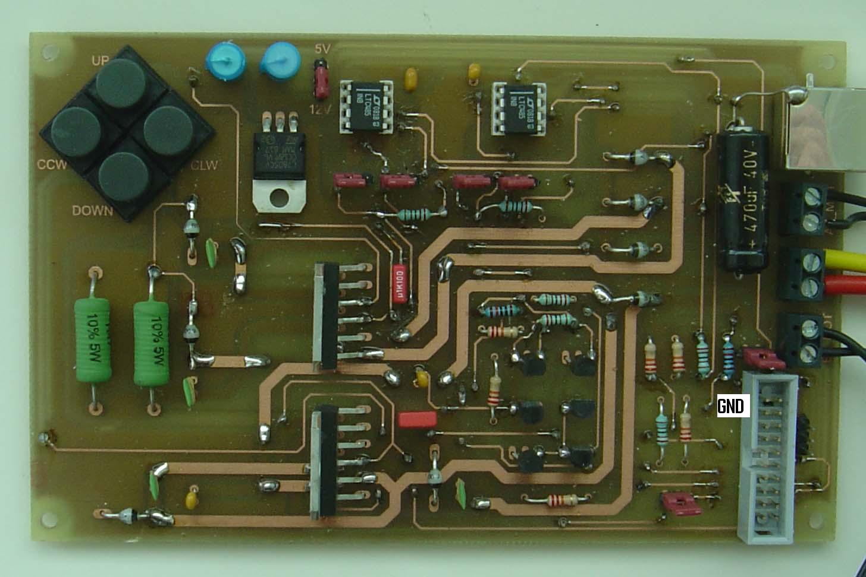
OE5JFL controller
Controller board:
Interface board
© 2017 ON4BCB Walter Crauwels

Slide 5
Main features:
Tracking of moon,sun,Cygnus,Sagittarius,Cassiopeia,Taurus,Leo and Aquarius
Azimuth and elevation motor controlling for all targets plus two free choice positions
Transmission of antenna position via LAN cable from antenna down to the controller in the shack
Interfacing with different absolute encoders is possible: 10..12bit
A2-S-S, MAB25, Prosistel inclino,HH-12 DF1SR
© 2017 ON4BCB Walter Crauwels

Slide 6
Main features:
Selectable stepsize for tracking
Selectable offset for azimuth and elev. up to +/- 9.9 deg
Motor control output clw/ccw up/down, including soft-start and soft-stop
Local operation by 4 buttons at controller, non volatile storage of all parameters
Real - Time – Clock + 4 x 20 character LCD – display
DC motor H-bridges for AZ and EL
© 2017 ON4BCB Walter Crauwels

Slide 7
NEW features:
Automatic calibration of the encoders by Sun or Moon
Support of new encoders (MAB28,ETS25,Positel inclino)
PWM speedcontrol in manual mode with CW,CCW,UP,Down buttons
© 2017 ON4BCB Walter Crauwels

Slide 8
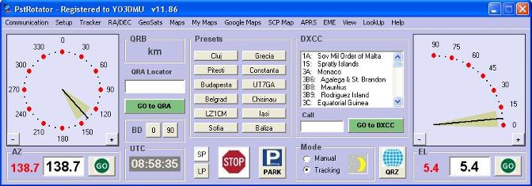
Software control:
Software control by PST rotator (YO3DMU)
Interfacing to any tracking program (DDE)
© 2017 ON4BCB Walter Crauwels

Slide 9
OE5JFL Antenna controller DIY (ON4BCB)
© 2017 ON4BCB Walter Crauwels

Slide 10
OE5JFL DIY ON4BCB
A single layer PCB (large tracks + wire jumpers) => DIY
External H-bridges (high power, low cost)
USB => to serial converter
PCB headers for external buttons and leds
All new features present on PCB headers
Almost all components thruehole & DIL
© 2017 ON4BCB Walter Crauwels

Slide 11
OE5JFL DIY ON4BCB
Megatron encoders via a PCB header (use own connectors)
US-digital via external interface OE5JFL compatible RJ45
IC buffered inputs and outputs (encoders & H-bridges)
LCD via PCB header (large LCD possible 4x20)
© 2017 ON4BCB Walter Crauwels

Slide 12
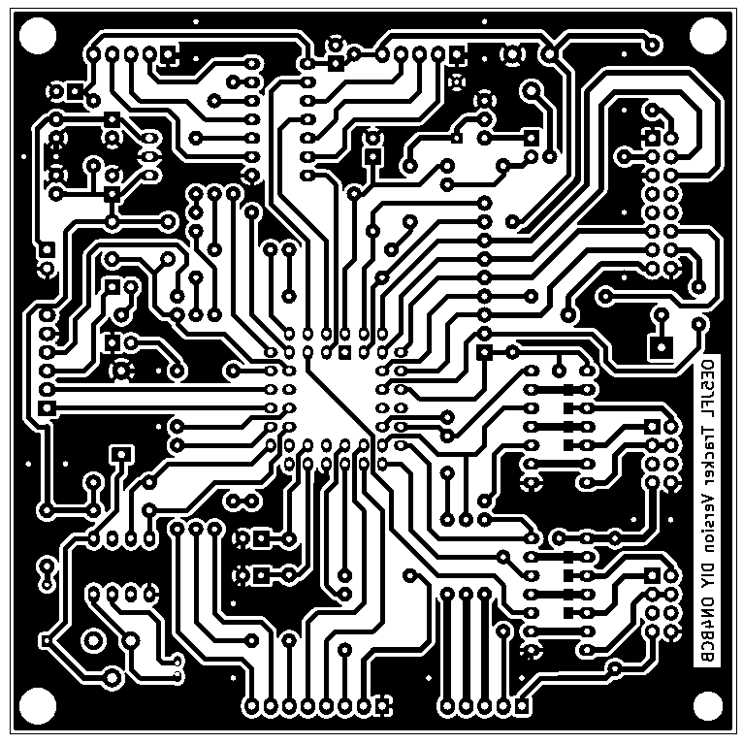
PCB layout
© 2017 ON4BCB Walter Crauwels

Slide 13
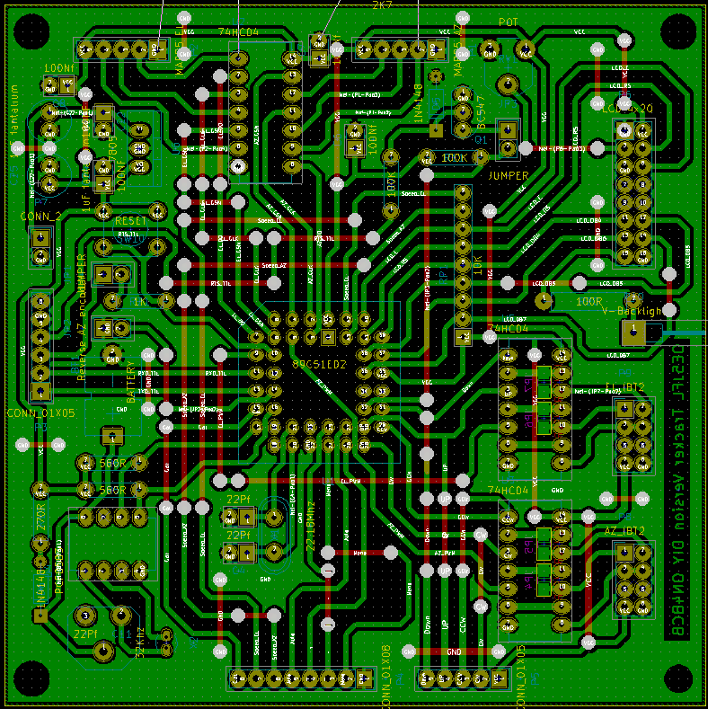
PCB layout
© 2017 ON4BCB Walter Crauwels

Slide 14
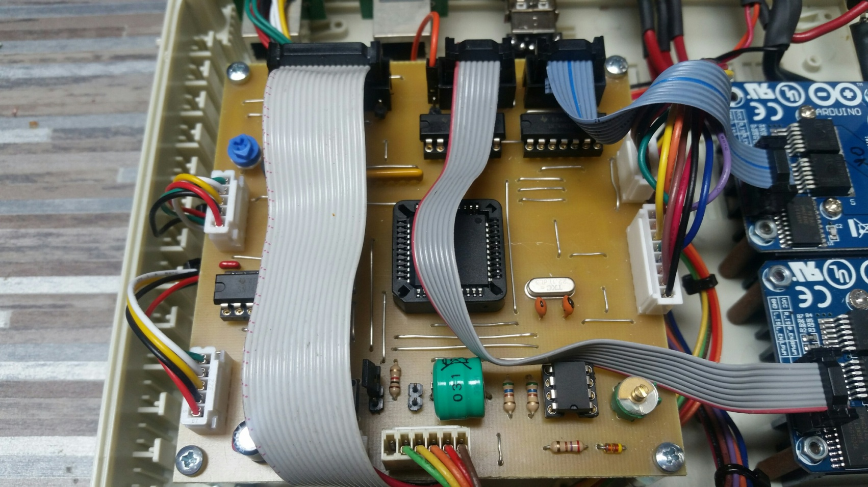
PCB layout
© 2017 ON4BCB Walter Crauwels

Slide 15
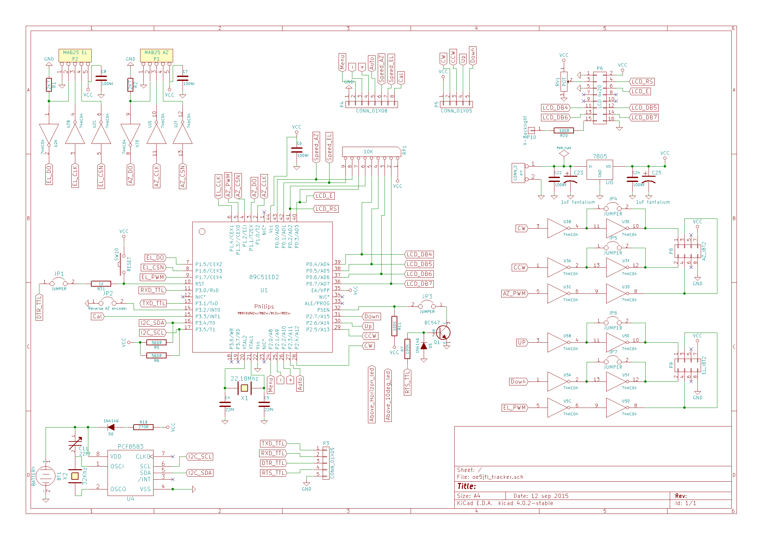
Schematic
© 2017 ON4BCB Walter Crauwels

Slide 16
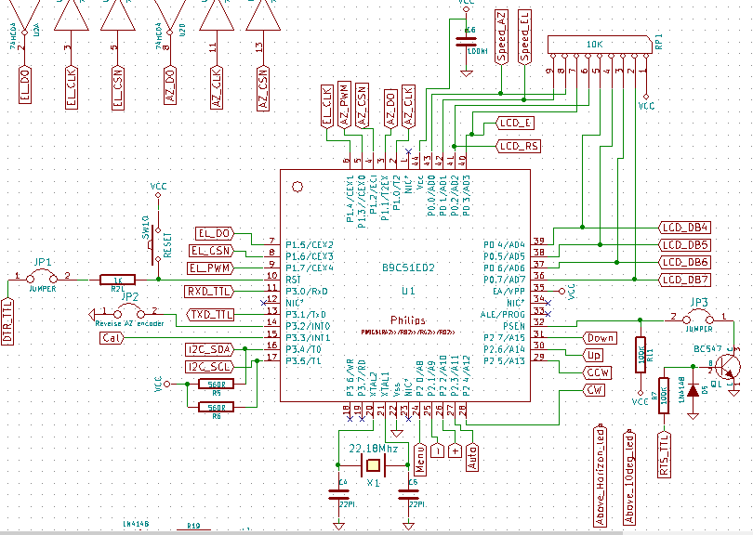
Schematic
© 2017 ON4BCB Walter Crauwels

Slide 17
Schematic
© 2017 ON4BCB Walter Crauwels

Slide 18
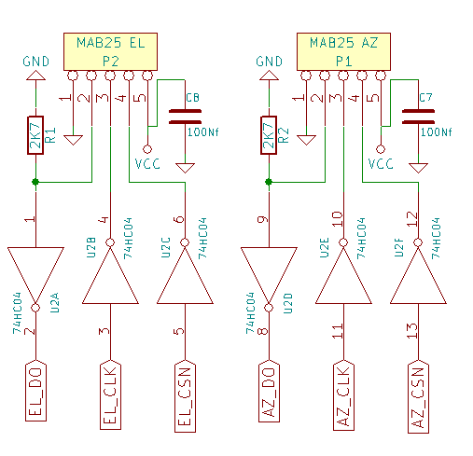
Schematic
© 2017 ON4BCB Walter Crauwels

Slide 19
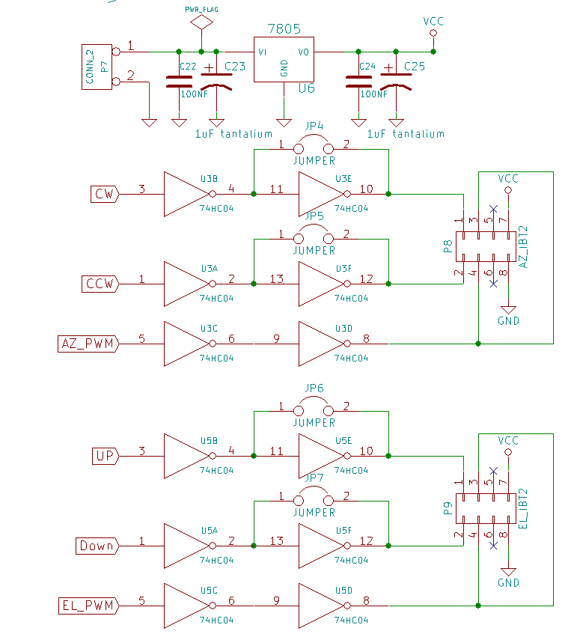
Schematic
© 2017 ON4BCB Walter Crauwels

Slide 20
Schematic
© 2017 ON4BCB Walter Crauwels

Slide 21
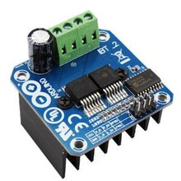
H-bridges:
IBT-2 h-bridge often used with arduino
BTS7960 chip rated for 43 amp
© 2017 ON4BCB Walter Crauwels

Slide 22
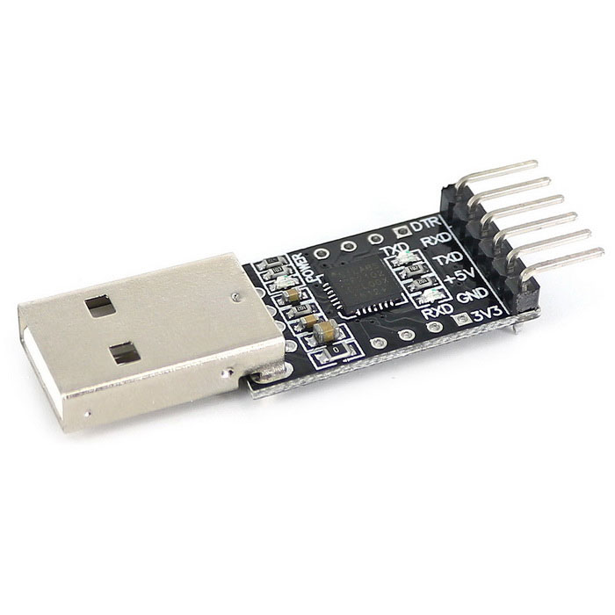
USB to serial:
CP2102 USB naar Serial Adapter Module (2,5 eu)
© 2017 ON4BCB Walter Crauwels

Slide 23
Demo:
Automatic calibration of the encoders by Sun or Moon
© 2017 ON4BCB Walter Crauwels

Slide 24
Demo:
PWM speedcontrol in manual mode with CW,CCW,UP,Down buttons
© 2017 ON4BCB Walter Crauwels

Slide 25
Demo:
PST rotator
© 2017 ON4BCB Walter Crauwels

Slide 26
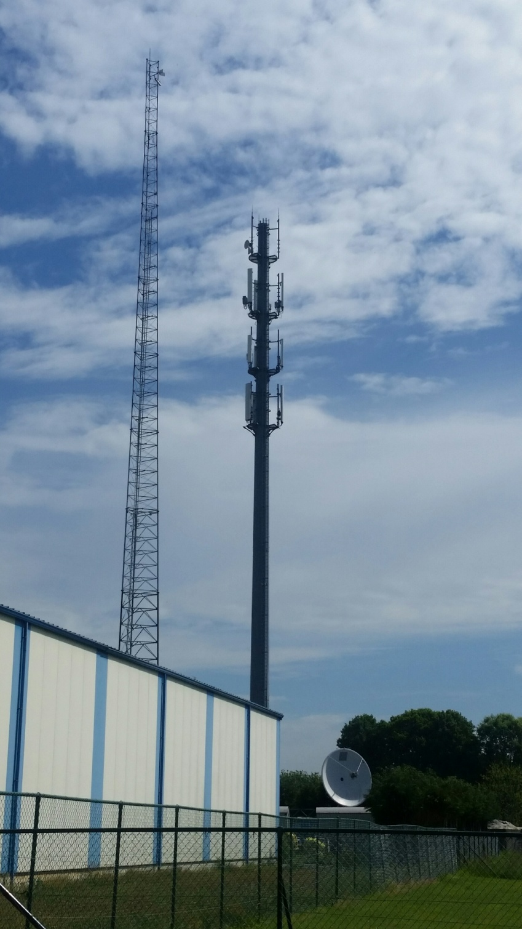
IS it reliable ?
Running on the ON0EME beacon for 5 years
© 2014 ON4BCB Walter Crauwels

Slide 27
Conclusion: Build it your self & Build it NICE !!!
© 2014 ON4BCB Walter Crauwels

Slide 28
Q&A ?
© 2014 ON4BCB Walter Crauwels

Slide 29
ON4BCB@Gmail.com
© 2014 ON4BCB Walter Crauwels

Slide 30
© 2014 ON4BCB Walter Crauwels

Slide 31
© 2014 ON4BCB Walter Crauwels

Slide 32
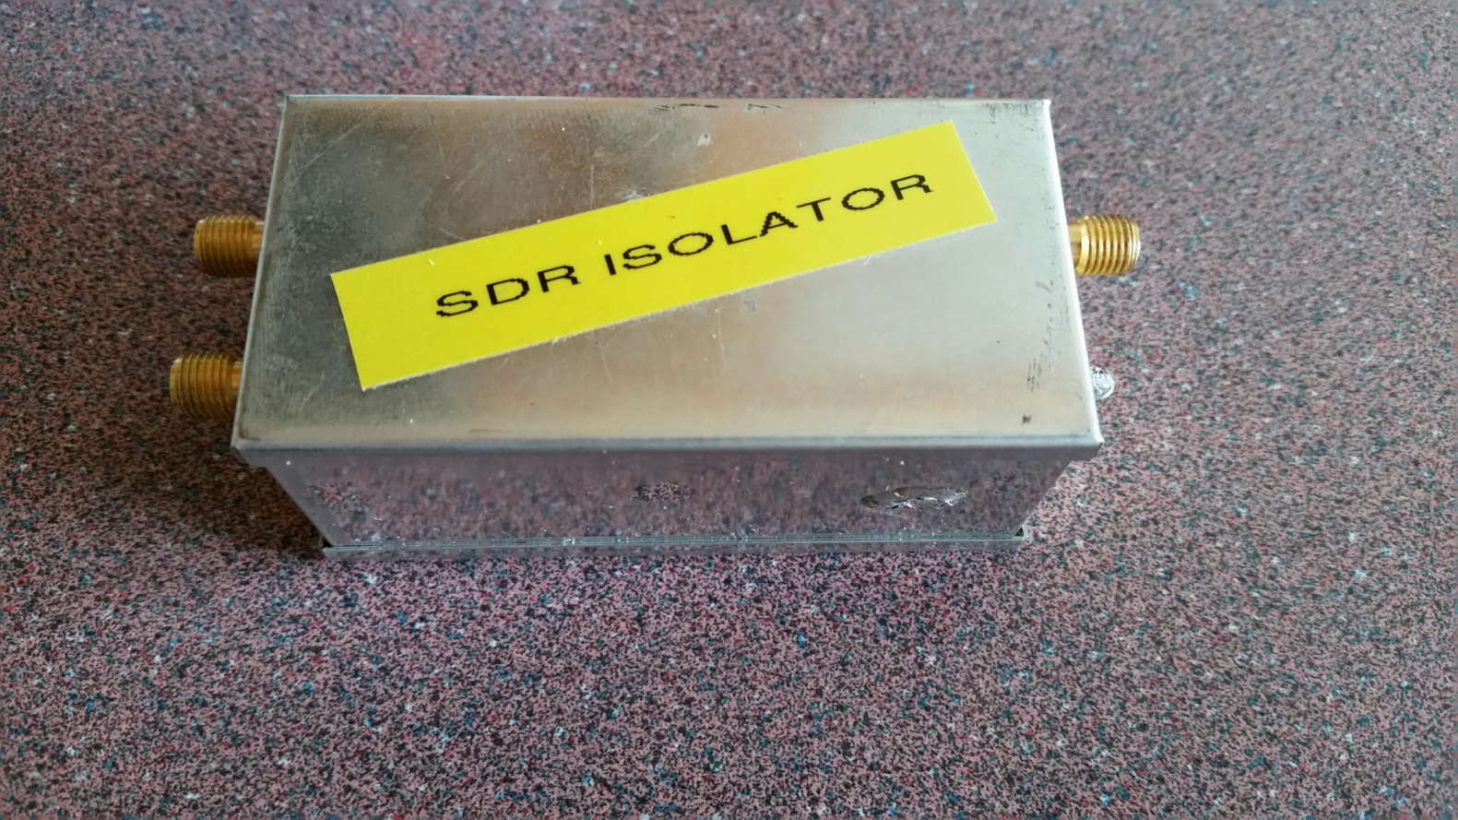
SDR isolator (ON4BCB)
© 2017 ON4BCB Walter Crauwels

Slide 33
SDR isolator
144mhz IF:
DC on the IF coax for TX (DB6NT) (SEQ)
No soldering in your tranceiver (PAT G4HUP)
© 2017 ON4BCB Walter Crauwels

Slide 34
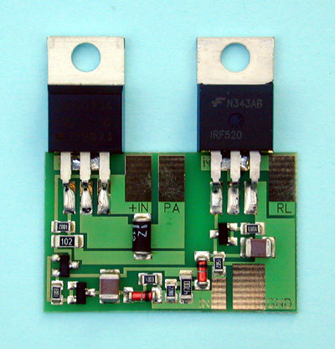
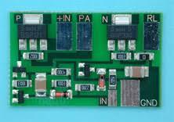
SDR isolator
144mhz IF:
DC on the IF coax (DB6NT) (SEQ)
© 2017 ON4BCB Walter Crauwels

Slide 35
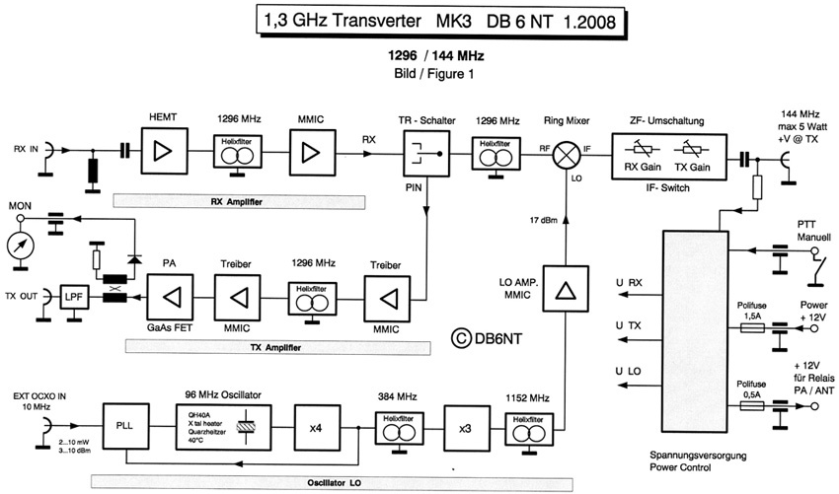
SDR isolator (ON4BCB)
© 2017 ON4BCB Walter Crauwels

Slide 36
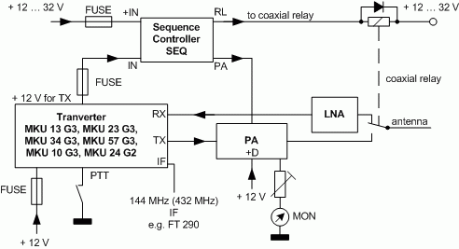
SDR isolator (ON4BCB)
© 2017 ON4BCB Walter Crauwels

Slide 37
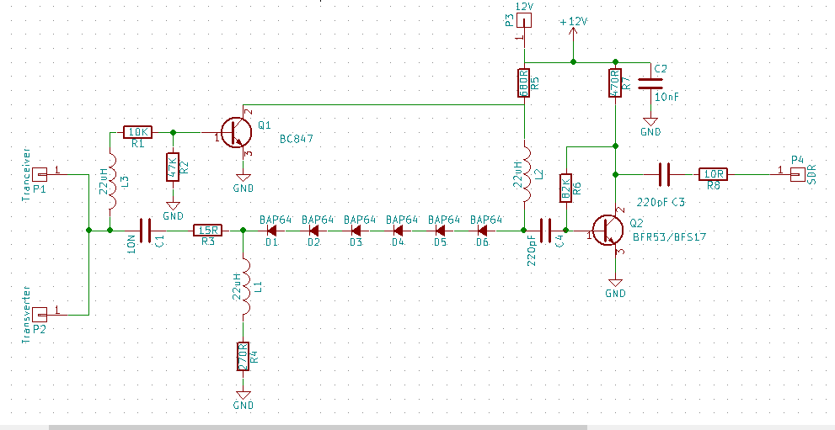
SDR isolator
Schematic
© 2017 ON4BCB Walter Crauwels

Slide 38
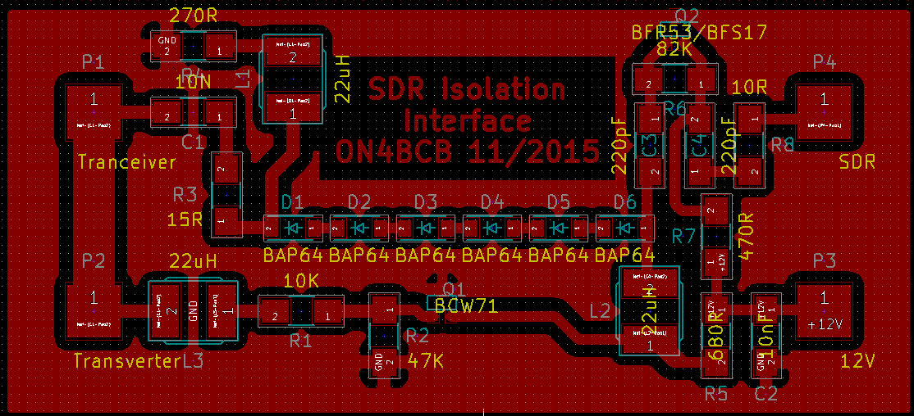
SDR isolator
PCB layout
© 2017 ON4BCB Walter Crauwels

Slide 39
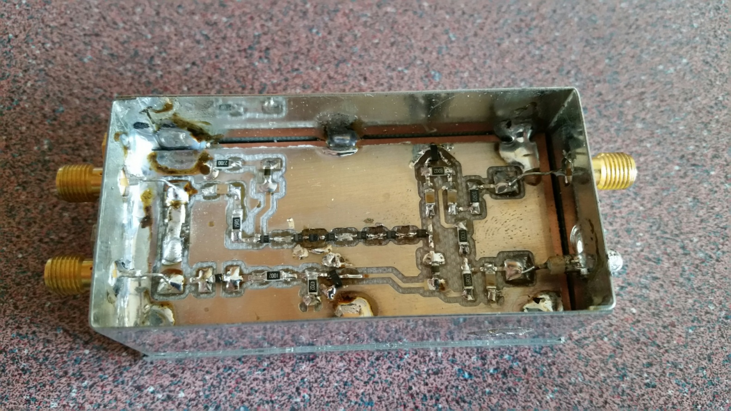
SDR isolator (ON4BCB)
© 2017 ON4BCB Walter Crauwels

Slide 40
SDR isolator
144mhz IF:
Isolation: 50 – 60 dB
© 2017 ON4BCB Walter Crauwels

Slide 41
Q&A ?
© 2014 ON4BCB Walter Crauwels

Slide 42
ON4BCB@Gmail.com
© 2014 ON4BCB Walter Crauwels

Slide 43
© 2014 ON4BCB Walter Crauwels

