Slide 1
Rebuilding a 6 m Dish antenna
ON7UN Orebro May 20, 2017

Slide 2
Antenna got damaged by a hail storm in 2009

Slide 3
Aluminum mesh got bumps

Slide 4
Antenna at ground level for restoration

Slide 5
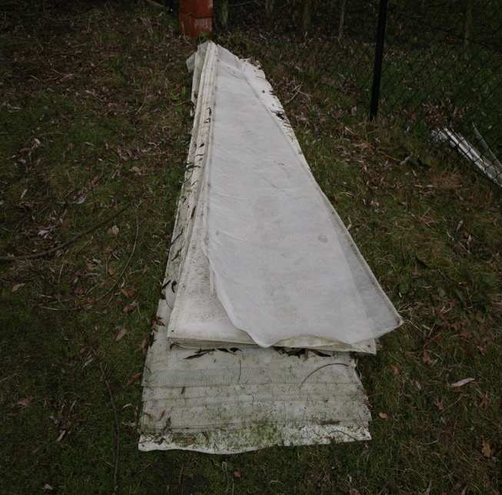
Mesh panels removed

Slide 6
New counterweight structure

Slide 7
Testing the new drive

Slide 10
Ready to receive the new panels

Slide 11
Solid panels MK2

Slide 13
Ready for Panel 24

Slide 14
Reflector ready

Slide 15
Ready to host back on the tower

Slide 16
Winching up

Slide 18
Antenna back on the tower in 2012

Slide 20
A service tower got constructed

Slide 22
Problems :
- I under estimated the extra windload on the ribs
- The central hub was found to light
- The elevation drive gear lost some teeth
- Crashed two ribs when loosing the elevation motor
- Changed elevation drive to a linear actuator
- Ribs started to break at its hub connection

Slide 23
Broken ribs

Slide 24
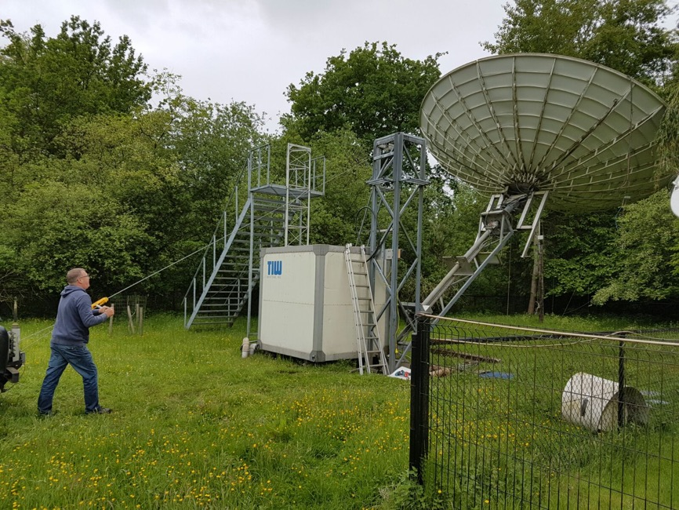
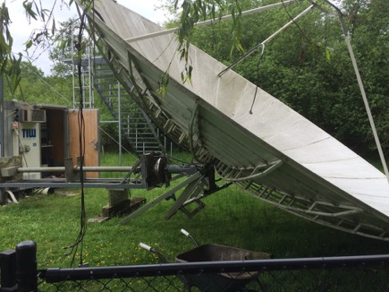
Antenna brought down for rework in 2015

Slide 25
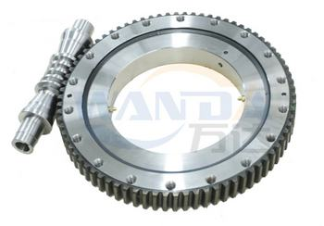
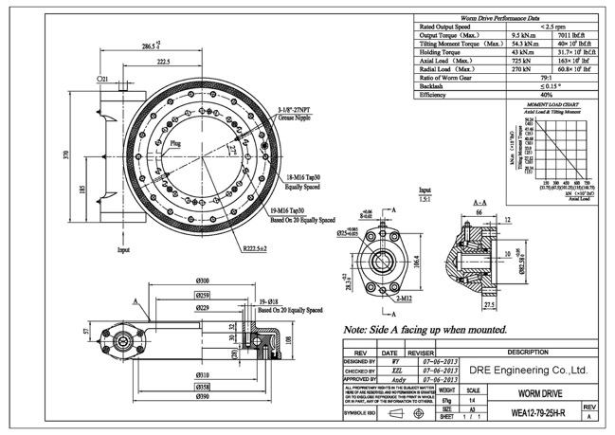
Looking for solutions
Michael DL1YMK gave a presentation about slewing gears at Orebro 2015
I contacted the Chinese manufacturer and ordered two gears, a 12 inch for AZ and 9 inch for EL

Slide 26
Rebuilding the mount
A complete new mount build out of stainless steel
Slewing gears for ( almost ) zero backlash
A stiff design for the central hub using the same mounting distances as the old hub so the existing ribs can be re-used.
A second support ring holding the rib in the middle for extra support of the rib.
Re-enforcing the ribs by placing an aluminum plate against each antenna rib

Slide 27
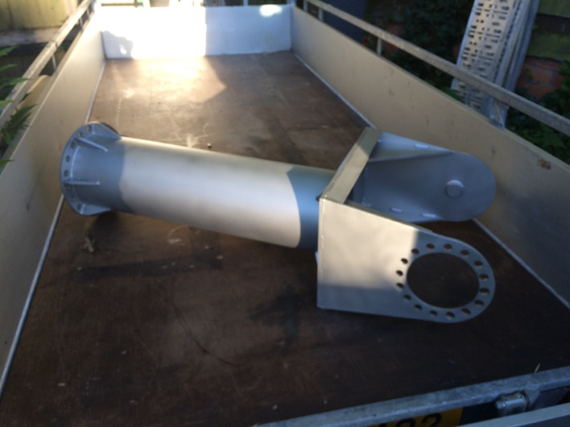
Left: the new hub to mount the 24 antenna ribs
Right: the new AZ pole to mount on the AZ gear and to hold the EL slewing gear

Slide 28
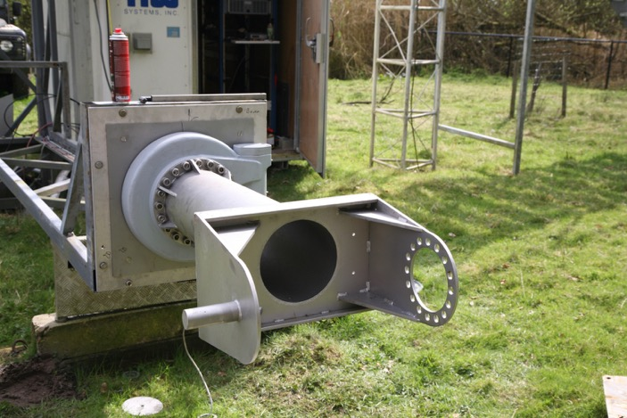
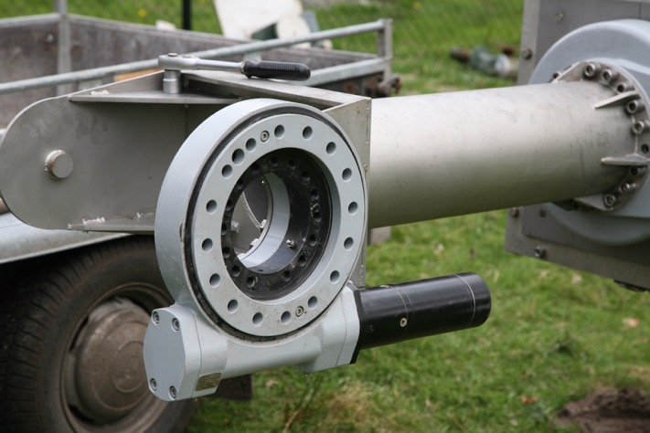
Bringing the components together

Slide 29
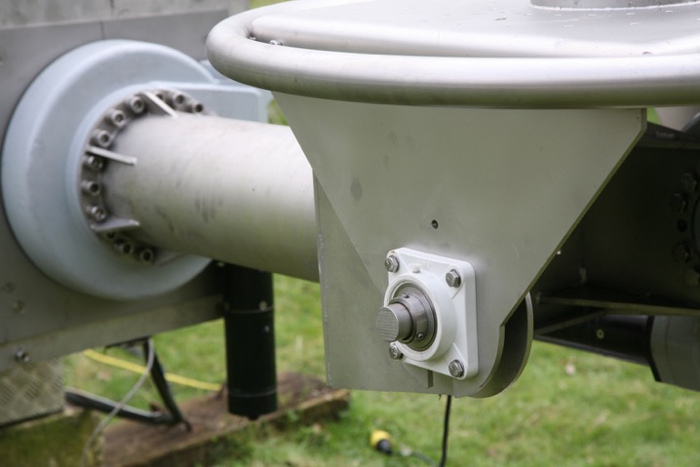
- Fixing point for AZ encoder
Additional bearing for higher mechanical stability of the central hub.
48mm diameter ring to support the second rib support ring
- Weight of the mount parts plus the two slewing gear: 190 Kgr

Slide 30
The new antenna mount

Slide 31
Testing the elevation drive

Slide 32
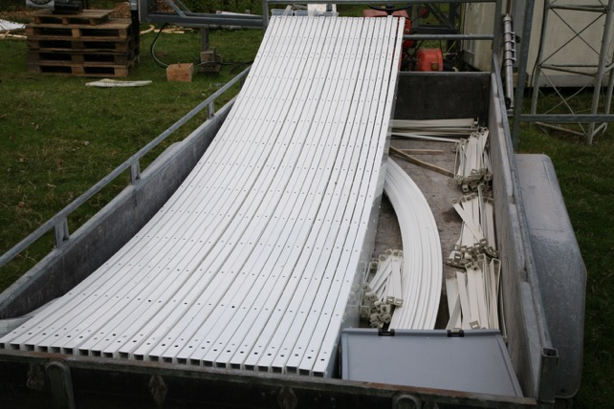
Preparing the ribs
24 aluminum plates got cut on a water cutter to be mounted against the existing ribs.
Mounted with 960 pop revets plus Polymer compound.
- All components are powder coated to protect against corrosion

Slide 33
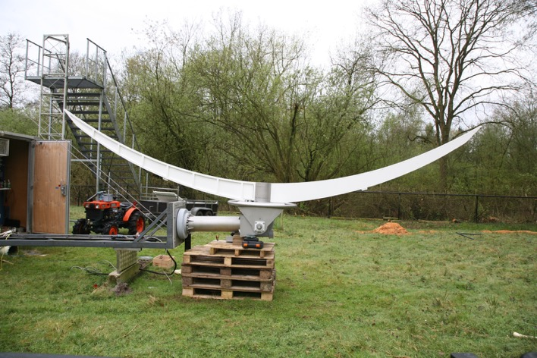
- Extra re-enforcement to the fixing points of the antenna ribs
- Two first ribs installed

Slide 34
Ribs are installed

Slide 35
Ribs are installed

Slide 36
Installing the rings

Slide 38
Testing the elevation gear

Slide 39
A backlash of 0,3° was found in the elevation gear
Found backlash in the ZE09 gear
Datasheet states ‘ Precision < 0,09 °
Manufacturer confirmed that they have a couple of cases with minor backlash
They first suggested to send me a video explaining how to adjust the gear for minimum backlash.
Engineers told me it is not possible to adjust.
A new ZE09 gear is being manufactured and will be send to me next week.

Slide 40
Installing panels

Slide 41
Inserting panels

Slide 42
Installing panels

Slide 43
Last panel

Slide 44
Second support ring

Slide 45
Second support ring

Slide 46
Hosting up the antenna

Slide 47
Hosting up the antenna

Slide 48
Hosting up the antenna

Slide 49
Hosting up the antenna

Slide 50
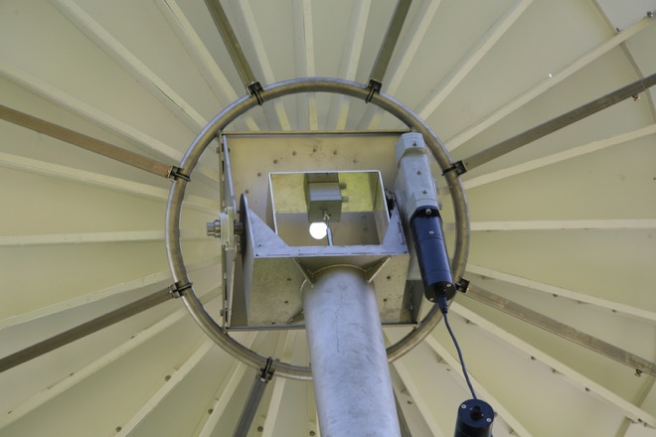
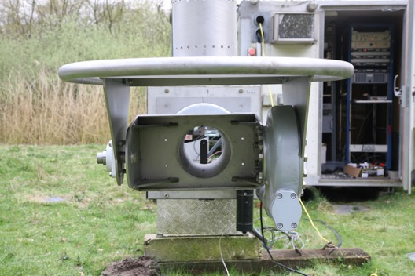
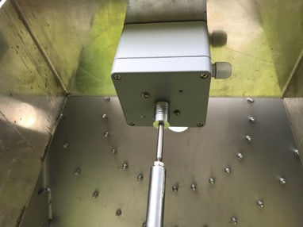
New AZ encoder installation

Slide 51
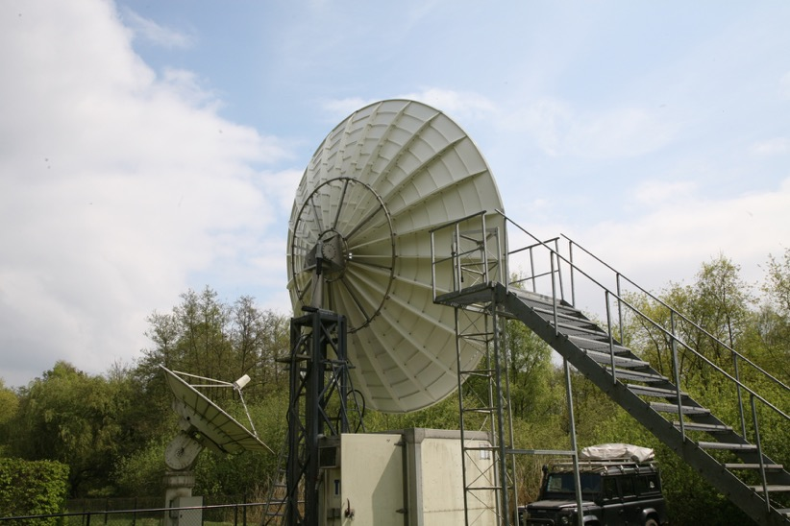
Antenna back on the tower

Slide 52
Elevation slewing gear data

Slide 53
Reflector data :
Rib weight 11 kgr x 24 is 264 kgr
Panel weight is 4,5 kgr x 24 is 108 kgr
Back panel construction is 28 kgr
Fasteners ( M6 600 pcs = nuts bolds washers) 4 kgr
Dual ring stainless steel supports : 34 kgr
Feed support and feed legs : 12 kgr
Total reflector weight : 450 kgr
Determination the point of gravity of the reflector

Slide 54
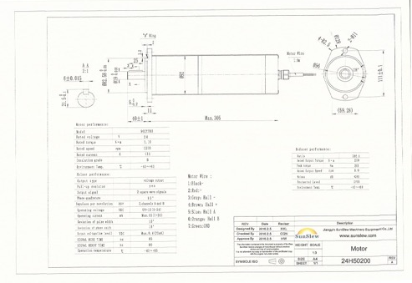
Maximum output torque
Maximum output torque for a ZE09 = 6,5 kN.m
To move the antenna up from 0° EL calculated output torque needed is 5,6 kN.m without feed
Motor current without feed to move antenna up from 0° is around 8 A @ 24 VDC.
Motor rated current out is < 11 A
Feedhorn for 23 cm weights 18 kgr
This adds around 600 N.m torque
Motor current with feedhorn : 10 A
A 1,2 kN.m counterweight will be installed
Final output will be 5 kN.m torque or about 7A of motor current @ 0° Elevation moving up the antenna
Antenna movement in Elevation is 3 minutes for 90°. A new motor is ordered with 3 RPM output to bring the elevation to 5 min for 90°

Slide 55
Installing the feedhorn from the service platform

Slide 56
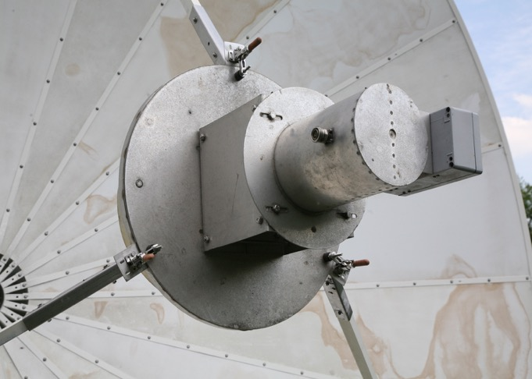
Quick release system for the feedhorns

Slide 57
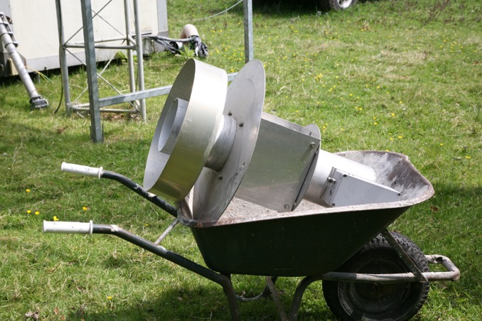
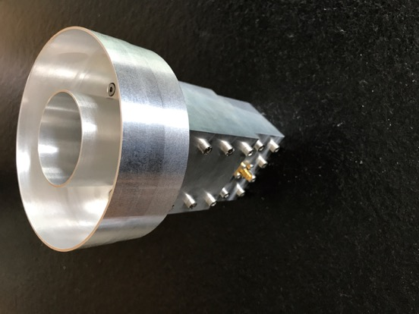
All feeds get the same mounting plate dimensions

Slide 58
Reflector not obstructed by the service platform

Slide 59
New antenna back structure

Slide 60
6,1 m and 3,7 m antennas side by side

Slide 61
New SSPA for 23 to be mounted behind the dish

Slide 62
Thank you for your attention !
QUESTIONS ?

